Slide 1

KDIGO Clinical Practice Guideline for the Management of ANCA-Associated Vasculitis
KDIGO Guideline Co-Chairs:
Jürgen Floege, MD
Brad H. Rovin, MD, FACP, FASN
Notes:
Please note: An update to the Lupus Nephritis Chapter was published on January 3, 2024. Please see the KDIGO 2024 Clinical Practice Guideline for the Management of Lupus Nephritis and updated Speaker's Guide: https://kdigo.org/guidelines/lupus-nephritis

Slide 2
Presenter Note
This slide deck covers the information presented in the KDIGO 2024 Clinical Practice Guideline for the Management of Antineutrophil Cytoplasmic Antibody (ANCA)–Associated Vasculitis
Customization of this deck for your use is encouraged.
However, the guideline statements are presented verbatim from the final publication and any edits to these statements is strongly discouraged.

Slide 3
Table of contents
Introduction
Guideline development process
Guideline statements and rationale from the KDIGO 2024 Clinical Practice Guideline for the Management of Lupus Nephritis
Acknowledgements

Slide 4
Introduction
Notes:
The management recommendations for LN may change in the coming months because several high-quality RCTs of novel therapies have recently been successfully completed.
These approaches will be incorporated into the guideline as the community understands how best to apply the new agents in the context of existing regimens.
However, as the 2021 guideline was being established, details of these new data were not yet available, such that the recommendations on choice of treatment may appear not too dissimilar to the 2012 guideline.
Nonetheless, some new management themes for LN have emerged, and management guidelines are presented in the current context.

Slide 5
KDIGO Programs
Guidelines
  KDIGO’s core mission. KDIGO is the only organization developing global guidelines in nephrology.
Controversies Conferences
  International conferences that examine significant topics in nephrology and related disciplines that are not fully resolved. Results in a published paper, usually in Kidney International. Often, a Controversies Conference will prompt development of a guideline or a guideline update.
Implementation Activities
  Dissemination and implementation of KDIGO guidelines
  Controversies Conference reports and observations
  Live Clinical Practice conferences – usually with a nephrology society to bring global KDIGO’s work to local audiences, using case studies
  Implementation Summits bring local experts together to discuss local or regional barriers and opportunities
  Core Implementation Kits – educational materials including Speaker’s Guides, Key Takeaways, Reference Tools, and Case Studies to assist with implementation of all KDIGO publications

Slide 6
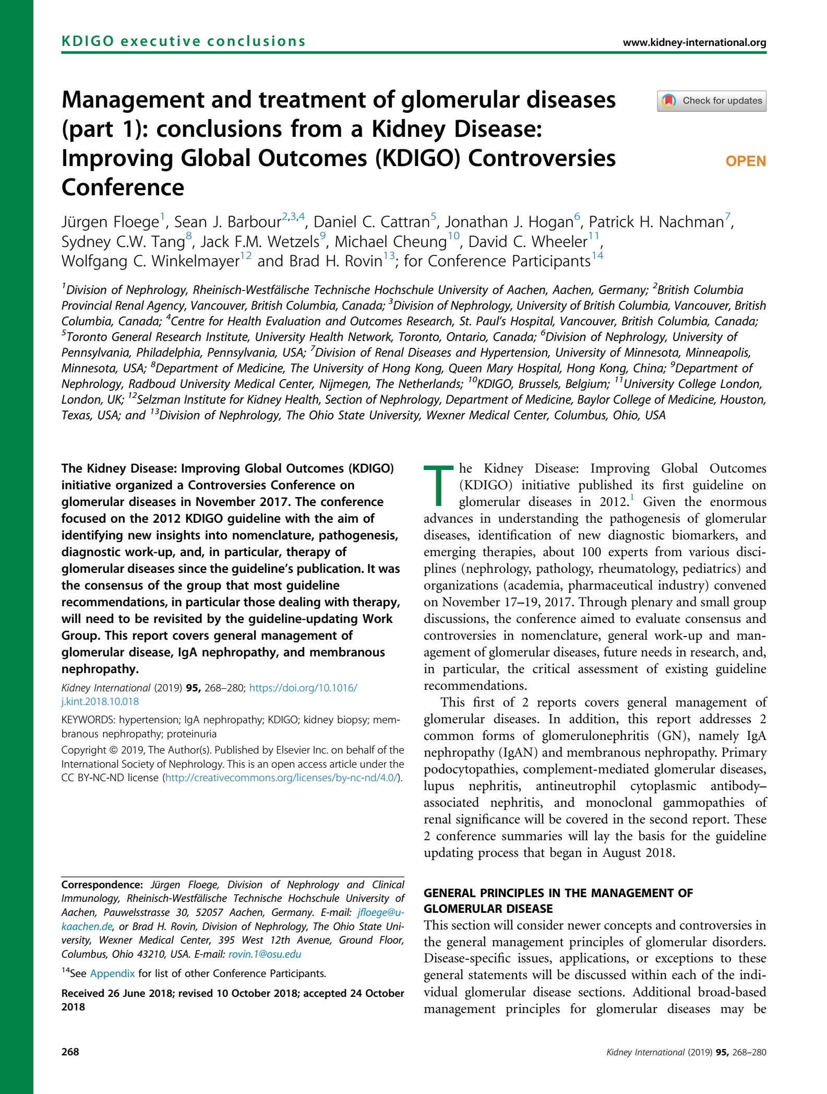
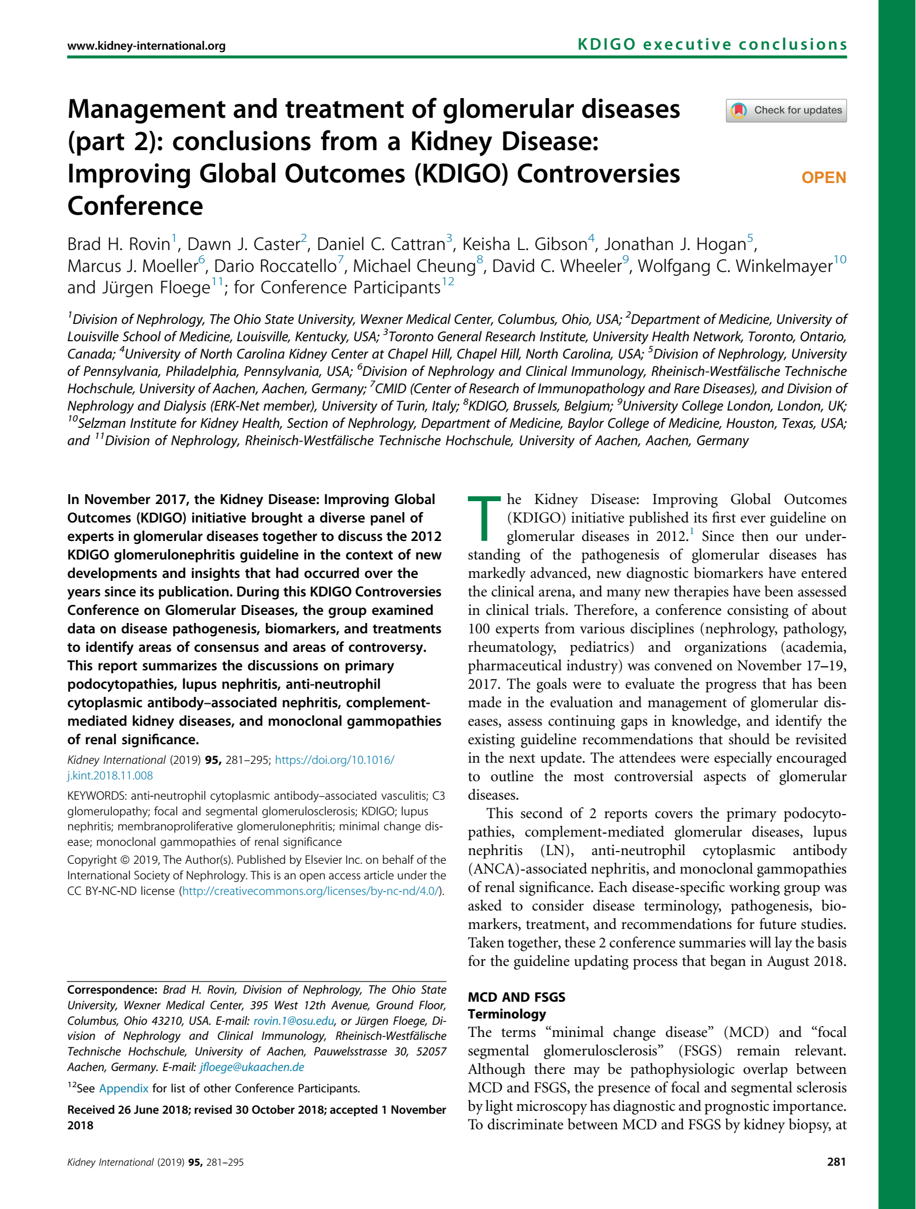
KDIGO Controversies Conference on Glomerular Diseases
November 2017 (Singapore)
Topics:
  General principles, Nephrotic syndrome, Membranoproliferative GN (MPGN), C3 glomerulonephritis (C3GN)
  IgA Nephropathy
  Membranous GN
  Minimal change disease (MCD) and Focal Segmental Glomerulosclerosis (FSGS)
  Lupus nephritis (LN) and ANCA vasculitis
Report published in Kidney International (2019)
Led to initiation of the update of the KDIGO guideline

Slide 7
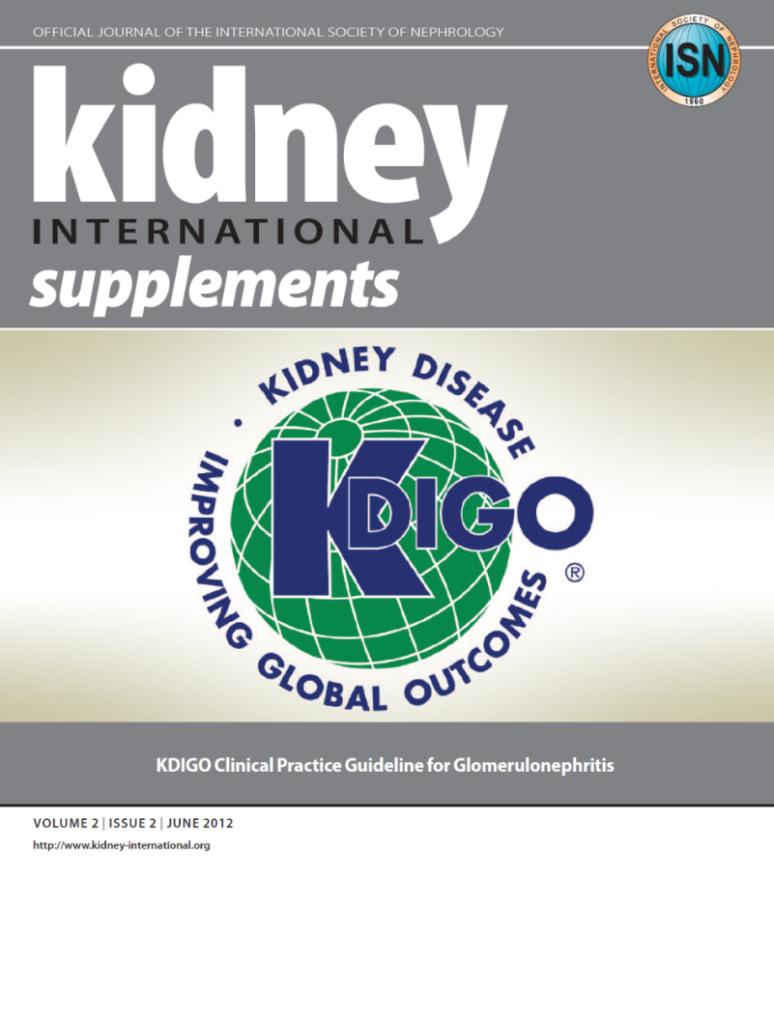


KDIGO 2012 Guideline: The Beginning
KDIGO 2021 Guideline: The Update
KDIGO 2024 Guideline: The ANCA Update

Slide 8
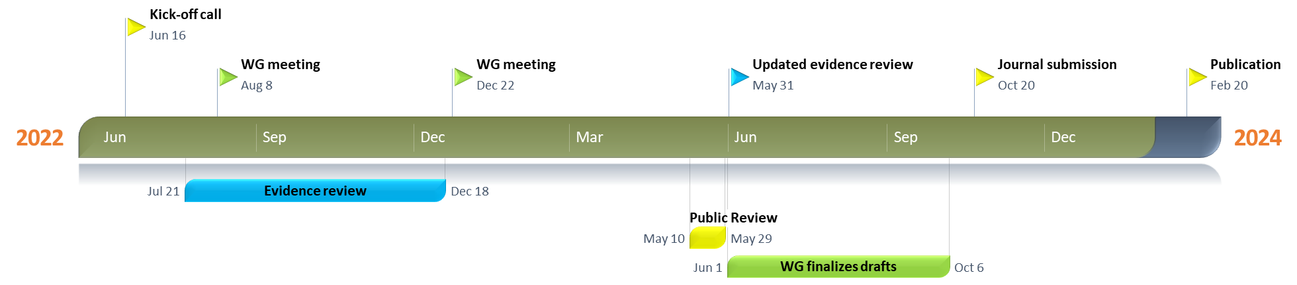
Timeline of Guideline for Management of ANCA Vasculitis

Slide 9
Guideline Goals
Generate a useful resource for clinicians and patients
  Address relevant questions with actionable recommendations
  Take on controversial topics when sufficient evidence
  Communicate clearly
Target audience: Primarily clinicians treating patients with ANCA-associated vasculitis
Stay true to evidence, where available
Propose research questions
Be mindful of implications for policy and payment

Slide 10

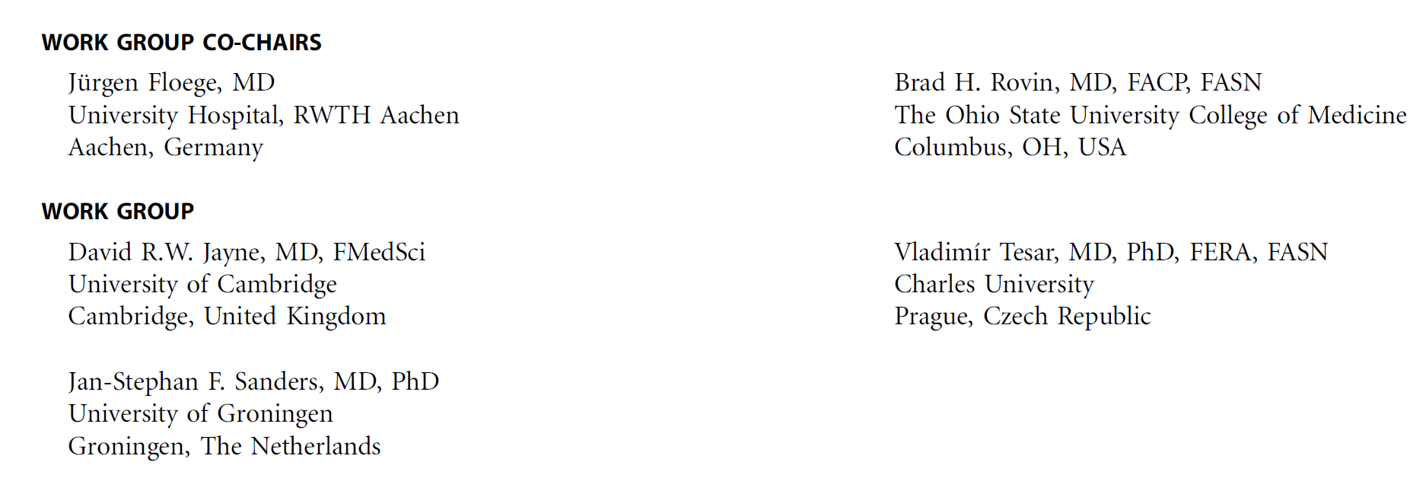


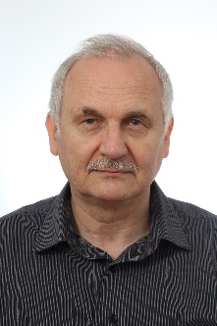
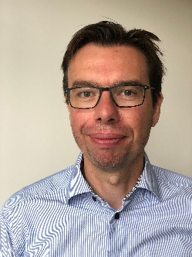
KDIGO ANCA Vasculitis Guideline Work Group
Notes:
The KDIGO Guideline Work Group is:
Worldwide scope
Prior GL WG Members
Deep experience
Evidence Review Team

Slide 11
What Is New Since the 2021 KDIGO Guideline
The C5a receptor inhibitor, avacopan, has been approved by the United States Food and Drug Administration (FDA) and the European Medicines Agency (EMA) as add-on therapy to standard-of-care for the treatment of ANCA-associated vasculitis (AAV).
This development directly relates to the second major emerging novel approach to the treatment of AAV, namely, a reduction of systemic glucocorticoid exposure
Identifying the profile of an AAV patient who needs avacopan in order to allow for lower glucocorticoid dosages is less clear.
Additionally, this new therapy adds significant cost to treatment, and long-term safety data are currently lacking.

Slide 12
Guideline Development Process
Notes:
The management recommendations for LN may change in the coming months because several high-quality RCTs of novel therapies have recently been successfully completed.
These approaches will be incorporated into the guideline as the community understands how best to apply the new agents in the context of existing regimens.
However, as the 2021 guideline was being established, details of these new data were not yet available, such that the recommendations on choice of treatment may appear not too dissimilar to the 2012 guideline.
Nonetheless, some new management themes for LN have emerged, and management guidelines are presented in the current context.

Slide 13
Evidence Review
ERT – 2021 Guideline: Cochrane Kidney Transplant; 2024 Update: Brown University
  Existing Population, Intervention, Comparator, Outcome, Study design (PICOS) questions
  Clinical and important outcomes identified
    The critical and important outcomes were voted on by the Work Group using an adapted Delphi process (1–9 Likert scale). Critical outcomes were rated 7–9, and important outcomes were rated 4–6 on the 9-point scale.
Critical outcomes | Important outcomes
All-cause mortality Kidney failure ≥50% loss of GFR Infection Glucocorticoid-related adverse events Malignancy | Complete remission or relapse Annual GFR loss (minimum 3 years follow-up)
GFR, glomerular filtration rate

Slide 14
PICOS Question
Key question | Population | Intervention | Comparator | Outcome | Study design
ANCA-associated vasculitis (AAV)
In adults with AAV, what immunosuppressive agents compared to no treatment, placebo, or other immunosuppressive therapies improve clinical efficacy outcomes and reduce adverse effects? | Adults with AAV | Immunosuppressive therapy | Placebo, no treatment, or other immunosuppressive therapy | Critical and important outcomes | RCTs

Slide 15
Literature Search
October 2018 Supplemented with additional studies until September 2019; Updated in June 2020, July 2022, and April 2023

Slide 16
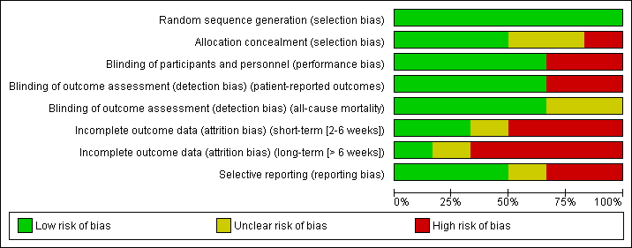
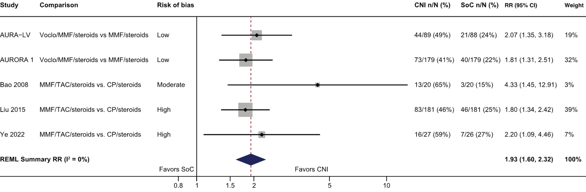
Evidence Synthesis
Risk of bias graph example
Standard Cochrane methods – Two independent reviewers
  Data abstraction
  Critical appraisal – using validated tools
Data-analysis
  Random effects meta-analysis and generic inverse variance
    Relative risk for dichotomous outcomes
    Mean difference for continuous outcomes
  Heterogeneity assessed using the I² statistic
Forest plot example

Slide 17

Grading Recommendations
  GRADE methodology
  The certainty of the evidence – Level A, B, C, D
    Study limitations
    Inconsistency
    Indirectness
    Imprecision
    Publication bias
  Strength of the recommendation – Level 1, “We recommend” or Level 2, “We suggest”
    Key Information
      Balance of benefits and harms
      Certainty of the evidence
      Patient values and preferences
      Resources and costs
      Considerations for implementation
    Rationale

Slide 18
Guideline Format
KDIGO guidelines continue to use the Grading of Recommendations Assessment, Development, Evaluation (GRADE) methodology, but we have strengthened the link between the recommendation statements and underlying evidence base.
Guidelines now include a mix of recommendations and “practice points” to help clinicians better evaluate and implement the guidance from the expert Work Group.
All graded recommendations follow a consistent and structured format and are similar in style to previous KDIGO recommendations.
Practice points may be formatted as text, a table, a figure, or an algorithm to make them easier to use in clinical practice.

Slide 19
Guideline Statements and Rationale

Slide 20
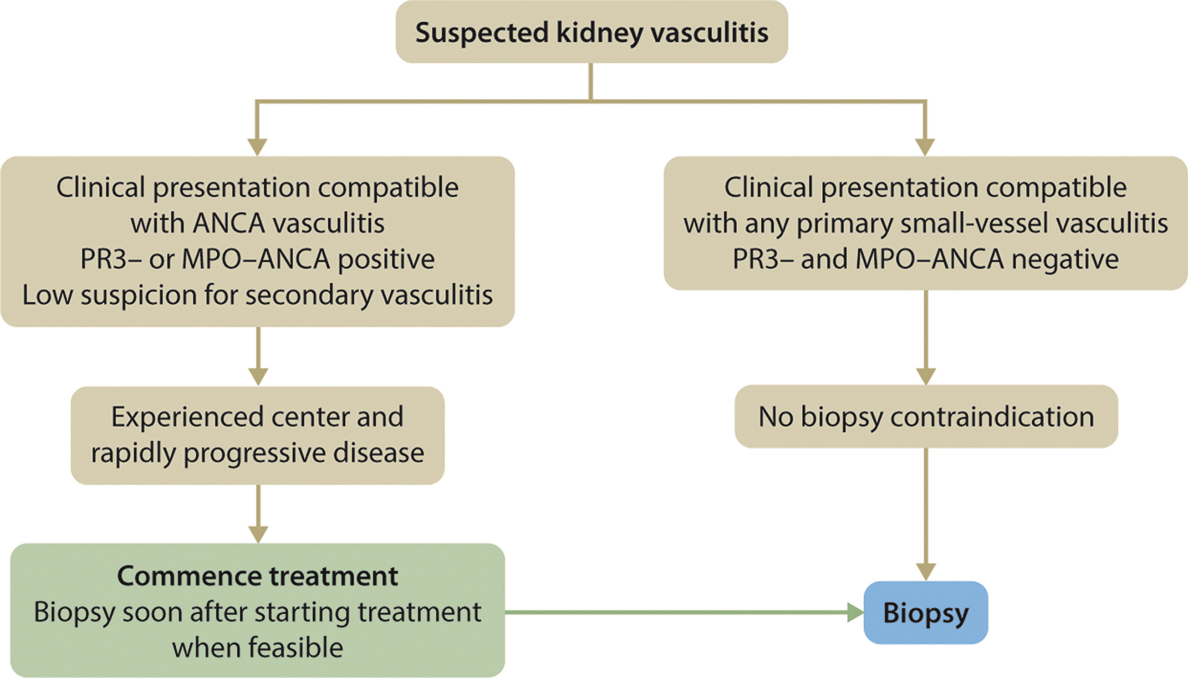
ANCA-associated Vasculitis - Diagnosis
Practice Point 9.1.1: In the case of a clinical presentation compatible with small-vessel vasculitis in combination with positive myeloperoxidase (MPO)- or proteinase 3 (PR3)-
ANCA serology, waiting for a kidney biopsy to be performed or reported should not delay starting immunosuppressive therapy, especially in patients who are rapidly deteriorating.
Notes:
Because of the potential severity of AAV, if a patient’s clinical presentation is compatible with a small-vessel vasculitis and myeloperoxidase (MPO)- or proteinase 3 (PR3)-ANCA serology is positive, waiting for a kidney biopsy to be done or reported to verify diagnosis should not delay starting immunosuppressive therapy.
Besides confirming diagnosis, the kidney biopsy provides prognostic information so it should be done when feasible.
In all cases, however, infection must be excluded with as much certainty as possible before significant immunosuppression is given.

Slide 21
ANCA-associated Vasculitis - Diagnosis
Practice Point 9.1.2: Patients with ANCA-associated vasculitis (AAV) should be treated at centers with experience in AAV management
Notes:
This slides presents the definition of disease activity, remission, relapse, and treatment-resistant disease in AAV

Slide 22
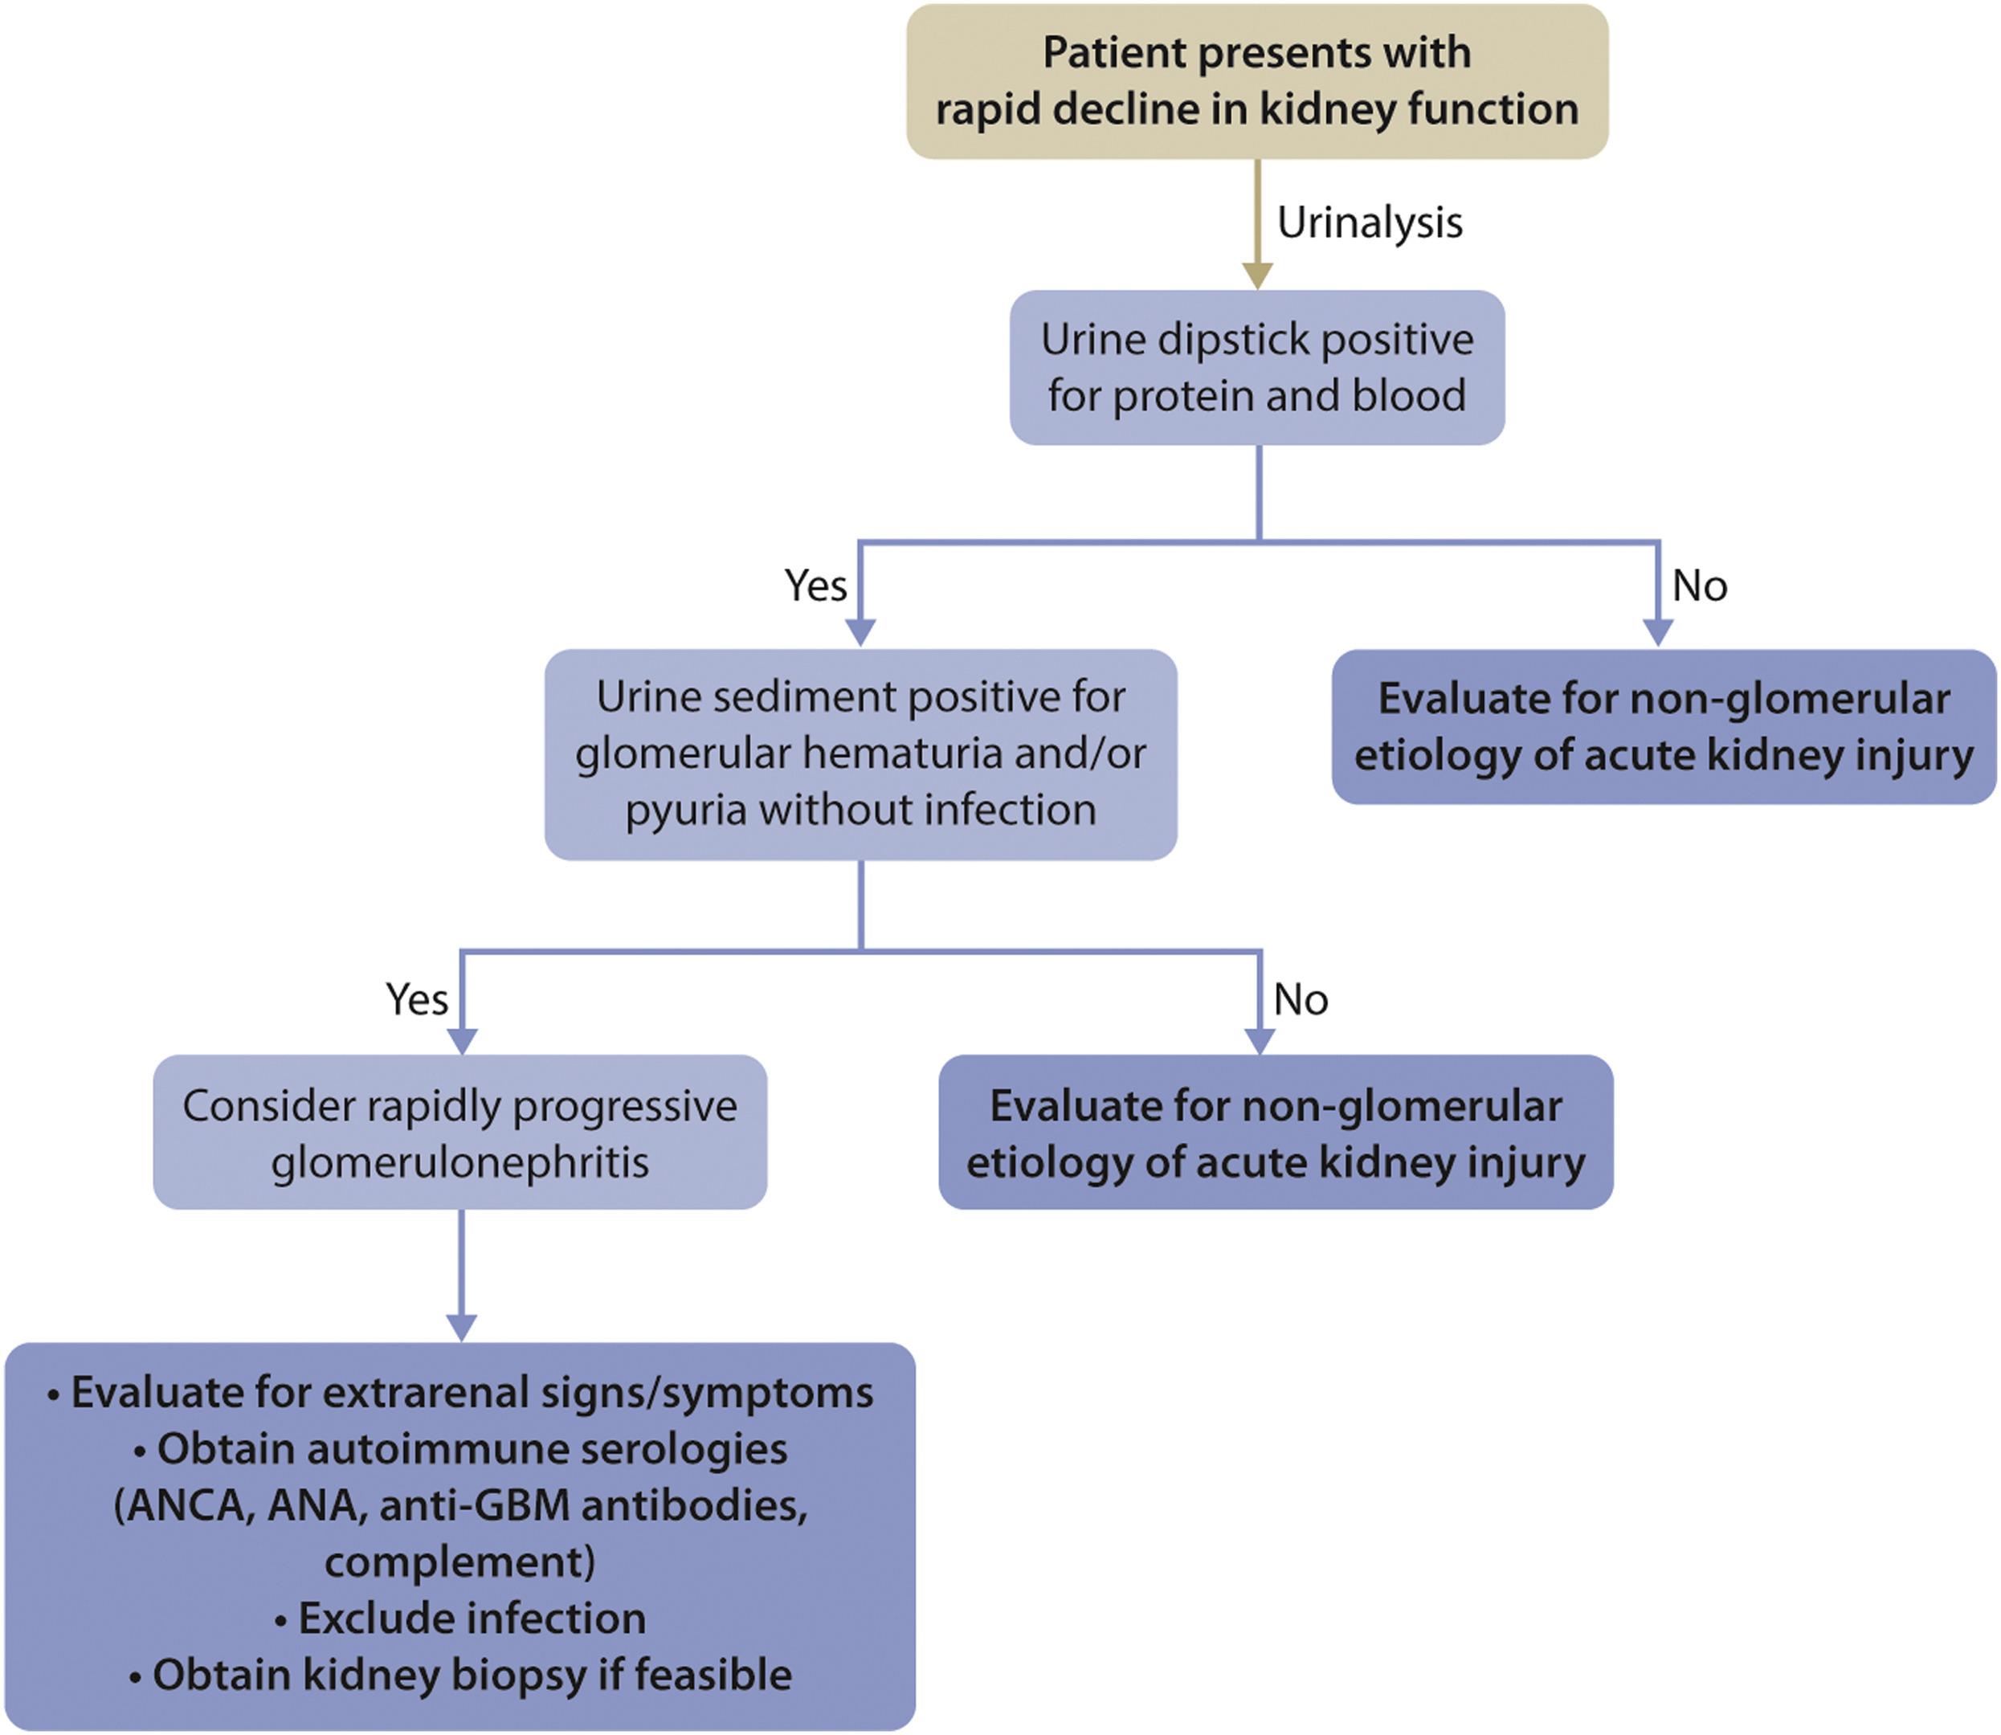
ANCA-associated Vasculitis - Diagnosis
Notes:
Diagnostic strategy in rapidly progressive glomerulonephritis

Slide 23
ANCA-associated Vasculitis - Diagnosis
Notes:
Frequency of organ involvement in AAV

Slide 24
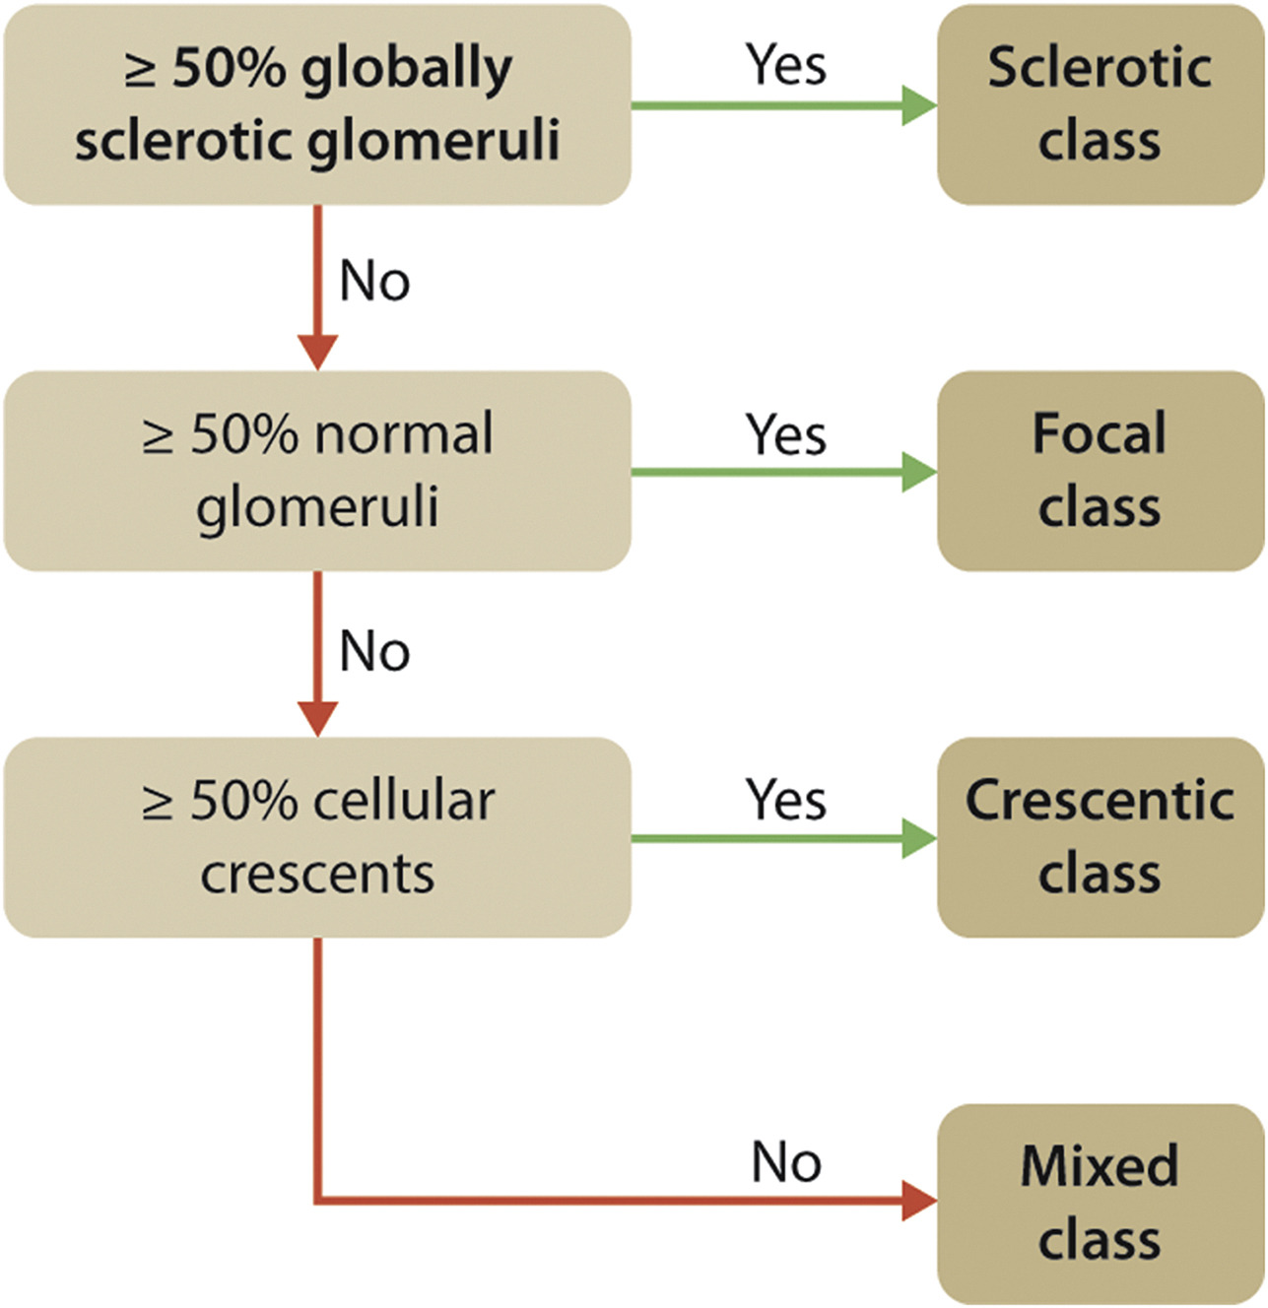
ANCA-associated Vasculitis – Prognosis: Kidney Prognosis and Treatment Response
Notes:
Kidney histology is predictive of long-term risk of kidney failure; prognostic histologic scores have been developed (e.g., by Berden et al. and Brix et al.)

Slide 25
ANCA-associated Vasculitis – Prognosis: Relapse
Practice Point 9.2.3.1: The persistence of ANCA positivity, an increase in ANCA levels, and a change in ANCA from negative to positive are only modestly predictive of future disease relapse and should not be used to guide treatment decisions.
Notes:
PR3- and MPO-AAV are characterized by the occurrence of relapses.
Patients who are PR3-ANCA-positive experience more relapses than those who are MPO-ANCA positive.
The achievement of ANCA-negativity after induction treatment is associated with a lower risk of relapse.
Both a rise or persistence of ANCA are only modestly predictive of future disease relapse.
Also, a change in ANCA status from negative to positive has been associated with a higher incidence of relapse, and more frequent clinical assessments should be considered.
However, regarding the relapsing phenotype of AAV, ANCA measurements should not guide treatment decisions in individual patients.

Slide 26
ANCA-associated Vasculitis – Treatment: Induction
Recommendation 9.3.1.1: We recommend that glucocorticoids in combination with rituximab or cyclophosphamide be used as initial treatment of new-onset AAV (1B).
Notes:
The initial therapy of new-onset AAV has been updated to include induction with cyclophosphamide or rituximab combined with glucocorticoids.
The best evidence is available for patients with new-onset AAV. In patients with severe (SCr >4 mg/dl [>354 mmol/l]) kidney disease, limited data for induction therapy with rituximab are available

Slide 27
ANCA-associated Vasculitis – Treatment: Induction
Practice Point 9.3.1.1: A practical treatment algorithm for AAV with kidney involvement is given in the figure.
Notes:
Please read slide and present algorithm

Slide 28
ANCA-associated Vasculitis – Treatment: Induction
Practice Point 9.3.1.2: In patients presenting with markedly reduced or rapidly declining glomerular filtration rate (GFR) (serum creatinine [SCr] >4 mg/dl [>354 mmol/l]), there are limited data to support rituximab and glucocorticoids. Both cyclophosphamide and glucocorticoids, and the combination of rituximab and cyclophosphamide can
be considered in this setting.
Practice Point 9.3.1.3: Considerations for choosing between rituximab and cyclophosphamide for induction therapy are given in the figure below.
*A combination of 2 intravenous pulses of cyclophosphamide with rituximab can be considered.
Notes:
As a caveat, it was emphasized that there are only limited data for rituximab induction in the setting of severely impaired kidney function (serum creatinine >4 mg/dl [>354 mmol/l]).
Cyclophosphamide remains the preferred immunosuppressive for such patients, although the combination of cyclophosphamide plus rituximab can be considered.
To help in choosing whether to use cyclophosphamide or rituximab, the Work Group provided several suggestions as shown in this slide.
For relapsing disease, patients should be re-induced and the treatment of choice is rituximab, especially if patients have already reached a cumulative dose of cyclophosphamide over 36 g, as this may increase chances for developing a malignancy.

Slide 29
ANCA-associated Vasculitis – Treatment: Induction
Practice Point 9.3.1.4: Considerations for choosing the route of administration of cyclophosphamide are given in the figure.
Practice Point 9.3.1.5: Consider discontinuation of immunosuppressive therapy after 3 months in patients who remain on dialysis and who do not have any extrarenal manifestations of disease.
Notes:
Please read slide and present information in the table

Slide 30
ANCA-associated Vasculitis – Treatment: Induction
Practice Point 9.3.1.6: Recommendations for oral glucocorticoid tapering are given in the figure.
Notes:
PEXIVAS demonstrated that glucocorticoid dosing can safely be reduced from the high dose regimens traditionally used in AAV.

Slide 31
ANCA-associated Vasculitis – Treatment: Induction
Practice Point 9.3.1.7: Avacopan may be used as an alternative to glucocorticoids. Patients with an increased risk of glucocorticoids toxicity are likely to receive the most benefit from avacopan. Patients with lower GFR may benefit from greater GFR recovery
Practice Point 9.3.1.8: Recommendations for immunosuppressive dosing are given in the figure.
Notes:
Please read slide and present information in the table

Slide 32
ANCA-associated Vasculitis – Treatment: Induction
Practice Point 9.3.1.9: Consider plasma exchange for patients with SCr >3.4 mg/dl (>300 mmol/l), patients requiring dialysis or with rapidly increasing SCr, or patients with
diffuse alveolar hemorrhage who have hypoxemia.
Practice Point 9.3.1.10: Add plasma exchange for patients with an overlap syndrome of ANCA-associated vasculitis and anti-glomerular basement membrane (GBM)
Notes:
One of the more controversial aspects of the initial management of AAV is the role of plasma exchange in patients who present with severe kidney failure and/or require dialysis.
Older studies suggested a benefit, but the recently reported PEXIVAS trial did not show that plasma exchange delayed time to kidney failure or death in AAV patients who presented with eGFR < 50 ml/min/1.73 m² or alveolar hemorrhage. It is suggested that plasma exchange not be used routinely in AAV.
However, if AAV overlaps with anti-GBM antibody GN, plasma exchange should be used

Slide 33
ANCA-associated Vasculitis – Treatment: Maintenance Therapy
Recommendation 9.3.2.1: We recommend maintenance therapy with either rituximab, or azathioprine and low-dose glucocorticoids after induction of remission (1C).
Practice Point 9.3.2.1: Following rituximab induction, maintenance immunosuppressive therapy should be given to most patients.
Practice Point 9.3.2.2: The optimal duration of remission therapy is between 18 months and 4 years after induction of remission.
Notes:
This recommendation places a higher value on prevention of relapses and a relatively lower value on adverse events related to immunosuppressive drugs.
After induction therapy, patients with AAV require maintenance immunosuppression because of their high likelihood of relapse, especially those with PR3-ANCA disease.

Slide 34
ANCA-associated Vasculitis – Treatment: Maintenance Therapy
Practice Point 9.3.2.3: When considering withdrawal of maintenance therapy, the risk of relapse should be considered, and patients should be informed of the need for prompt attention if symptoms recur.
Practice Point 9.3.2.4: Consider mycophenolate mofetil (MMF) or methotrexate as alternatives to azathioprine for maintenance therapy in patients intolerant of azathioprine.
Methotrexate should not be used for patients with a GFR <60 ml/min per 1.73 m².
Notes:
This recommendation places a higher value on prevention of relapses and a relatively lower value on adverse events related to immunosuppressive drugs.
After induction therapy, patients with AAV require maintenance immunosuppression because of their high likelihood of relapse, especially those with PR3-ANCA disease.

Slide 35
ANCA-associated Vasculitis – Treatment: Maintenance Therapy
Practice Point 9.3.2.5: Considerations for choosing rituximab or azathioprine for maintenance therapy are presented in the figure.
Notes:
The updated recommendations for AAV maintenance include rituximab or azathioprine plus low-dose glucocorticoids, although the Work Group preferred rituximab for maintenance.
Considerations for using rituximab or azathioprine are outlined in this slide.

Slide 36
ANCA-associated Vasculitis – Treatment: Maintenance Therapy
Practice Point 9.3.2.6: Recommendations for dosing and duration of maintenance therapy are given in the figure.
Notes:
The dosing and duration of maintenance immunosuppression in AAV is not clear.
Both rituximab and azathioprine have been used for a minimum of 18 months, and up to 4 years for azathioprine.
It is therefore suggested that the duration of maintenance therapy be at least 18 months.
Withdrawal can then be considered, after factoring in the risk of disease relapse.

Slide 37
ANCA-associated Vasculitis – Treatment: Relapsing Disease
Practice Point 9.3.3.1: Patients with relapsing disease should be reinduced (Recommendation 9.3.1.1), preferably with rituximab.
Notes:
It must be noted that, the commonly monitored serologies in ANCA vasculitis are imperfect biomarkers of disease relapse.
Persistence of ANCA positivity after treatment, rising titers of ANCA, and conversion from ANCA negativity to ANCA positivity are only modestly predictive of future relapse; therefore, removing maintenance therapy remains a clinical decision, as opposed to a biomarker-driven decision for now.
Relapses respond to immunosuppression with a similar response rate as the initial presentation, and severe relapses should be treated by reintroducing induction therapy.
When deciding whether to use cyclophosphamide again, the cumulative dose of cyclophosphamide already given should be taken into account. Cumulative dosages above 36 g have been associated with the occurrence of malignancies.
In a post hoc analysis of the RAVE trial, higher remission rates were seen in relapsing patients treated with rituximab compared to cyclophosphamide, especially for patients with PR3-AAV.
In patients with non-severe relapses, immunosuppression should be increased while avoiding cyclophosphamide.
Apart from MMF, which has been tested in combination with glucocorticoids in RCTs for induction therapy in relapsing patients, there is no strong evidence to support other regimens.
However, if non-severe relapses are treated with MMF, there is an increased rate of future relapse, and glucocorticoid exposure will be increased accordingly.
Rituximab is therefore preferred for relapsing AAV.

Slide 38
ANCA-associated Vasculitis – Special Situations: Refractory Disease
Practice Point 9.4.1.1: Refractory disease can be treated by an increase in glucocorticoids (intravenous or oral), by the addition of rituximab if cyclophosphamide induction had
been used previously, or vice versa. Plasma exchange can be considered.
Practice Point 9.4.1.2: In the setting of diffuse alveolar bleeding with hypoxemia, plasma exchange can be considered in addition to glucocorticoids with either cyclophosphamide or rituximab.
Notes:
Please read this slide

Slide 39
ANCA-associated Vasculitis – Special Situations: Transplantation
Practice Point 9.4.2.1: Delay transplantation until patients are in complete clinical remission for ≥6 months. The persistence of ANCA should not delay transplantation.
Notes:
If patients progress to require long-term kidney replacement therapy, kidney transplantation should be delayed until patients are in clinical remission for ≥6 months.
Importantly, persistent ANCA positivity should not delay kidney transplantation

Slide 40
Research Recommendations
RCTs are needed to incorporate patient-reported outcomes, to assess long-term outcomes, to define the use of rituximab in severe AAV, and to assess therapies in ethnically diverse populations.
Biomarker studies to identify early markers of disease relapse, markers to guide the choice of therapy, including plasma exchange, markers to predict optimal dosing and dosing interval for rituximab, and surrogate markers of remission

Slide 41
Acknowledgments

Slide 42
Acknowledgments
KDIGO gratefully acknowledges our Knowledge Translation Lead, Edgar V. Lerma, MD, FACP, FASN, FAHA, FASH, FNLA, FNKF, FASDIN, FCRS, FPSN (Hon) for his time and expertise in creating the speaker's notes in this Speaker's Guide.
KDIGO also gratefully acknowledges Guideline Co-Chairs, Brad Rovin, MD (United States), and Jürgen Floege, MD (Germany), and the Guideline Work Group for their dedication, time, and insights in authoring the Glomerular Diseases Guideline.
This Speaker's Guide was supported by an educational grant from Travere Therapeutics.

Slide 43
Notes
Use the subsequent slides to tailor individual presentations
Notes:
Sample slide

Slide 44
Questions?
Notes:
Optional slide to close with questions

Slide 46
Sample Header
Bullet 1
Bullet 2
  Sub-bullet

Slide 47
Notes:
Sample slide

