Slide 1


Early Identification and Intervention of Chronic Kidney Disease
Speaker’s Guide
March 2021

Slide 2

Introduction:
Statistics for Chronic Kidney Disease (CKD)

Slide 3
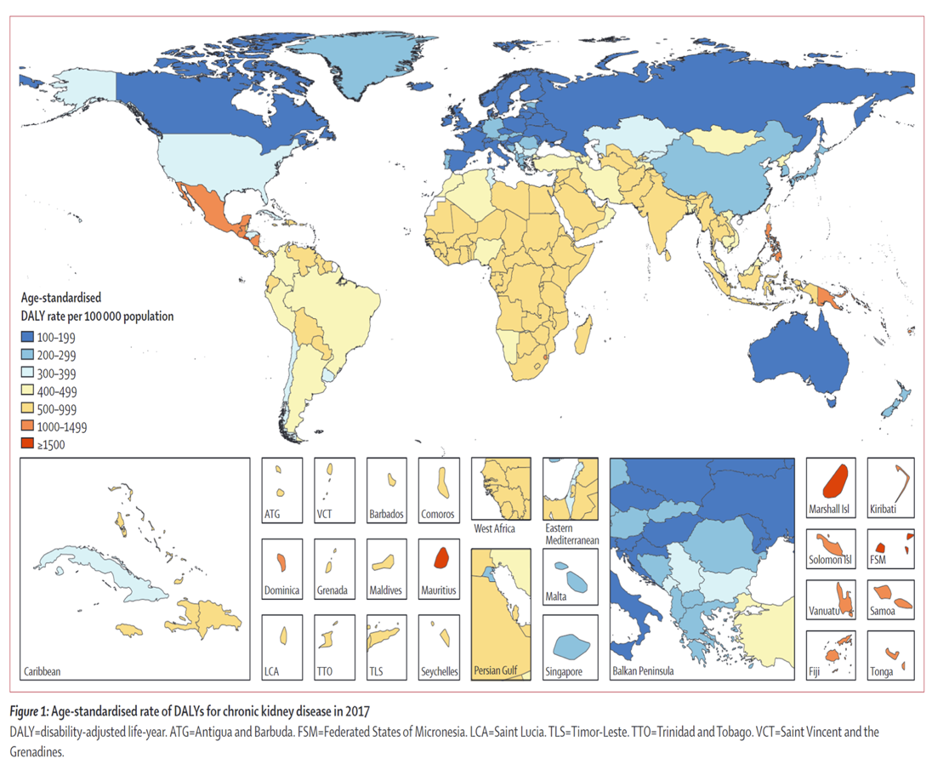
Kidney Disease Statistics for the United States: Prevalence
Bikbov B, Purcell CA, Levey AS, et al. Global, regional, and national burden of chronic kidney disease, 1990–2017: a systematic analysis for the Global Burden of Disease Study 2017. The Lancet 2020
Notes:
Nearly 700 million persons worldwide have chronic kidney disease, and the burden falls disproportionately upon socially disadvantaged and other vulnerable groups. According to the latest Global Burden of Disease Study 2019, CKD is now ranked #18 in age-standardized rate of DALYs compared to #29 in 1990. (Lancet 2020; 396: 1204–22)

Slide 4
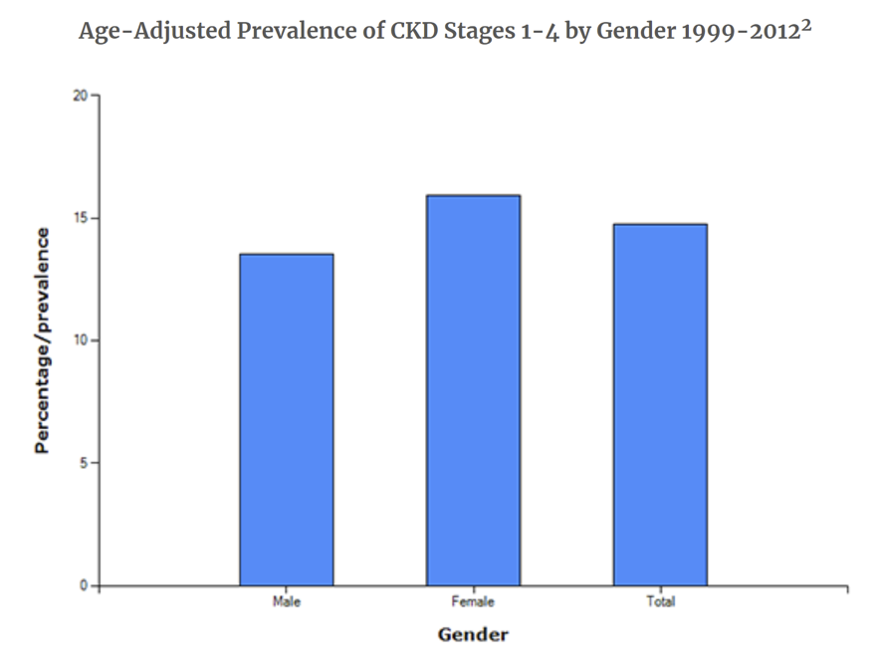
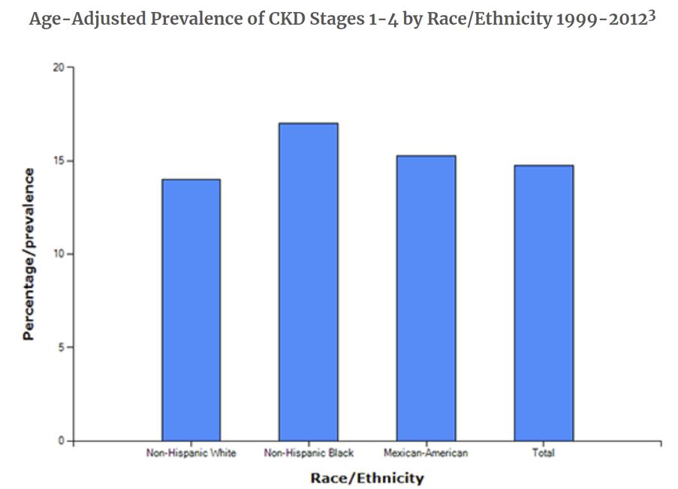
Kidney Disease Statistics for the United States: Prevalence
Kidney Disease Statistics for the United States | NIDDK (nih.gov)

Slide 5
Kidney Disease Statistics for the United States: Costs
Medicare spending for patients with CKD ages 65 and older exceeded $81 billion in 2018 and represented 22% of all Medicare spending in this age group.
More than 70% of Medicare spending for CKD patients age 65 and older was incurred by those who also had diabetes, congestive heart failure or both.
Spending was more than twice as high for patients with all three chronic conditions of CKD, diabetes, congestive heart failure ($57,965) than in patients with only CKD ($25,734).
Total Medicare-related expenditures for beneficiaries with ESRD rose to $49.2B in 2018 and accounted for 7.2% of Medicare fee-for-service expenditures.
Kidney Disease Statistics for the United States | NIDDK (nih.gov)

Slide 6
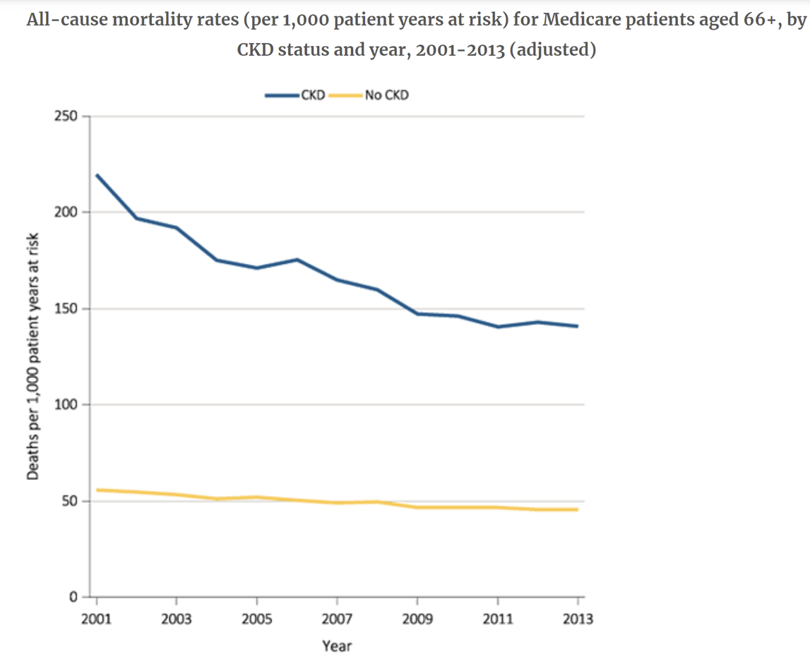
Kidney Disease Statistics for the United States: Mortality
Kidney Disease Statistics for the United States | NIDDK (nih.gov)

Slide 7
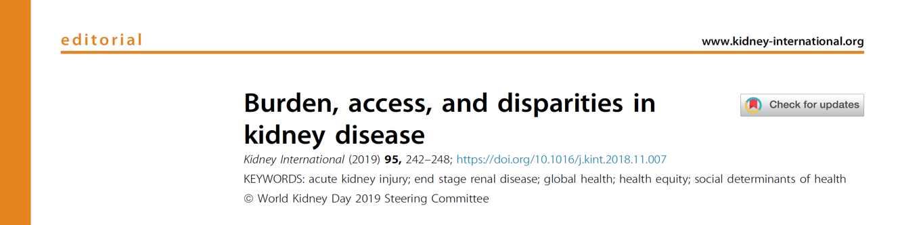
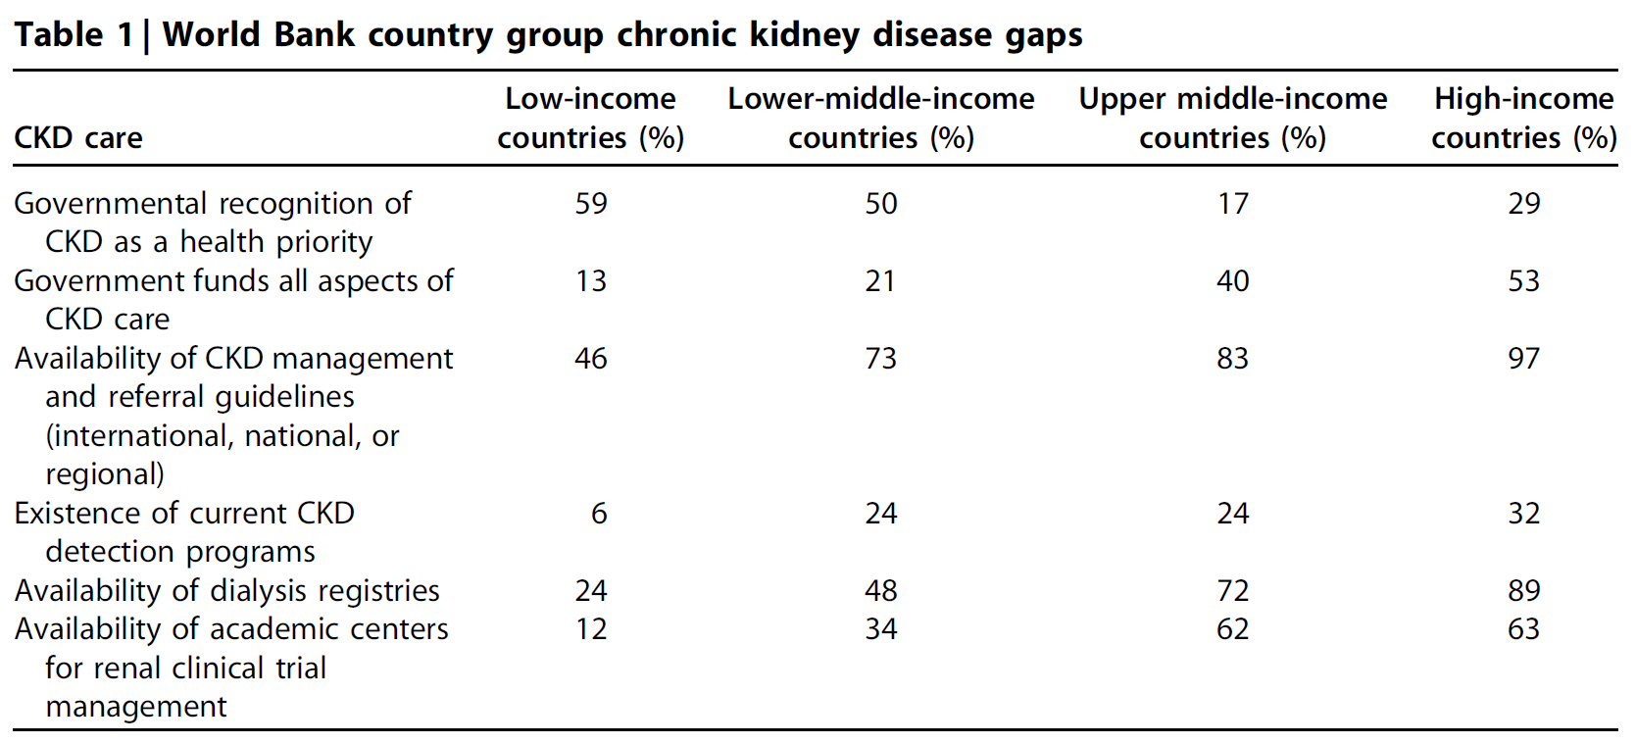
Crews DC, Bello AK, Saadi G, World Kidney Day Steering C. Burden, access, and disparities in kidney disease. Kidney Int Rep 2019;4:372-9.

Slide 8
Mean Annual Health Care Cost Per Patient with CKD (developed countries)
Progression from CKD G1–G2 to CKD G3a-3b was associated with a 1.1–1.7 fold increase in per patient mean annual health care cost
Mean annual total health care costs per patient:
CKD G1-G3b: $1,600 to $25,037
CKD G4–G5: $5,367 to $53,186
Kidney failure: $20,110 to $100,593
Elshahat S et al. PLoS ONE 2020; 15: e0230512

Slide 9
Screening for CKD:
Barriers to Early Identification & Intervention

Slide 10
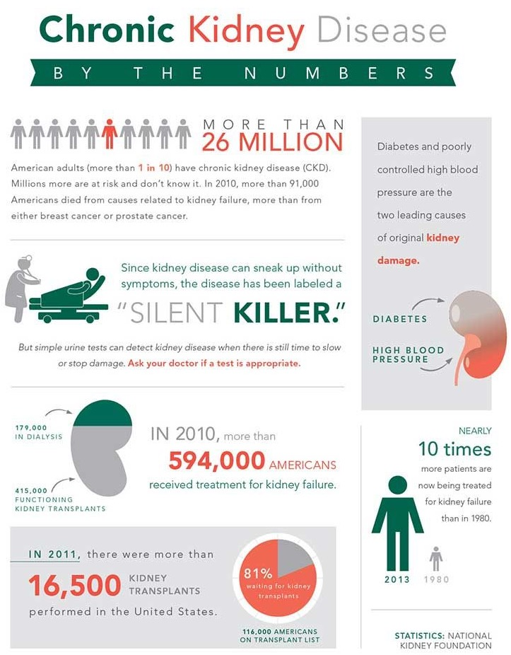
Early identification of CKD
Screening
Risk stratification
Treatment
https://www.pinterest.com/pin/374361787748770734/
Notes:
Early identification of CKD by screening for kidney disease, followed by risk stratification and treatment, offers the potential to substantially reduce the morbidity and mortality from CKD and its related complications, such as cardiovascular disease.
However, at present, there is no accepted systematic strategy for early detection and treatment of CKD.

Slide 11
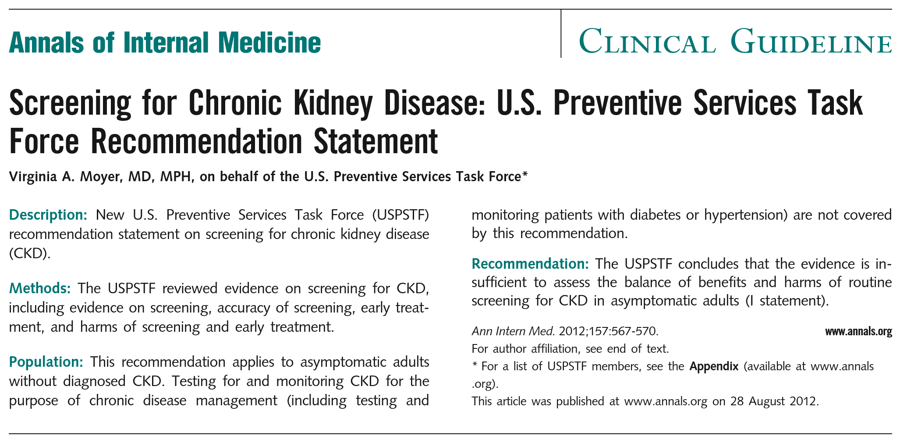
Professional organizations have been discordant on whether or not to screen for CKD
Notes:
Despite effective methods to diagnose and treat CKD at its earliest stages, there is a lack of consensus on whether health systems and governments should implement CKD screening programs. Professional societies have been discordant on whether or not to screen for CKD.
Moyer VA. Screening for chronic kidney disease: U.S. Preventive Services Task Force recommendation statement. Annals of internal medicine 2012;157:567-70.
Qaseem A, Hopkins RH, Jr., Sweet DE, Starkey M, Shekelle P. Screening, monitoring, and treatment of stage 1 to 3 chronic kidney disease: A clinical practice guideline from the American College of Physicians. Ann Intern Med 2013;159:835-47.
Microvascular Complications and Foot Care: Standards of Medical Care in Diabetes-2020. Diabetes Care 2020;43:S135-s51.

Slide 12
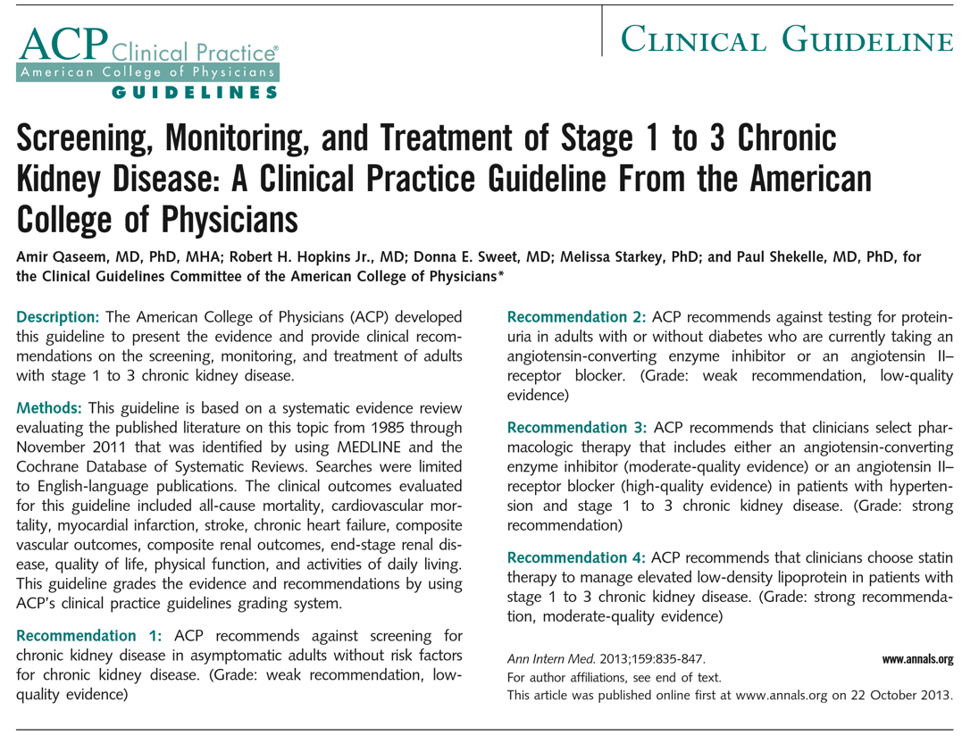
Professional organizations have been discordant on whether or not to screen for CKD
In the absence of direct evidence to support screening, we have to make tough choices using all available evidence.
Notes:
Despite effective methods to diagnose and treat CKD at its earliest stages, there is a lack of consensus on whether health systems and governments should implement CKD screening programs. Professional societies have been discordant on whether or not to screen for CKD.
Moyer VA. Screening for chronic kidney disease: U.S. Preventive Services Task Force recommendation statement. Annals of internal medicine 2012;157:567-70.
Qaseem A, Hopkins RH, Jr., Sweet DE, Starkey M, Shekelle P. Screening, monitoring, and treatment of stage 1 to 3 chronic kidney disease: A clinical practice guideline from the American College of Physicians. Ann Intern Med 2013;159:835-47.
Microvascular Complications and Foot Care: Standards of Medical Care in Diabetes-2020. Diabetes Care 2020;43:S135-s51.

Slide 13
KDIGO Early Identification & Intervention in CKD Controversies Conference

Slide 14


KDIGO Early Identification & Intervention in CKD
Controversies Conference
(Official hashtag: #KDIGOEarlyCKD)
Notes:
To address this ongoing controversy, in October of 2019, the Kidney Disease: Improving Global Outcomes (KDIGO) held a Controversies Conference entitled, Early Identification and Intervention in CKD. Meeting participants represented a global multidisciplinary panel of clinicians and scientists.

Slide 15
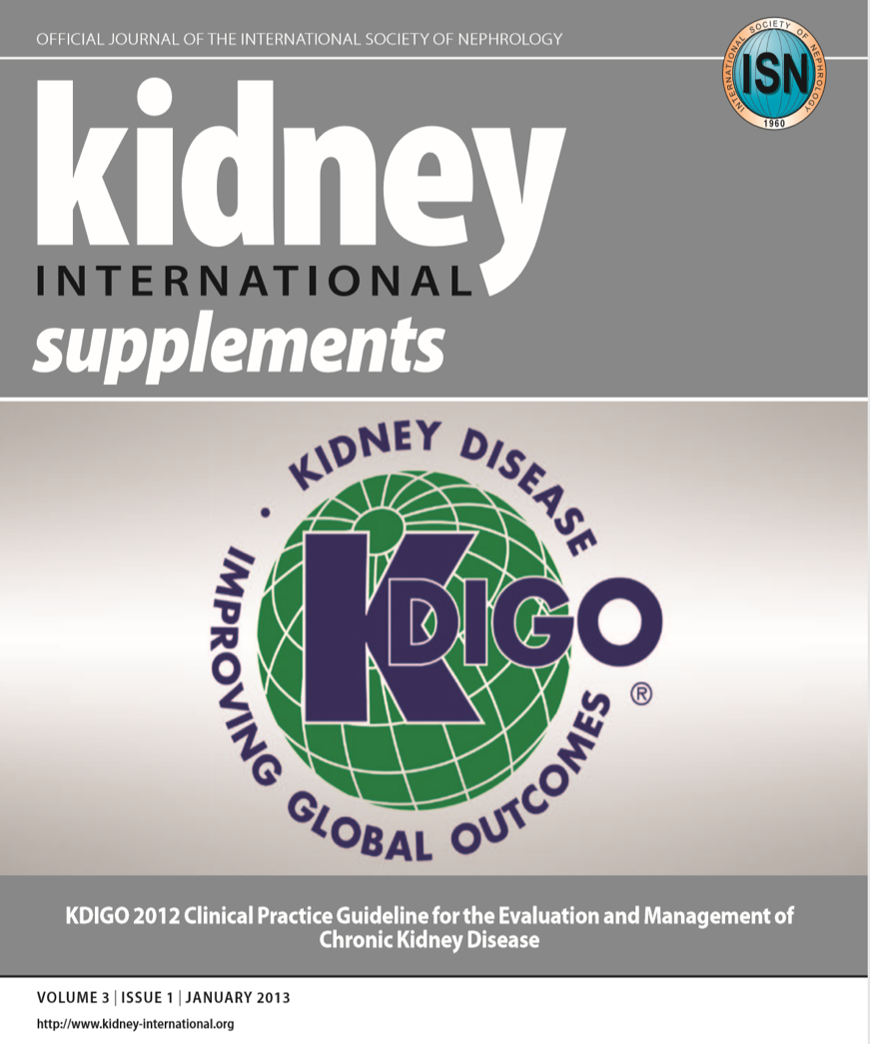
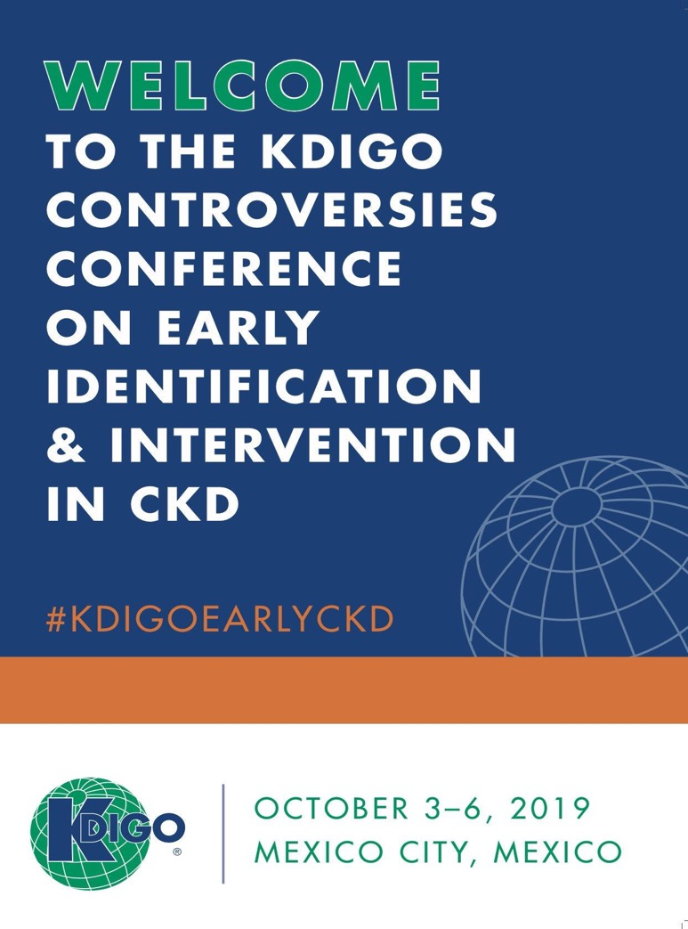

Slide 16
Outline: Four Major Topics
The selection of candidate populations for CKD early detection
The relative diagnostic and predictive characteristics of tests for kidney disease and their potential costs
The evidence base for treatments that could reduce the risk of CKD progression and cardiovascular events
The implementation strategies for CKD early detection and treatment programs and the key factors determining resource allocation and cost-effectiveness

Slide 17
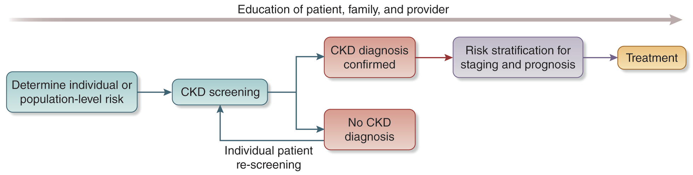
Conceptual framework of a CKD screening, risk stratification, and treatment program
Notes:
After comprehensive review of the conference topics by four breakout groups and by all attendees in collective discussion, consensus was reached to endorse a broad and proactive plan for CKD screening, risk stratification, and treatment with the goal of reducing the global burden of kidney disease.

Slide 18

WHO Screening Principles Apply to CKD
Public health problem
Early asymptomatic phase
Detectable by affordable testing
Treatments are effective and available
Disease progression understood
Screening treatment must be ongoing, not just one episode
Affordable for overall healthcare budget
Notes:
The rationale for CKD screening strategies was evaluated within the context of the World Health Organization (WHO) principles of screening for disease.

Slide 19
Additional Considerations
Patients overwhelmingly prefer earlier CKD screening and diagnosis.
Patient education has the potential to improve self-management and disease prognosis.
Economic rationale must favor some program of early CKD screening/risk stratification/treatment, given the costs of kidney failure to healthcare systems and society.
Notes:
Two additional themes to emerge from the conference serve as important underlying principles for CKD screening strategies.

Slide 20

Approaches considered to CKD screening, risk-stratification and treatment
Identification of all persons with CKD
Identification of individuals within high-risk populations to maximize testing yield
Identification of individuals with CKD who are most likely to progress to kidney failure or experience cardiovascular or other CKD complications
Additional topics:
  Definitions of high-risk populations
  Optimal frequency of rescreening
Notes:
Conference participants reviewed different potential objectives for CKD screening and treatment initiatives: the identification of all persons with CKD; the identification of individuals within high-risk populations to maximize testing yield; or the identification of individuals with CKD who are most likely to progress to kidney failure or experience cardiovascular or other CKD complications. Additional topics of discussion included the definitions of high-risk populations and the optimal frequency of rescreening. The conference participants concluded that individual and population-level risk of having CKD and experiencing its complications should inform whether persons should be screened for CKD. Decisions concerning the age to initiate testing, the frequency of repeat testing, and the time to forgo or end testing should all be individualized based upon risk factors, preferences, and life expectancy.

Slide 21

Individualized Treatment
Decisions concerning the age to initiate testing, the frequency of repeat testing, and the time to forgo or end testing should all be individualized based upon:
Risk factors
Preferences
Life expectancy
Notes:
The conference participants concluded that individual and population-level risk of having CKD and experiencing its complications should inform whether persons should be screened for CKD. Decisions concerning the age to initiate testing, the frequency of repeat testing, and the time to forgo or end testing should all be individualized based upon risk factors, preferences, and life expectancy.

Slide 22


Controversies Conference Report Conclusion 1:
Persons with hypertension, diabetes, and cardiovascular disease should be screened for CKD.

Slide 23
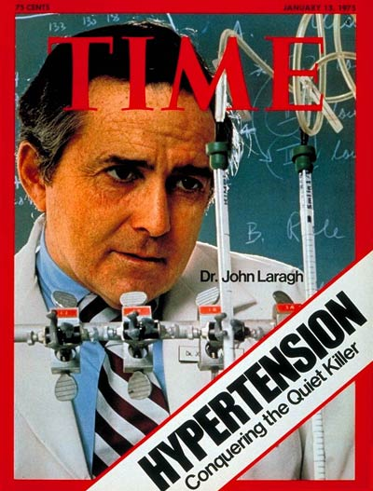


Conclusion 1: Persons with hypertension, diabetes, and cardiovascular disease should be screened for CKD.
Notes:
Efforts for early CKD detection should first be implemented in individuals with established CKD risk factors, given the higher expected prevalence of CKD among these individuals.
Identifying and treating all CKD cases would be the most complete approach to improving kidney health and reducing the burden of kidney disease. However, population-wide CKD screening programs were noted to have potential drawbacks, including higher costs and greater barriers to implementation than targeted high-risk screening.
A strategy of CKD screening in populations with common and important CKD risk factors will prioritize the identification of cases at high risk for CKD progression and cardiovascular events and with established treatment strategies.
This approach would detect individuals with CKD at a lower cost per case identified but could miss CKD cases that are attributable to less common or unrecognized risk factors.

Slide 24
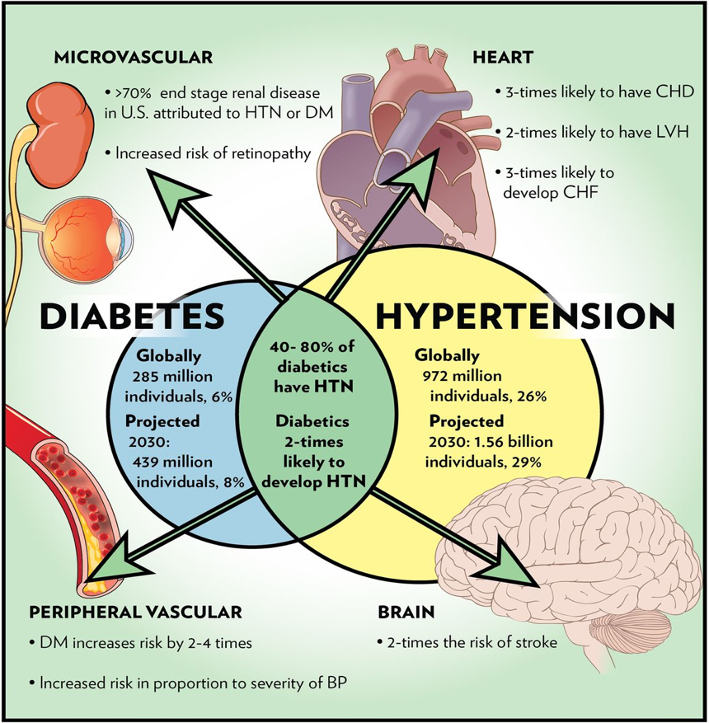
Screening Strategy
CKD screening should be implemented for groups with these well-accepted CKD risk factors:
    Hypertension,
    Diabetes, and/or
    Cardiovascular disease
https://heart.bmj.com/content/99/8/577
Notes:
A CKD screening strategy based upon the presence of specific risk factors could miss a large population of patients who have not yet been diagnosed with those CKD risk factors or who are not followed in primary care.

Slide 25
Controversies Conference Report Conclusion 2:
CKD screening and treatment programs should be also implemented in other high-risk individuals and populations based on comorbidities, environmental exposures, or genetic factors.

Slide 26








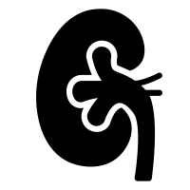




Conclusion 2: CKD screening and treatment programs should also be implemented in other high-risk individuals and populations based on comorbidities, environmental exposures, or genetic factors.
Older age
Race/ ethnicity
SLE
HIV
Family History
Genetic Risk Factors
Low Socioeconomic Status
Environmental
Exposures
Prior AKI
Preeclampsia
Nephrotoxins
Obesity
Notes:
Several other characteristics that may elevate an individual’s likelihood of having CKD, including older age, race/ethnicity, other systemic diseases that impact kidneys (e.g., systemic lupus erythematosus, HIV infection), family history of kidney disease, genetic risk factors, poor access to healthcare or low socioeconomic status, high-risk occupations and environmental exposures, prior acute kidney injury, pre-eclampsia, exposure to nephrotoxins, and obesity were identified.
CKD screening for persons with these risk factors should be guided by an individualized clinical assessment and joint decision making, rather than a uniform approach

Slide 27
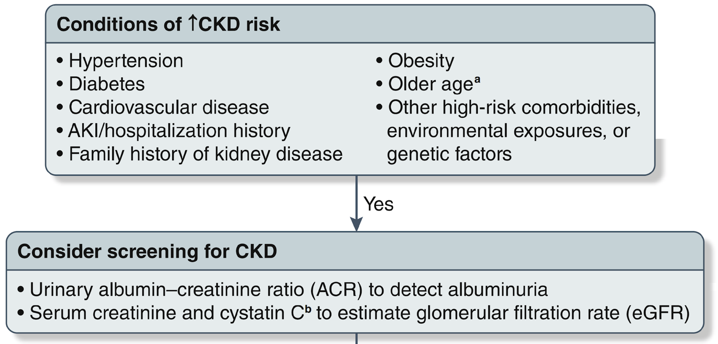
Conclusion 2: CKD screening and treatment programs should also be implemented in other high-risk individuals and populations based on comorbidities, environmental exposures, or genetic factors.
Notes:
Several other characteristics that may elevate an individual’s likelihood of having CKD, including older age, race/ethnicity, other systemic diseases that impact kidneys (e.g., systemic lupus erythematosus, HIV infection), family history of kidney disease, genetic risk factors, poor access to healthcare or low socioeconomic status, high-risk occupations and environmental exposures, prior acute kidney injury, pre-eclampsia, exposure to nephrotoxins, and obesity were identified.
CKD screening for persons with these risk factors should be guided by an individualized clinical assessment and joint decision making, rather than a uniform approach

Slide 28
Controversies Conference Report Conclusion 3:
The initiation, frequency, and cessation of CKD screening should be individualized based on kidney and cardiovascular risk profiles and individual preferences.

Slide 29
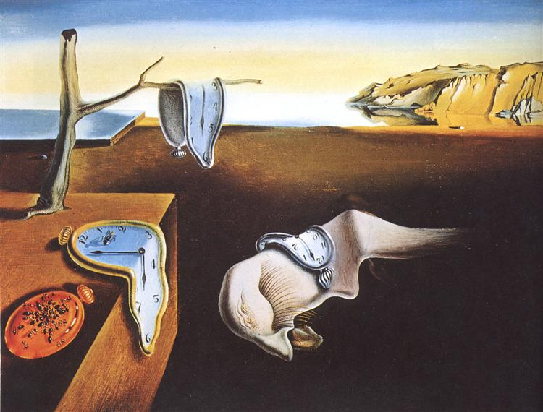
Conclusion 3: The initiation, frequency, and cessation of CKD screening should be individualized based on kidney and cardiovascular risk profiles and individual preferences.
The timing of initiation of CKD screening should be based on comorbidities and individualized risk assessment, rather than at a specific chronologic age.
https://www.wikiart.org/en/salvador-dali/the-persistence-of-memory-1931
Notes:
The time in the life course when screening for CKD should begin should be based upon the estimated likelihood of having CKD for that individual, rather than chronologic age alone.

Slide 30
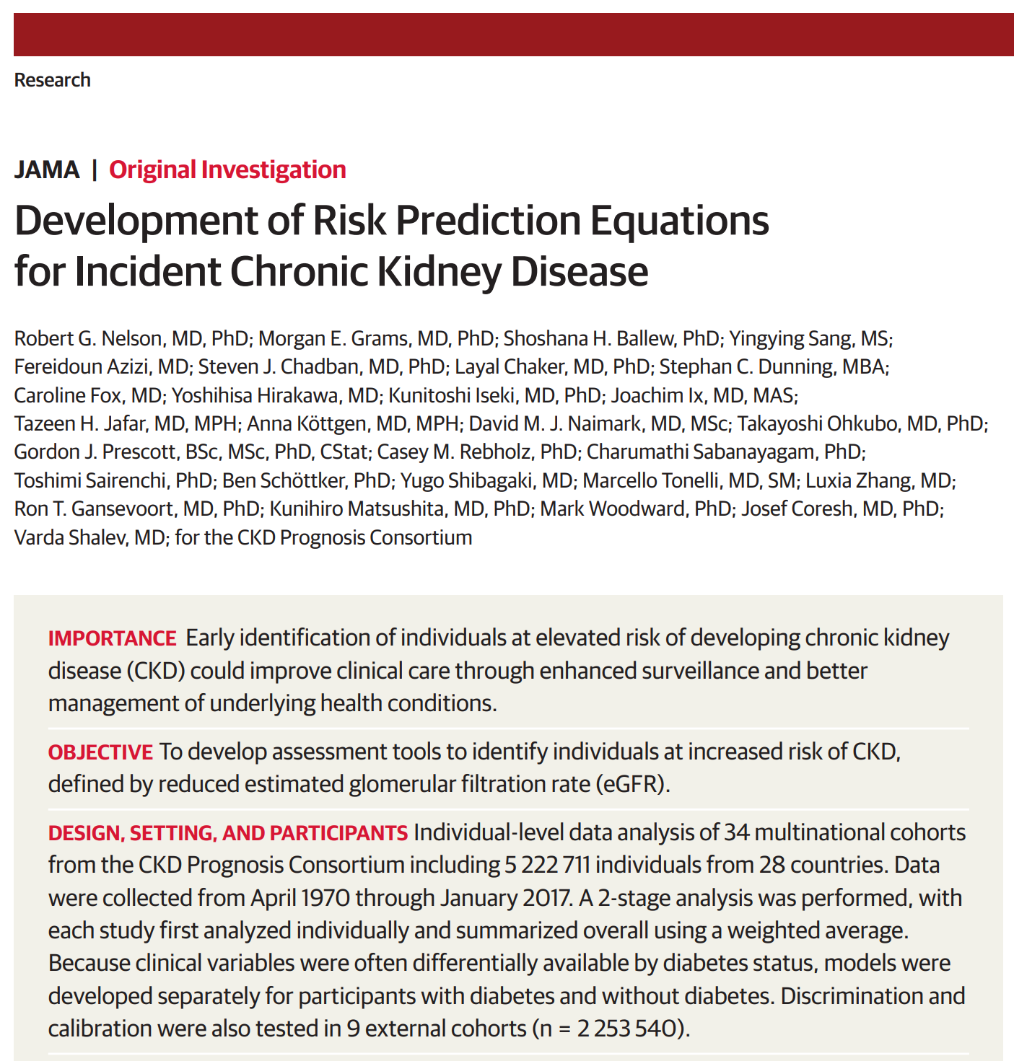
The frequency of testing is a critical aspect of CKD screening programs and has substantial impact on costs.
Must be individualized and could range from 1 to 10 years.
Risk equations that estimate future CKD probabilities could be used to guide the timing of the subsequent testing.
Notes:
The frequency of repeat testing should not be uniform for all persons, but rather should be guided by each individual’s risk of developing CKD, based in part upon the results of previous testing.

Slide 31
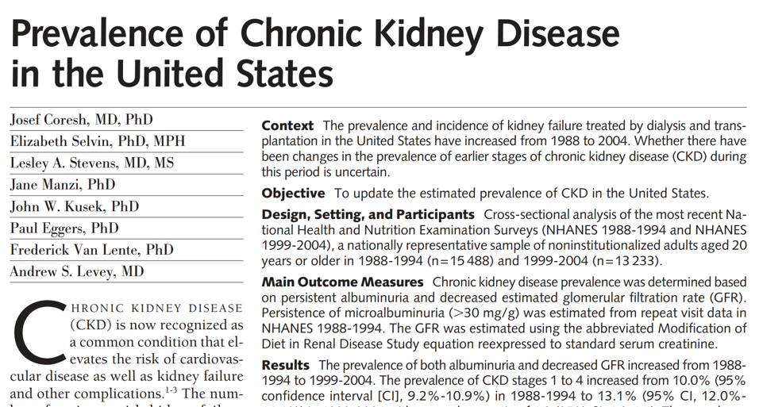
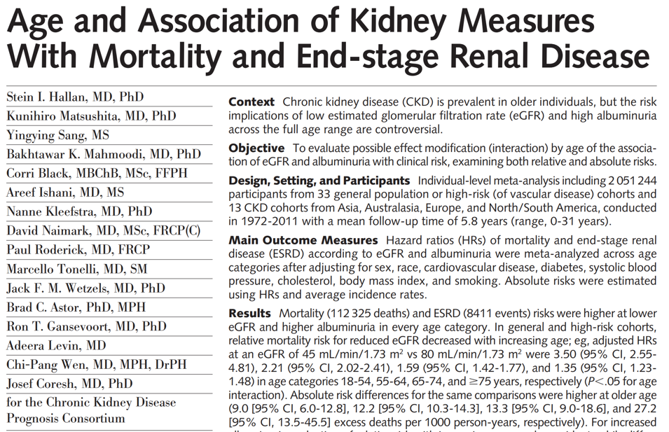
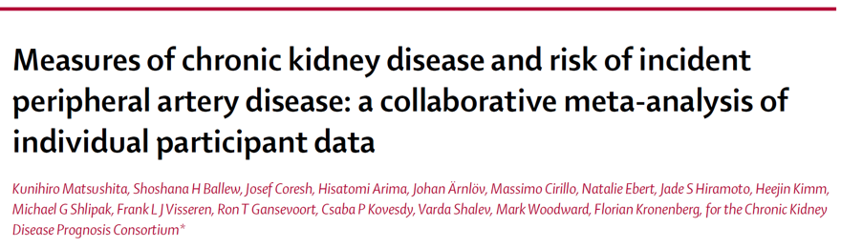
Overdiagnosis vs the greater relative burden of CKD on the elderly
Notes:
The diagnosis of CKD is currently a controversial topic among older adults, who experience the greatest burden of CKD and are at the highest risk for certain complications, such as cardiovascular disease and heart failure.

Slide 32
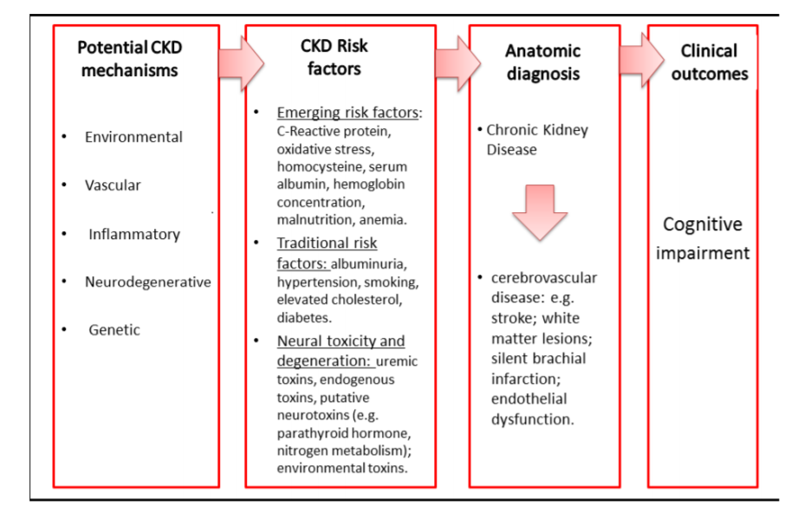
Notes:
There is concern that CKD is overdiagnosed among older adults and have called for an age-adapted definition. However, underdiagnosis of CKD in older adults also carries consequences, as older adults have the highest prevalence of CKD, and CKD impacts their physical and cognitive function, medication safety, and cardiovascular prognosis.

Slide 33

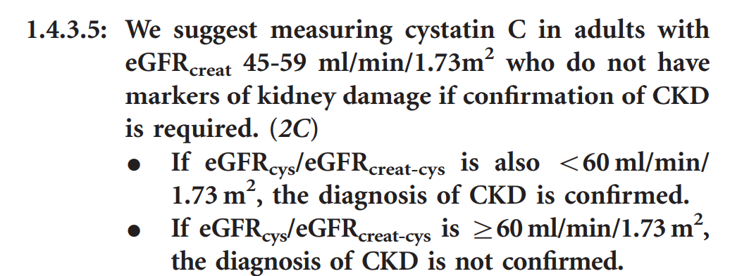
Potential harms associated with CKD overdiagnosis in older adults can be mitigated using available diagnostic and risk tools.
Notes:
While there are potential harms associated with CKD overdiagnosis in older adults; it must be emphasized that CKD should be appropriately diagnosed and risk stratified in older adults using all available measurements. For example, among those with eGFR_{Cr} 45-59 ml/min/1.73 m² and ACR< 30 mg/g, the diagnosis of CKD should require confirmation by cystatin C testing, as recommended by the KDIGO 2012 Guidelines (recommendation 1.4.3.5).

Slide 34
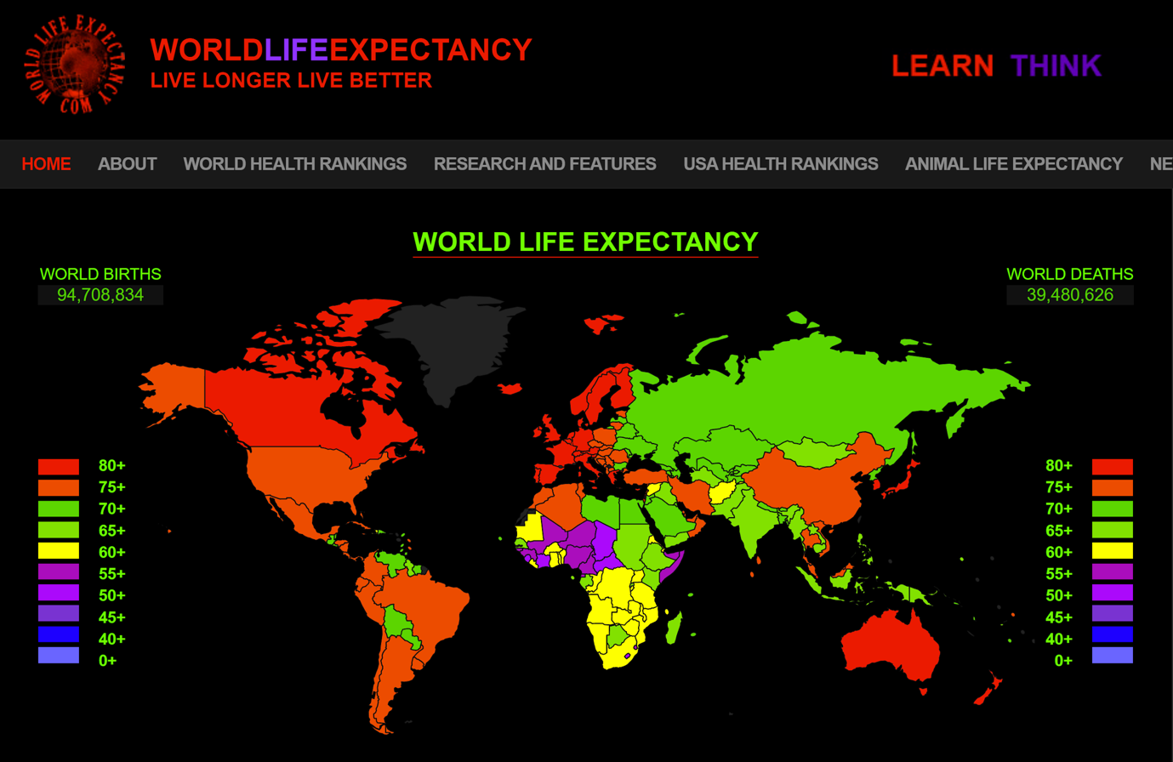
Older adults should not be excluded from CKD screening programs
Notes:
In the setting of limited life expectancy, CKD treatment strategies should carefully weigh the risks and benefits of treatment. https://www.worldlifeexpectancy.com/
Older adults should not be excluded from CKD screening programs, and whether or not to screen for CKD in an older individual should be determined with a holistic approach to patient treatment goals as with other population-based screening programs, like cancer detection.

Slide 35
Controversies Conference Report Conclusion 4:
CKD screening and risk stratification must consist of a dual assessment of estimated glomerular filtration rate (eGFR) and albuminuria (UACR).

Slide 36
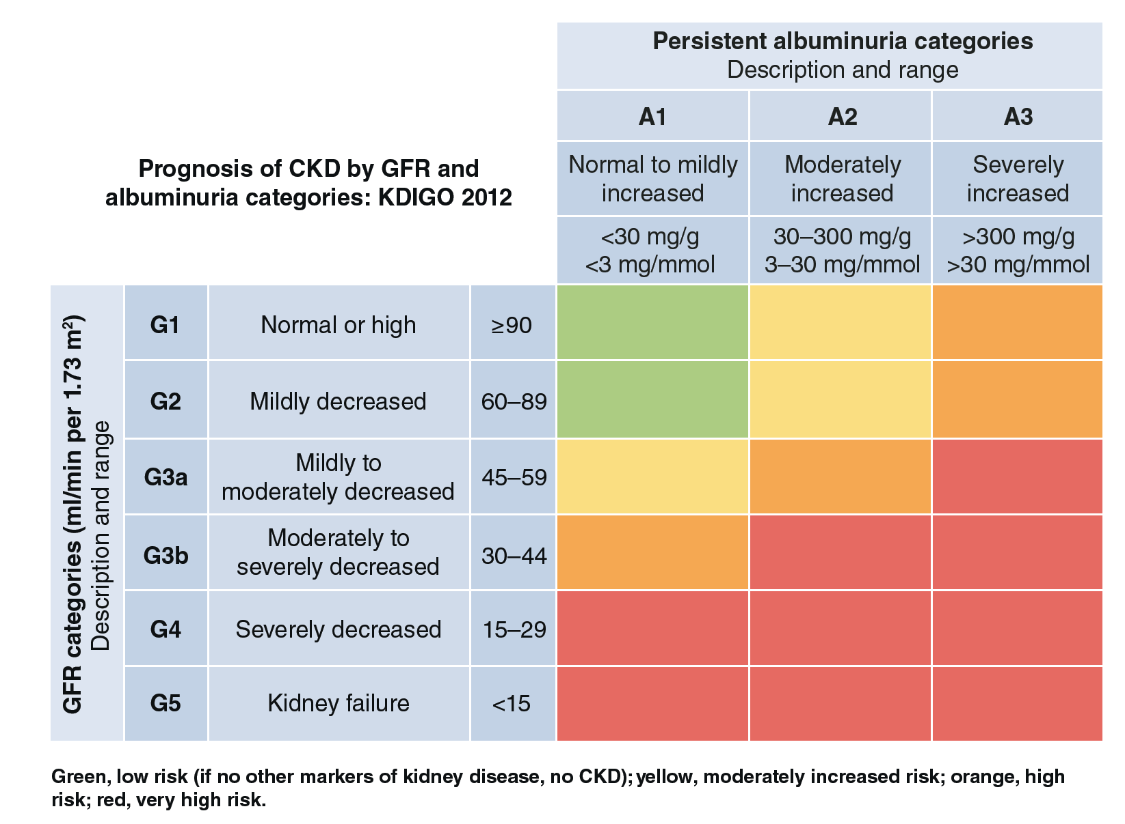
Conclusion 4: CKD screening and risk stratification must consist of a dual assessment of estimated glomerular filtration rate (eGFR) and albuminuria (UACR).
Notes:
Assessing both kidney function by estimating glomerular filtration rate (eGFR) and kidney damage by measuring albuminuria are critical both to detect and to risk stratify CKD. Lower eGFR and higher albuminuria are both strongly associated with risks of cardiovascular events, kidney failure, and mortality, so their measurement is crucial for effective risk stratification of persons with CKD. The presence and severity of albuminuria also guides the use and dosage of treatments such as ACEi/ARBs.

Slide 37
Measurements for Early CKD
The ideal initial screening and diagnosis approach would consist of the triple marker panel:
  Serum creatinine
  Serum cystatin C, and
  Urine albumin-to-creatinine ratio (UACR)

Slide 38
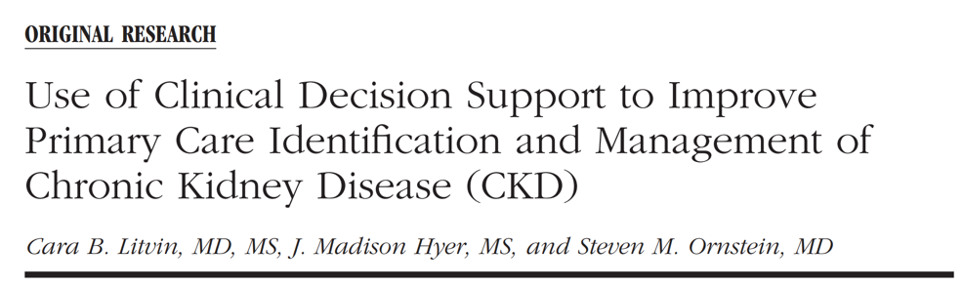
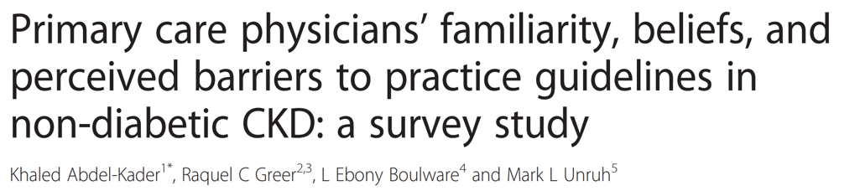
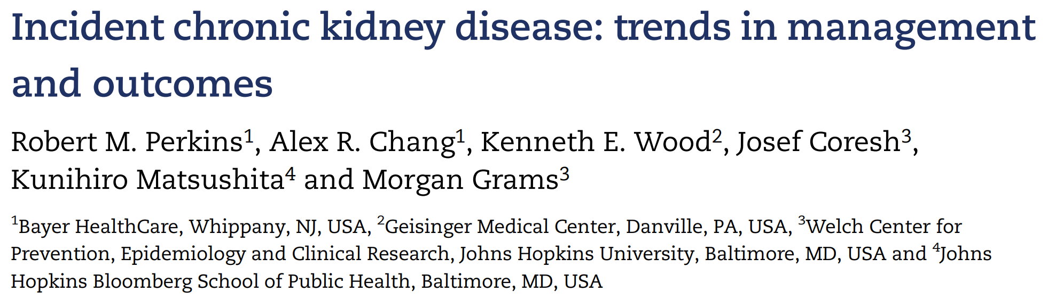
Notes:
Despite guideline recommendations, many clinicians currently fail to assess albuminuria in patients with reduced eGFR or diabetes.

Slide 39
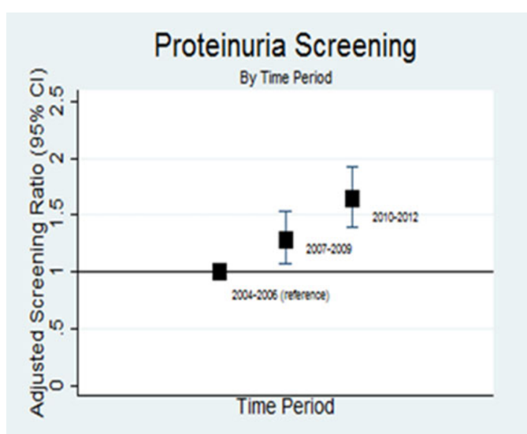
Low rates of albuminuria testing in CKD
In a US study of more than one million patients with eGFR < 60 ml/min/1.73 m², only 19% of the participants had the necessary ACR testing to calculate the 4-variable KFRE.
Further examples:
Cleveland Clinic: 36% of patients with CKD had no proteinuria assessed
UK Cohort: 17% reported ACR testing within the first year of registration of CKD
Perkins et al. CKJ 2016; 9: 432-437
In this population of incident CKD Stage G3 patients, quantification rates of urinary protein excretion doubled over the study period, but remained low in absolute terms; less than half of the incident CKD population in 2010–12 underwent urinary protein quantification.
Naranjo FS., et al. Kidney360 in press
Notes:
Despite guideline recommendations, many clinicians currently fail to assess albuminuria in patients with reduced eGFR or diabetes.

Slide 40
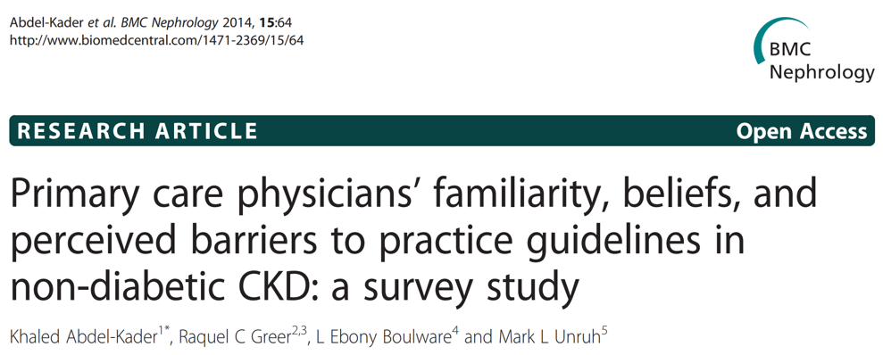
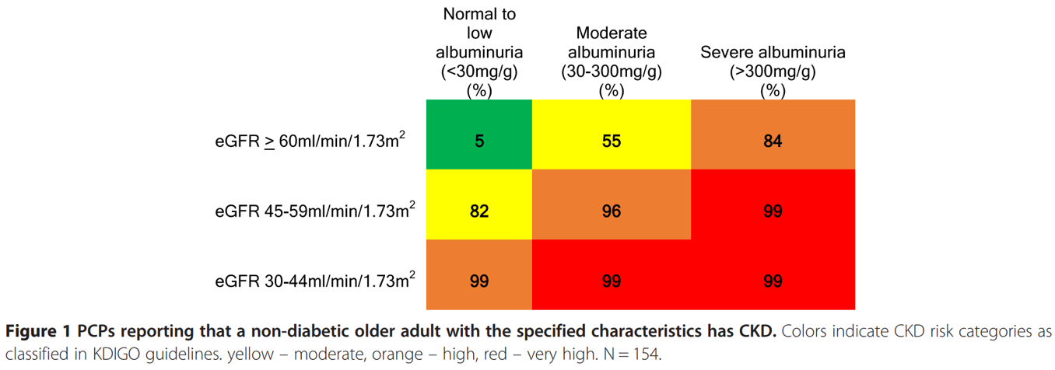
How attuned are PCPs to isolated albuminuria abnormalities?
Notes:
In this study, PCPs were less attuned to isolated albuminuria abnormalities. For example, while 99% of PCPs recognized that patients with a severe reduction in eGFR to 30–44 ml/min/1.73 m² with “normoalbuminuria” had CKD, only 84% of PCPs recognized that patients with severe albuminuria and relatively preserved eGFR had CKD (P < 0.001).

Slide 41
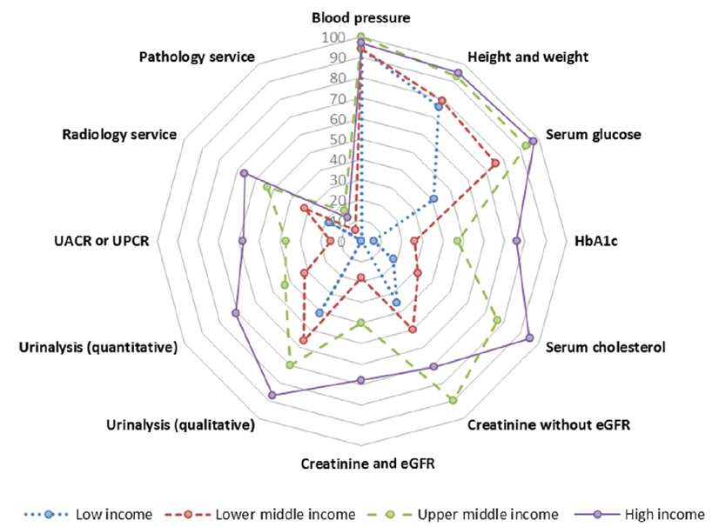
Poor Adherence to CKD Screening Guidelines in Patients with CKD Risk Factors (e.g., diabetes, hypertension)
Htay H et al. KI Suppl .8: 64-73, 2018
Albuminuria testing in persons with diabetes
  41.8% of Medicare
  49% of Optum Clinformatics™
Albuminuria testing – HTN alone
  6.6% of Medicare
  7.1% of Optum Clinformatics™
2018 USRDS Annual Data Report. NIDDK, 2018
Capacities of primary health care services for CKD (by income groups): Qualitative urinalysis using test strips for albumin or protein or both was available in 41% of low-income countries, 58% of high-income countries in primary care. Only one-third of low-income countries were able to measure serum creatinine in primary care, and none was able to access eGFR.

Slide 42
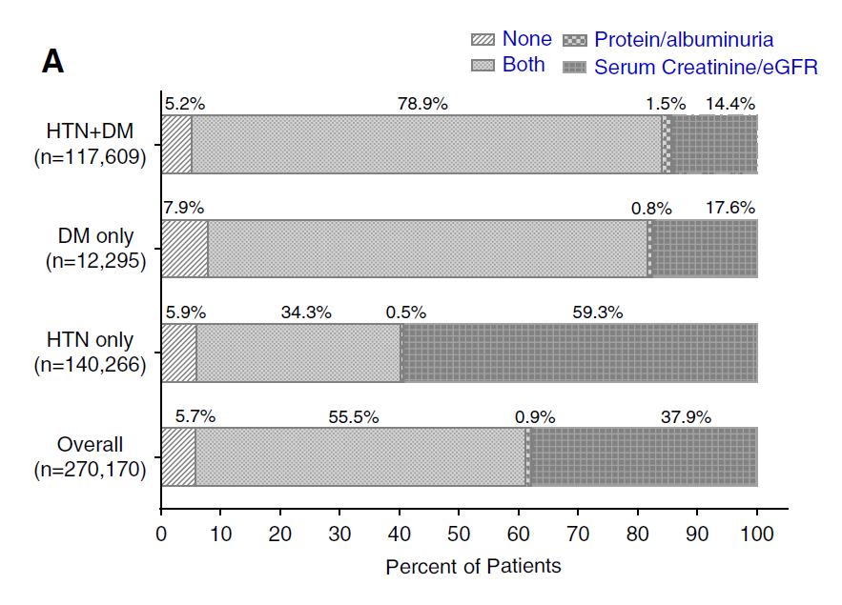
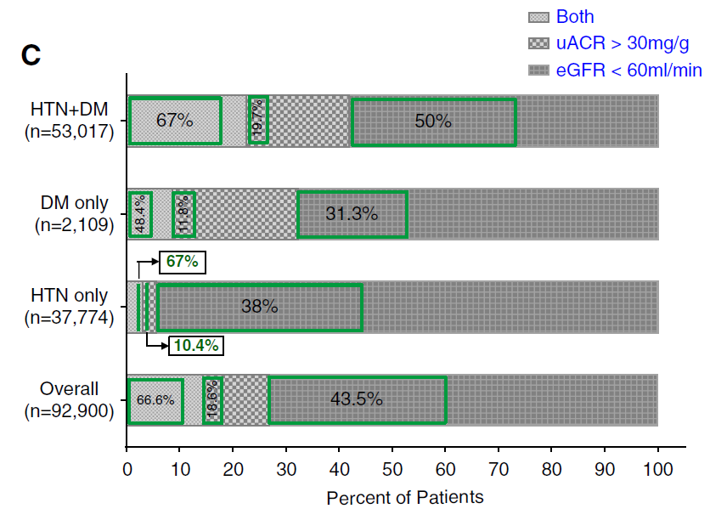
Poor Adherence to CKD Screening Guidelines in Patients with CKD Risk Factors (e.g., diabetes, hypertension)
Screening and Recognition of CKD in VA Health Care System Primary Care Clinics
Bansal S. et al. Kidney360. 2020; 1:904-915
Percentage of patients with diabetes (DM),
hypertension (HTN), or both who had screening tests in the chart
Within each criterion of CKD, green box represents the percentage of patients who
were recognized to have CKD
Notes:
Overall, 254,831 (94%) patients had either eGFR, urine protein/albumin, or both. However, screening for protein/albuminuria was low (56%), particularly in patients with isolated HTN (35%). Of 254,831 patients, 92,900 (36%) had laboratory evidence of CKD and, of these, 40,586 (44%) were recognized to have CKD by ICD code and/or nephrology referral. CKD due to presence of uACR criteria alone had the lowest recognition (19%) as compared with CKD due to eGFR criteria (44%) or both (67%).

Slide 43
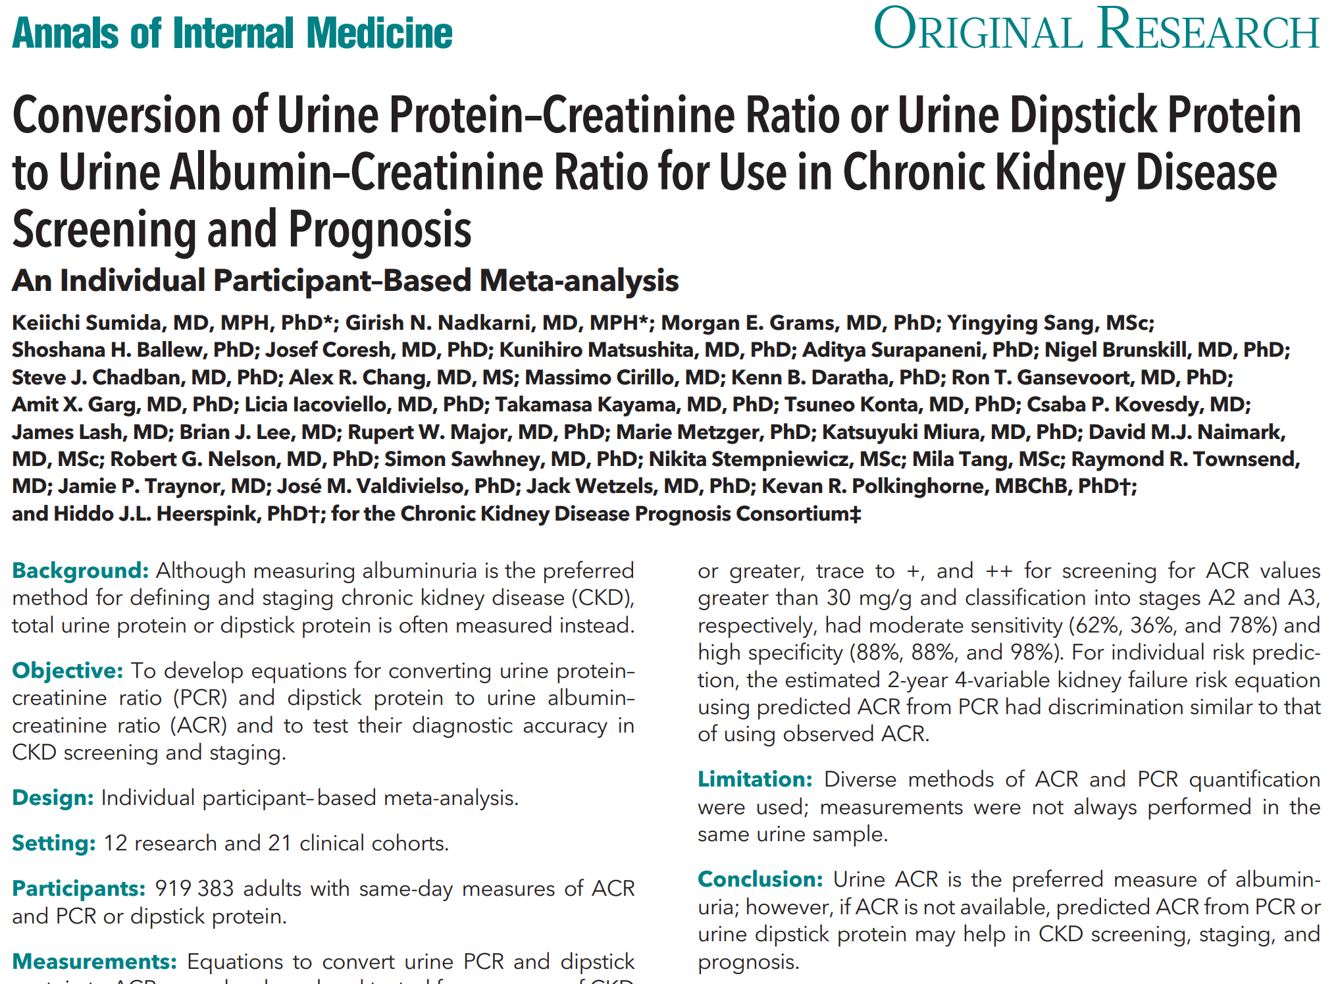
Notes:
The preferred method for initial screening for CKD, in addition to eGFR measurement, is the UACR.
UACR is preferred over urine protein-to-creatinine ratio (UPCR) because UACR specifically detects albumin, which has stronger associations with clinical outcomes and is required to appropriately stage CKD according to the KDIGO 2012 CKD guidelines. UPCR also measures non-albumin proteins and may be less sensitive for albumin at the lower ranges of detection. Urine dipstick assays are inexpensive, but less sensitive for detecting clinically important albuminuria, especially in the 30-300 mg/g range. In resource poor settings with elevated risk of proteinuric kidney disease, such as populations with prevalent APOL1 high risk variants, widespread screening with urine dipstick may be beneficial, ideally accompanied by eGFR measurement.

Slide 44
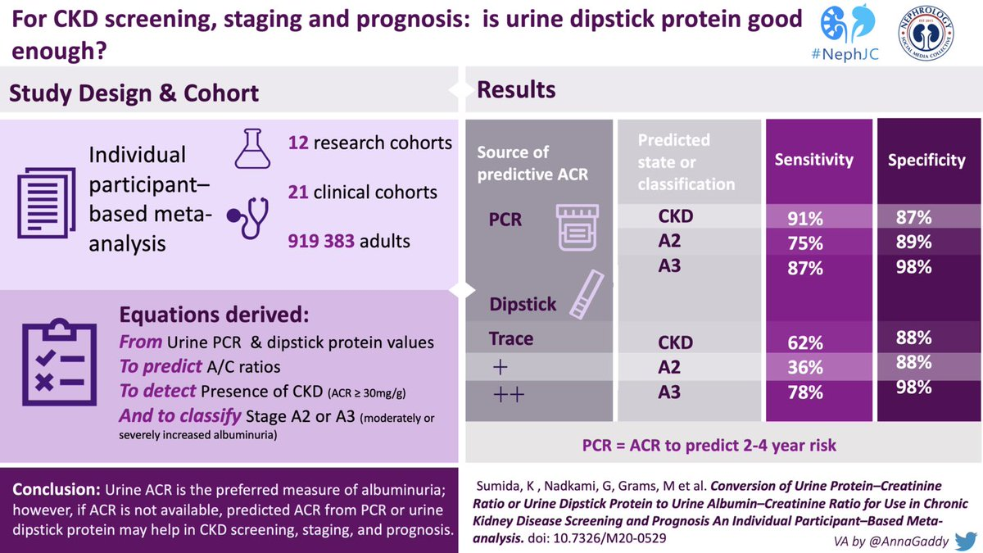
Notes:
The preferred method for initial screening for CKD, in addition to eGFR measurement, is the UACR.
UACR is preferred over urine protein-to-creatinine ratio (UPCR) because UACR specifically detects albumin, which has stronger associations with clinical outcomes and is required to appropriately stage CKD according to the KDIGO 2012 CKD guidelines. UPCR also measures non-albumin proteins and may be less sensitive for albumin at the lower ranges of detection. Urine dipstick assays are inexpensive, but less sensitive for detecting clinically important albuminuria, especially in the 30-300 mg/g range. In resource poor settings with elevated risk of proteinuric kidney disease, such as populations with prevalent APOL1 high risk variants, widespread screening with urine dipstick may be beneficial, ideally accompanied by eGFR measurement.

Slide 45
Controversies Conference Report Conclusion 5:
Accurate GFR estimation includes both creatinine and cystatin C measurement for initial diagnosis and staging.

Slide 46
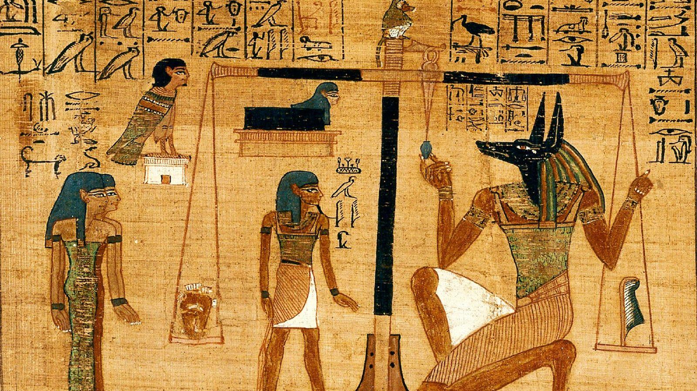
Conclusion 5: Accurate GFR estimation includes both creatinine and cystatin C measurement for initial diagnosis and staging.
Creatinine
Cystatin C
Notes:
GFR should be estimated in parallel using creatinine and cystatin C, which would more accurately diagnose and stage CKD, with less misclassification, than a strategy based upon creatinine alone.

Slide 47
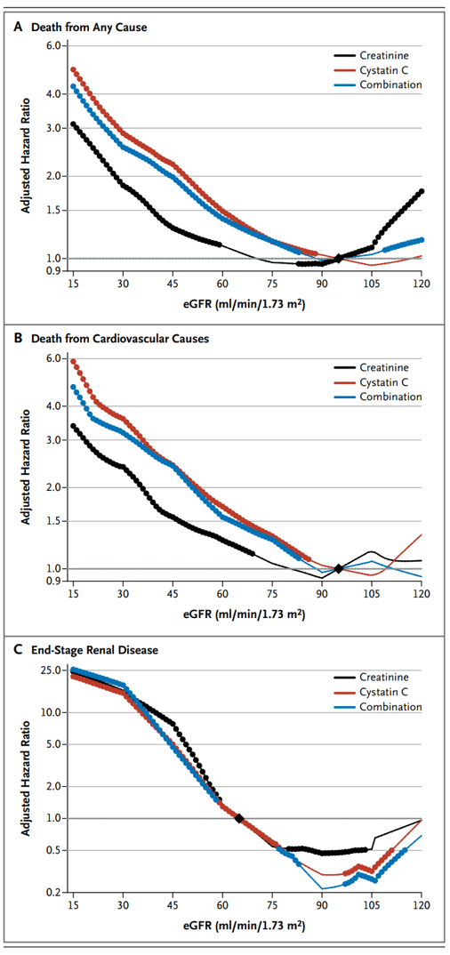
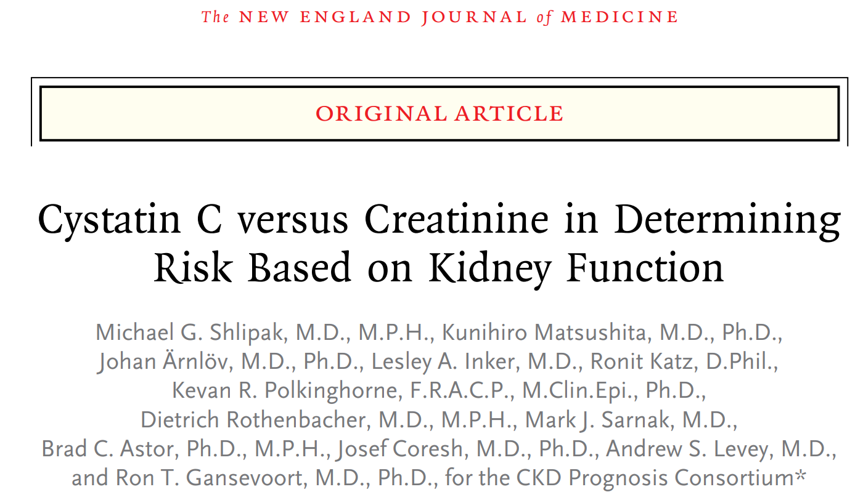
Notes:
The inclusion of cystatin C in CKD diagnosis and treatment initiatives is consistent with the KDIGO 2012 CKD Guideline, and is a critical component of accurate risk stratification, as cystatin C markedly strengthens the association between eGFR and cardiovascular events, kidney failure, and death.

Slide 48
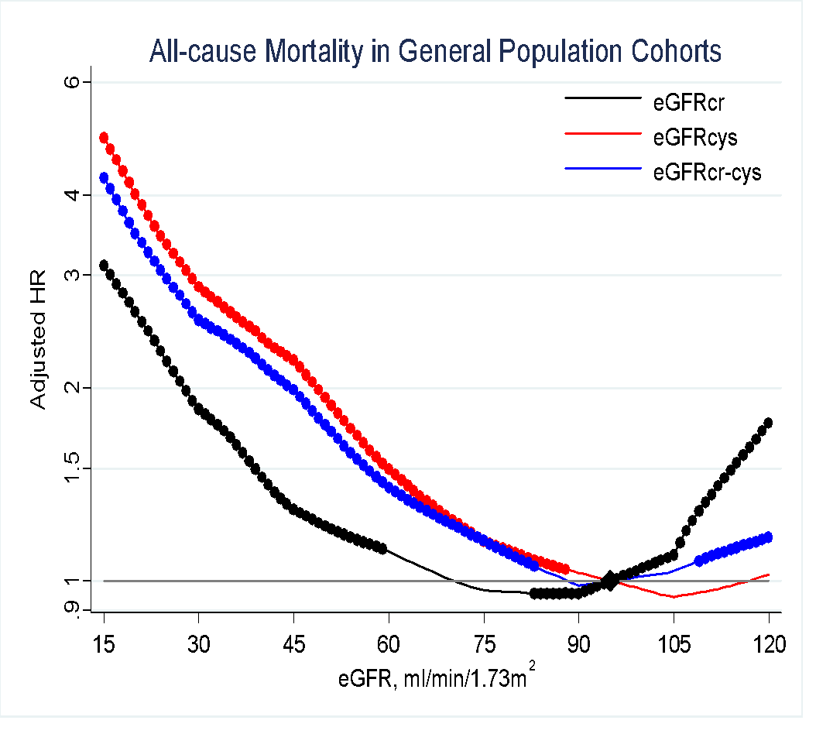
Comparisons of eGFR Using Creatinine, Cystatin C, or both with All-Cause Mortality
N= 90,750
12,351 deaths
The use of cystatin C alone or in combination with creatinine strengthens the association between the eGFR and the risks of death and end-stage renal disease across diverse populations
83
88
59
Shlipak MG. et al. N Engl J Med, 2013.
Notes:
From an epidemiological perspective, this is an amazing paradigm shift. But how does it change clinical practice?
The above graph represents adjusted hazard ratios for death from any cause in the general-population cohort studies. Hazard ratios for death from any cause, according to whether the estimated glomerular filtration rate was calculated with the measurement of creatinine, cystatin C, or both. The graphs show associations by plotting the adjusted hazard ratio versus the reference points, which are indicated by black diamonds (at 95 ml/min/1.73 m² of BSA for death from any cause and death from cardiovascular causes and at 65 ml/min/1.73 m² for end-stage kidney disease). The hazard ratios were adjusted for age, sex, race, BMI, SBP, total cholesterol, presence or absence of a history of cardiovascular disease, smoking status, presence or absence of diabetes, and level of albuminuria. In each panel, solid circles indicate that the adjusted hazard ratio at the indicated estimated glomerular filtration rate level was significant, as compared with the reference point. For death from any cause, the meta-analysis included 11 general-population cohorts with 90,750 participants, of whom 12,351 died during follow-up.

Slide 49
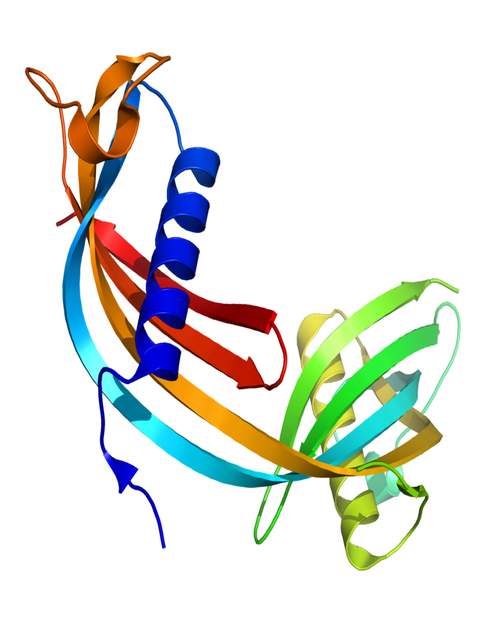
Cystatin C
Cystatin C has the additional advantage of offering GFR estimates that do not require the incorporation of a race coefficient, as is required for creatinine.
http://www.nephjc.com/news/cystatinc
Notes:
Although cystatin C is an integral test for the initial diagnosis and staging of CKD, it may not be required for routine monitoring after the diagnosis of CKD is made.

Slide 50
Controversies Conference Report Conclusion 6:
The combination of Creatinine, Cystatin C, and UACR for CKD screening is affordable in high income settings.

Slide 51

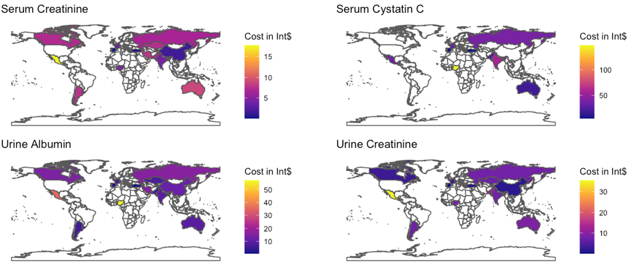
Conclusion 6: The combination of Creatinine, Cystatin C, and UACR for CKD screening is affordable in high income settings.
Tummalapalli SL, et al. Am J Nephrol. 2020; 51:959-965
Notes:
The cost of the tests used to screen for CKD has a major influence on the affordability and the cost-effectiveness of a CKD screening and treatment program. Because these are all automated tests, the cost of each measure will decrease proportionately to the volume of tests that are conducted.
To assess international CKD testing availability and costs, KDIGO collaborated with the International Society of Nephrology (ISN) to conduct a global survey.
Of 24 respondents (response rate 73%), there was high availability of CKD laboratory tests globally, and a low cost of serum creatinine and UACR testing. Reimbursement rates for the “triple marker” panel of serum creatinine, serum cystatin C, and UACR are likely affordable in high-income settings.
The median reimbursement was 22 international dollars for serum creatinine plus urine ACR testing; $47 for the “triple marker” panel of serum creatinine, serum cystatin C, and urine ACR; and $13 for serum creatinine plus dipstick urinalysis testing.

Slide 52
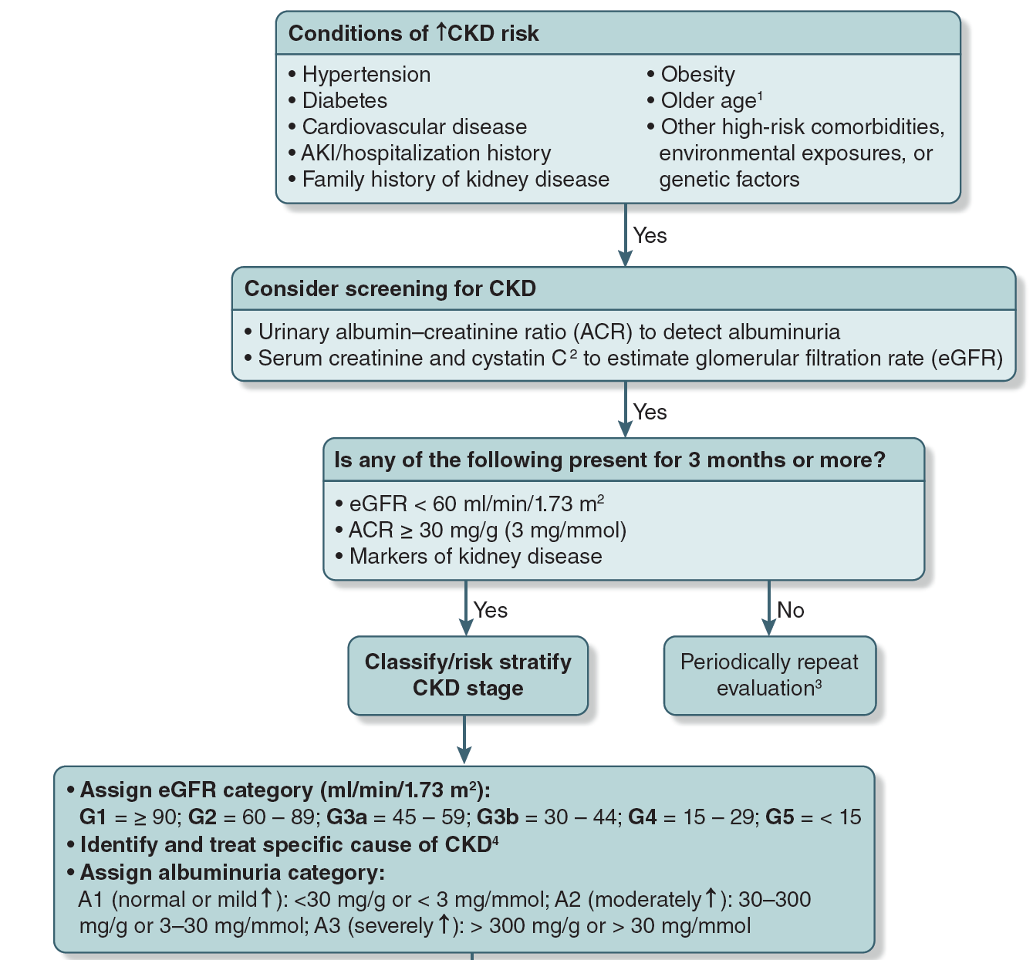
SCREEN
RISK STRATIFY

Slide 53
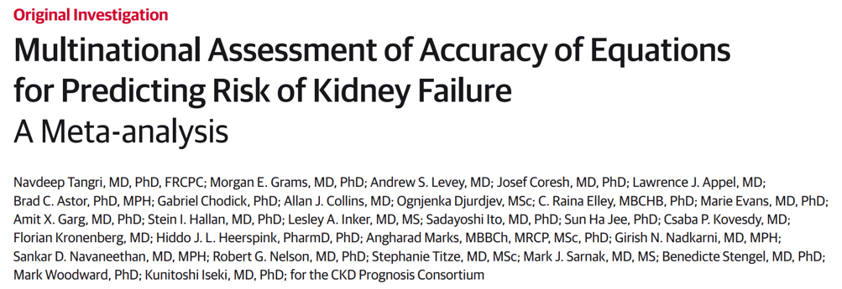
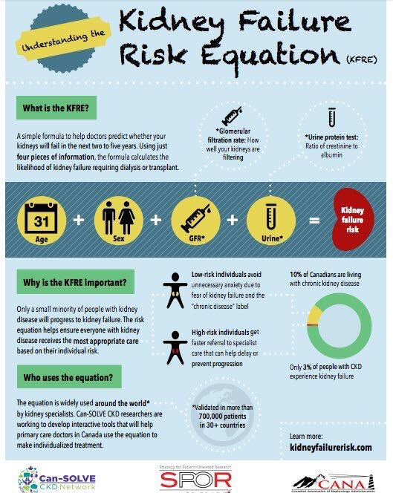
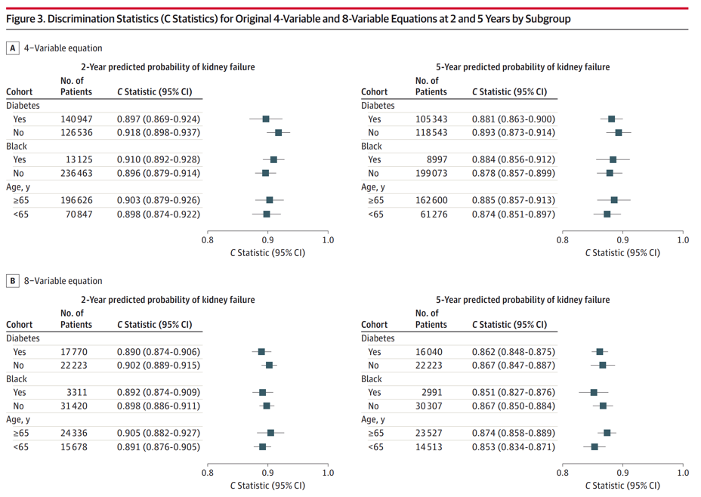
Notes:
The extensively validated Kidney Failure Risk Equation could risk stratify patients for appropriate referral to specialty care and frequency of follow-up, thereby improving efficiency. Selection of high-risk individuals and populations should be tailored to local populations, who may face distinct biological, environmental, and social risk factors (see Tangri N, et al. JAMA. 2016;315:164-174).

Slide 54

Interventions for CKD
Notes:
A fundamental justification for the early detection of CKD is the availability of evidence-based interventions to slow the progression of CKD and reduce its complications. Accurate diagnosis and staging of CKD impact the choice of treatments. Conference participants reviewed the evidence for effective interventions in CKD.

Slide 55
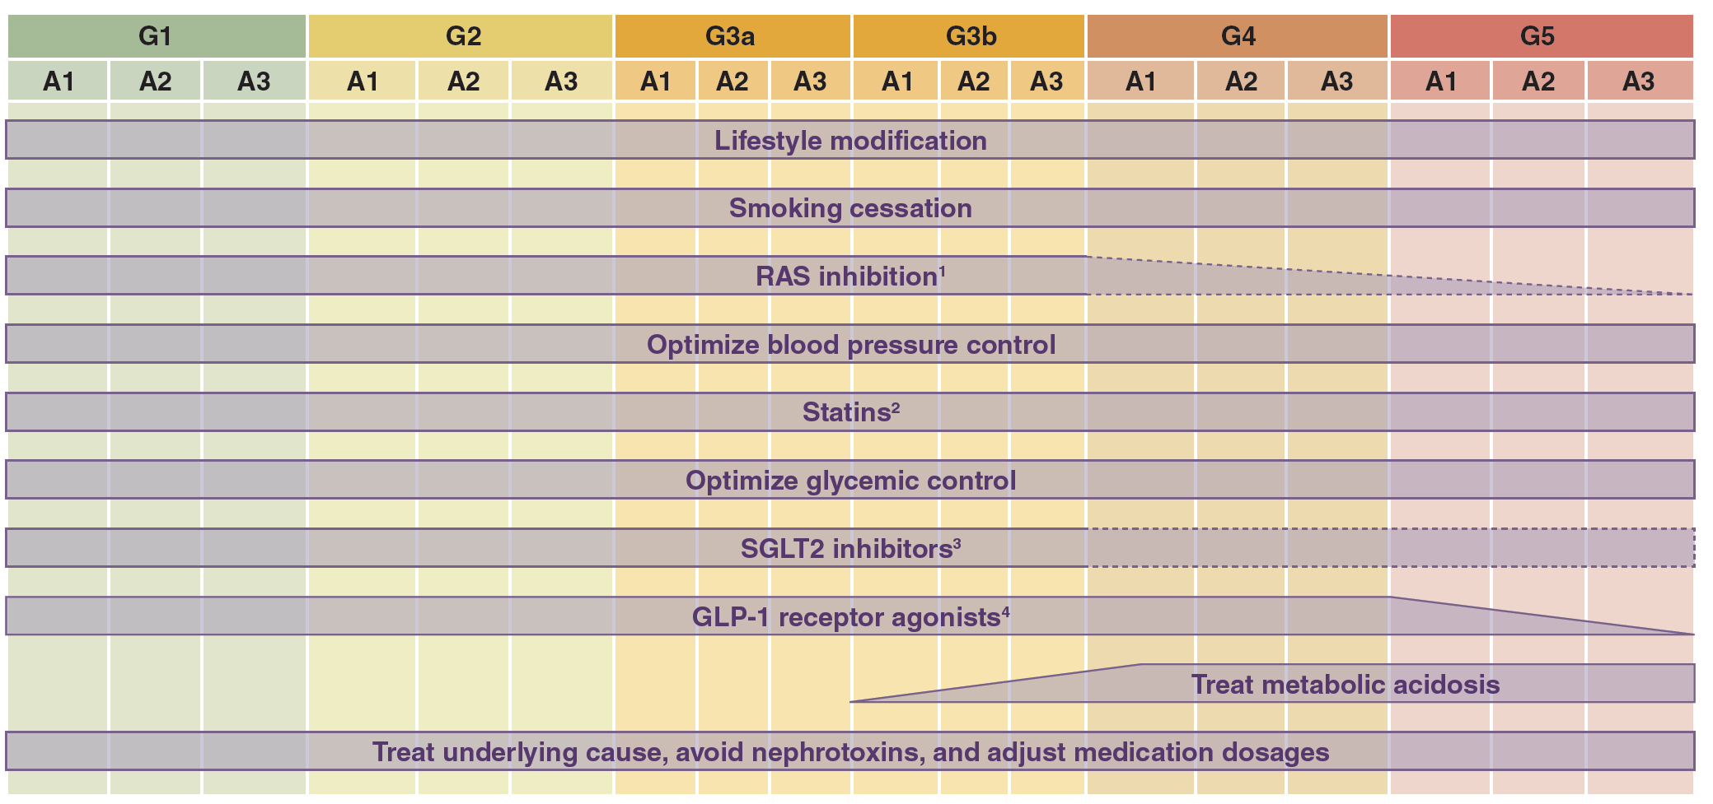
Notes:
Because the utility of CKD screening and risk stratification depend upon the potential for effective treatments, the conference summarized available evidence for interventions that delay CKD progression and reduce cardiovascular risk. A cornerstone of managing CKD is lifestyle modification, and although the benefits are largely inferred from observational studies, implementing lifestyle recommendations poses no or low risk for patients. For all persons with CKD, recommendations include smoking cessation, regular exercise, and a healthy diet (fruit, vegetables, legumes, and whole grains)
Supplemental notes:
¹Unclear if and when to discontinue RAS inhibition in advanced CKD.
²Statins should not be initiated for those beginning dialysis therapy. However, patients already receiving statins at the time of dialysis initiation can continue their statin treatment.
³Applies to CKD patients with type 2 diabetes only. SGLT2 inhibitor is recommended as first-line treatment with metformin and may also have benefits in persons with CKD and no diabetes. SGLT2 inhibitors should be initiated if eGFR 30 ml/min/1.73 m² and can be continued through G4–G5 until dialysis initiation at which point SGLT2 inhibitor should be discontinued. Evidence is emerging for the utility of SGLT2 inhibitors in patients with diabetes and eGFR < 30 ml/min/1.73 m² (Bakris G, et al. CJASN. 2020;15:1705-1714, Heerspink HJL, et al. NEJM. 2020;383:1436-1446) and in CKD patients without diabetes (Wheeler DC, et al. Lancet Diabetes Endocrinol. 2021;9:22-31).
⁴Applies to CKD patients with type 2 diabetes only. GLP-1 receptor agonist can be considered when SGLT2 inhibitor and/or metformin is not tolerated or glycemic target is not reached. Dulaglutide can be used if eGFR > 15 ml/min/1.73 m²; exenatide can be used if CrCl > 30 ml/min; there are limited data for use of liraglutide or semaglutide in severe CKD. Consult dosing recommendations for use of these agents in CKD G4, G5.

Slide 56
Controversies Conference Report Conclusion 7:
A key rationale for CKD screening is the availability of many effective interventions to delay CKD progression and reduce cardiovascular risk.

Slide 57



Conclusion 7: A key rationale for CKD screening is the availability of many effective interventions to delay CKD progression and reduce cardiovascular risk.
Notes:
Contrary to a common criticism of CKD screening programs, there are numerous effective treatments for CKD.

Slide 58
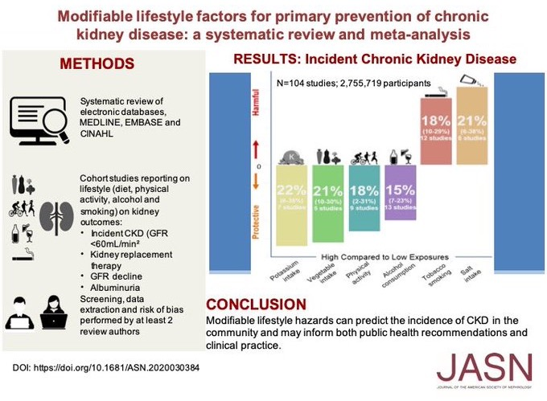
Lifestyle Improvements May Help Reduce Progression at All Stages of CKD
Notes:
For all persons with CKD, recommendations include smoking cessation, regular exercise, and a healthy diet (fruit, vegetables, legumes, and whole grains).

Slide 59
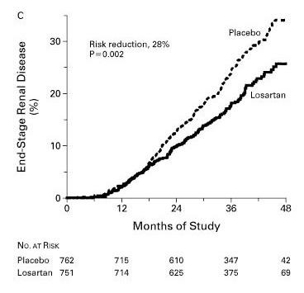
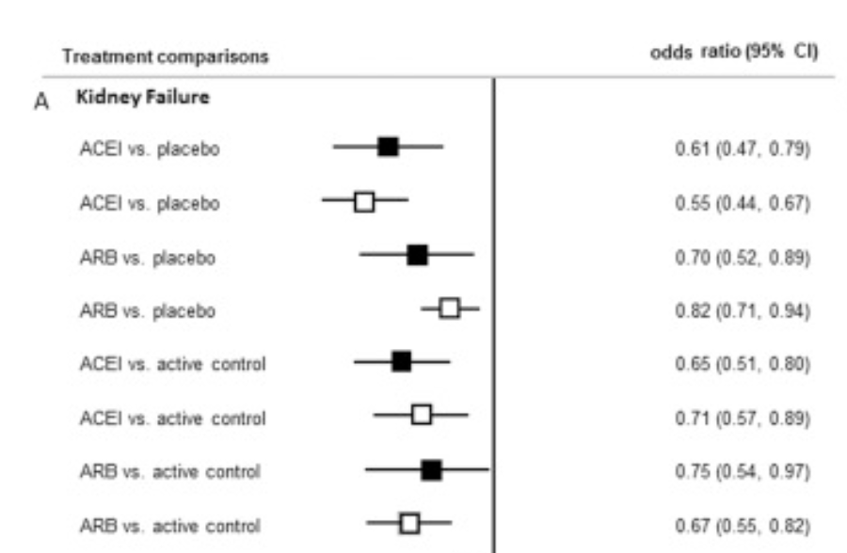
ACEi/ARB Reduce the Risk of CKD Progression and Kidney Failure
ACEi/ARB and Kidney Failure Odds Ratio (95% CI)
Brenner BM et al. N Engl J Med. 2001; Xie X et al. AJKD. 2016.
Notes:
RENAAL Trial in NEJM 2001 showed that in patients with type 2 diabetes and CKD, losartan reduced the risk of doubling of serum creatinine and kidney failure
A meta-analysis of randomized trials showed that ACEi/ARB therapy lowered the odds of kidney failure by 30-39%
(Bayesian network meta-analysis - solid squares; Traditional meta-analysis - open squares)

Slide 60

Benefits of Intensive BP Lowering in CKD
Notes:
Intensive blood pressure lowering has been shown to reduce cardiovascular events and all-cause mortality in non-diabetic CKD, and is likely to be cost-effective.

Slide 61



Mortality Benefits of Intensive BP Lowering in CKD
Cheung AK et al. JASN. 28: 2812–2823, 2017
Malhotra R., et al. JAMA Intern Med. 177: 1498-1505, 2017
SPRINT
Malhotra et al. systematic review and meta-analysis

Slide 62


Statins Lower CVD Risk in Persons with CKD G3 or G4
Notes:
Use of statins and ezetimibe lower the risk of major adverse cardiovascular events and low-cost statins are cost-effective in CKD.

Slide 63


Glucose Control Lowers Risk of CKD Progression in Type 2 Diabetes
Notes:
Evidence is emerging on the role of intensive glucose control in reducing the risk of kidney events, however the renal benefits of intensive glucose control should be weighed with risks when using agents that cause hypoglycemia

Slide 64
SGLT2 Inhibitors: the New Cardiorenal Miracle Drugs
URINE
PROXIMAL TUBULE
BLOOD
Na⁺
3 Na⁺
Na⁺/K⁺
ATPase
SGLT2
2 K⁺
Glucose
Glucose
GLUT
Glucose
Ferrannini, E. Cell Metab. 2017;26:27-38.
Notes:
SGLT2 reabsorbs 1 glucose molecule together with 1 sodium ion and GLUT2 transfers glucose back to the bloodstream. S3 segment of proximal tubules: SGLT1 reabsorbs 1 glucose molecule together with 2 sodium ions and GLUT1 is responsible for glucose transport into blood capillaries. Na+/K+-ATPase for maintenance of an electrochemical sodium gradient necessary for active transport of glucose by SGLTs against its concentration gradient. Similar process occurs in the small gut where SGLT1 is the more abundant sodium-glucose co-transporter.

Slide 65

Effects of SGLT2 Inhibitors on Major Kidney Outcomes*
*based on CANVAS, DECLARE-TIMI 58, EMPA-REG, and CREDENCE
Neuen BL et al. Lancet Diabetes Endocrinol. 7: 845-854, 2019

Slide 66

Effects of SGLT2 Inhibitors on Early CKD*
G1
G2
G3a
*based on CANVAS, DECLARE-TIMI 58, EMPA-REG, and CREDENCE
Effect of SGLT2 inhibitors on substantial loss of kidney function, kidney failure, or death due to kidney disease as stratified by baseline GFR
Neuen BL et al. Lancet Diabetes Endocrinol. 7: 845-854, 2019

Slide 67

Effects of SGLT2 Inhibitors on Early CKD*
A1
A2
*based on CANVAS, DECLARE-TIMI 58, EMPA-REG, and CREDENCE
Effect of SGLT2 inhibitors on substantial loss of kidney function, kidney failure, or death due to kidney disease as stratified by baseline albuminuria
Neuen BL et al. Lancet Diabetes Endocrinol. 7: 845-854, 2019

Slide 68

SGLT2 Inhibitors: Evidence Summary of Cardiovascular and Kidney Benefits
Kang A & Jardine M. Nat Rev Nephrol. 17: 83-84, 2021

Slide 69
SGLT2 Inhibitors: Primary Kidney Outcome Trials
 |  |  | Albuminuria stages, description and range
 |  |  | A1 | A2 | A3
 |  |  | Normal to mildly increased | Moderately increased | Severely increased
 |  |  | <30 mg/g | 30 – 300 mg/g | >300 mg/g
GFR category | G1 | ≥90
 | G2 | 60 – 89
 | G3a | 45 – 59
 | G3b | 30 – 44
 | G4 | 15 – 29
 | G5 | <15
CREDENCE (DKD)
eGFR ≥30 to <90 mL/min/1.73 m²
and UACR ≥300 mg/g
DAPA-CKD (CKD)
eGFR ≥25 to <75 mL/min/1.73 m²
and UACR ≥200 mg/g
EMPA-KIDNEY (CKD)
eGFR ≥45 to <75 mL/min/1.73 m²
and UACR ≥200 mg/g
OR
eGFR ≥20 to <45 mL/min/1.73 m²
The cardiovascular outcome trials are indicated in the circles and positioned based on their mean eGFR and median UACR
CREDENCE: Perkovic et al. N Engl J Med 2019, 380: 2295-2306
DAPA-CKD: Heerspink et al. N Engl J Med. 2020; 383: 1436-1446
EMPA-KIDNEY: Ongoing; Herrington WG, et al. Clin Kidney J. 2018; 11:749-761.
Courtesy of Dr. Peter Rossing

Slide 70

Notes:
More recently, SGLT2 inhibitors show a strong cardiovascular benefit and also in slowing the progression of diabetic kidney disease, with the greatest absolute benefits in those with higher albuminuria.

Slide 71

Notes:
Evidence of benefits for SGLT2 inhibitors is now also extended to CKD patients without diabetes as shown in the DAPA-CKD trial (see Wheeler DC et al., Lancet Diabetes Endocrinol. 2021; 9:22-31).

Slide 72


Slide 73

GLP-1 RA Recommended for Persons with Diabetes and eGFR
<30 ml/min/1.73 m²
Notes:
Another class of glucose lowering agents, glucagon-like peptide-1 (GLP-1) receptor agonists, significantly reduce cardiovascular outcomes among persons with CKD, and may slow diabetic kidney disease progression.

Slide 74


Effects of GLP-1RA on All-Cause Mortality and CV Outcomes*
*based on ELIXA, EXSCEL, HARMONY, LEADER, PIONEER 6, REWIND, SUSTAIN-6
Kristensen SL et al. Lancet Diabetes Endocrinol. 7: 776-785, 2019

Slide 75

Effects of GLP-1RA on Kidney Outcomes and Heart Failure*
*based on ELIXA, EXSCEL, HARMONY, LEADER, PIONEER 6, REWIND, SUSTAIN-6
Kristensen SL et al. Lancet Diabetes Endocrinol. 7: 776-785, 2019

Slide 76

For more information on pharmacotherapies for patients with diabetes and CKD, please refer to the KDIGO Speaker’s Guide noted below:
KDIGO Diabetes in CKD Guideline Website:
https://kdigo.org/guidelines/diabetes-ckd/
KDIGO Diabetes in CKD Speaker’s Guide Direct Download:
https://kdigo.org/wp-content/uploads/2018/03/KDIGO-Diabetes-2020-Guideline-Speakers-Guide_Final.pptx

Slide 77

Management of Metabolic Acidosis
Notes:
Treatment of metabolic acidosis in CKD G3 with fruits and vegetables or oral bicarbonate may preserve GFR and additional studies are ongoing

Slide 78
Controversies Conference Report Conclusion 8:
Accurate diagnosis and staging of CKD are necessary to utilize treatments effectively.

Slide 79

Conclusion 8: Accurate diagnosis and staging of CKD are necessary to utilize treatments effectively.
Notes:
Accurate diagnosis and staging of CKD is critical to choose effective treatments, dose medications appropriately, and minimize nephrotoxic burden. Early identification of CKD is important in the consideration of blood pressure management and targets. Identification of albuminuria impacts the choice of antihypertensive agent, as ACEi/ARBs are first-line agents in those with albuminuria, even in the absence of hypertension

Slide 80

Drug Factors associated with increased risk of nephrotoxicity
Notes:
Accurate GFR estimates are crucial for safe and effective medication dosing in persons with CKD (Perazella MA. CJASN. 2018; 13:1897-1908).

Slide 81
SCREEN
RISK STRATIFY

Slide 82

Treatment

Slide 83
Controversies Conference Report Conclusion 9:
Patient engagement is a critical component of efforts to screen for and treat CKD.

Slide 84

Conclusion 9: Patient engagement is a critical component of efforts to screen for and treat CKD
Patient and family education and engagement
Potential benefits:
  Improved patient activation
  Improved access to healthcare
  Improved access and adherence to medications
  Timely nephrology referral, dietician referral, and diabetes education
Notes:
Patient and family education and engagement are critical to the success of early CKD care. When implemented appropriately, education can have a number of potential benefits, including improved patient activation, improved access to healthcare, improved access and adherence to medications, timely nephrology referral, dietician referral, and diabetes education. There is evidence suggesting that well-designed, interactive, frequent, and multifaceted educational interventions that include both individual and group participation can improve knowledge and self-management for secondary prevention of CKD

Slide 85

Measures for Defining Success in CKD Screening, Risk Stratification and Treatment Programs

Slide 86



Lopez-Vargas PA, et al. Am J Kidney Dis. 2016; 68: 353-370
Notes:
There is evidence suggesting that well-designed, interactive, frequent, and multifaceted educational interventions that include both individual and group participation can improve knowledge and self-management for secondary prevention of CKD (see Lopez-Vargas PA, et al. Am J Kidney Dis. 2016; 68: 353-370).

Slide 87

Samples of Successful CKD Education Efforts
Narva AS, et al. Clin J Am Soc Nephrol. 2016; 11:694-703
Notes:
There is evidence suggesting that well-designed, interactive, frequent, and multifaceted educational interventions that include both individual and group participation can improve knowledge and self-management for secondary prevention of CKD

Slide 88

Role of Information Technology in CKD Care
Notes:
Several online tools and mobile applications are now available to engage people in the detection and management of early CKD.

Slide 89

https://www.niddk.nih.gov/
Notes:
The National Kidney Disease Education Program (NKDEP) sponsors an initiative to promote kidney disease education via digital media, and curates educational topics targeted to patients rather than providers.

Slide 90

Types of Telehealth Applications to Enhance CKD Knowledge and Awareness
Tuot DS, Boulware LE. Adv Chronic Kidney Dis. 2017; 24:39-45.
Notes:
Patient portals allowing direct access to providers and medical information can facilitate patient self-management and communication with providers. As mobile technologies emerge to support healthcare delivery, a large portion of the CKD population may have difficulty accessing them because individuals with CKD are frequently older, may have lower socioeconomic status and health literacy, and may have privacy concerns about disease labeling and health information. Moving forward, the co-design of interventions with patients embedded in local communities will be important for ensuring utility and acceptability.

Slide 91

Health System and Economic Factors
Notes:
Although the KDIGO 2012 Guideline for the Evaluation and Management of CKD was a major step toward defining high quality CKD care, the uptake in clinical practice has been suboptimal, with clinicians typically failing both to assess albuminuria for CKD diagnosis and staging and to confirm the diagnosis of CKD in persons with eGFR_{Cr} 45-59 ml/min/1.73 m² with measurements of cystatin C, where available.

Slide 92
Controversies Conference Report Conclusion 10:
CKD screening and treatment efforts require multi-stakeholder implementation strategies to overcome barriers to high quality CKD care.

Slide 93

Conclusion 10: CKD screening and treatment efforts require multi-stakeholder implementation strategies to overcome barriers to high quality CKD care.
Notes:
https://www.nlm.nih.gov/exhibition/perez/the_bureaucrats.html

Slide 94
Key Strategies for CKD Screening Program Development and Success
PATIENT RELATED BARRIERS
Low patient knowledge of CKD and its associated risks, and social risk factors, such as limited financial resources and low health literacy
HEALTH SYSTEM RELATED BARRIERS
Perceived lack of urgency for detecting early CKD among primary care clinicians
Lack of knowledge of CKD guidelines
Lack of incentives for CKD interventions
Lack of CKD-specific clinical quality measures
Suboptimal communication between specialties

Slide 95

Health System-Level Approaches for Improving Early CKD Identification and Management
Notes:
Interventions for CKD early identification and intervention should be integrated into existing workflows, using quality improvement principles or as effectiveness-implementation hybrid studies. Overarching principles for development include efficiency, equity, ethics, education, sustainability, scalability, cultural appropriateness, access, and quality. Interventions based upon detection and management of other chronic diseases could be applied or extended to include CKD screening, risk stratification, and treatment.

Slide 96

Health System-Level Approaches for Improving Early CKD Identification and Management
Notes:
Interventions for CKD early identification and intervention should be integrated into existing workflows, using quality improvement principles or as effectiveness-implementation hybrid studies. Overarching principles for development include efficiency, equity, ethics, education, sustainability, scalability, cultural appropriateness, access, and quality. Interventions based upon detection and management of other chronic diseases could be applied or extended to include CKD screening, risk stratification, and treatment.

Slide 97
Measures for Defining Success in CKD Screening, Risk Stratification and Treatment Programs

Slide 98
Controversies Conference Report Conclusion 11:
Financial and nonfinancial incentives need to be aligned toward CKD screening, risk stratification, and treatment.

Slide 99

Conclusion 11: Financial and non-financial incentives need to be aligned toward CKD screening, risk stratification and treatment.
Advancing American Kidney Health Executive Order
Infographic courtesy of Dr. Tejas Desai
Notes:
For health systems to be incentivized toward CKD early identification, payors would need to adopt a lifetime risk perspective, as the benefits of CKD screening and early intervention accrue slowly. Currently, in many countries physicians receive greater reimbursement for time spent treating patients with kidney failure than for an equal amount of time treating CKD at earlier stages. New programs in the Advancing American Kidney Health Initiative offer positive steps forward, but still focus on late-stage CKD and dialysis care. We must move greater efforts to earlier stage CKD. To achieve success in CKD screening programs, resources need to be allocated toward prevention of kidney-related and cardiovascular adverse outcomes. CKD screening and treatment programs may benefit from utilizing financial incentives and/or penalties, through pay-for-performance programs or alternative payment models. Tactics for reducing program costs include high throughput testing, leveraging generic treatments including fixed-dose combinations, price negotiations, and strategic purchasing.

Slide 100
Controversies Conference Report Conclusion 12:
CKD screening in high-risk groups is likely to be cost-effective.

Slide 101

Conclusion 12: CKD screening in high-risk groups is likely to be cost-effective.
Savira et al. JASN 2021; doi: https://doi.org/10.1681/ASN.2020081148
This Australian study demonstrated that even a modest 10% reduction in CKD incidence translated into the prevention of 1503 cases of CKD G3, 117 cases of CKD G4-G5, and six new cases of kidney failure per year and would result in a gain of 7590 productivity-adjusted life years (PALYs), with an associated cost savings of US$1.1 billion.
Notes:
Existing CKD detection and treatment simulation models indicate that screening high-risk individuals for CKD, including those with hypertension or diabetes, is likely to be cost-effective in high income countries based upon thresholds of approximately $50,000-$150,000 USD per quality-adjusted life year. Important drivers of cost-effectiveness for CKD screening are the frequency of testing, expected prevalence and incidence (testing yield) of CKD, and costs of confirmatory tests and treatment, among others.

Slide 102

Conclusion 12: CKD screening in high-risk groups is likely to be cost-effective.
Yarnoff et al. BMC Nephrology 2017; 18:85
Using CKD risk scores may also allow clinicians to cost-effectively identify a broader population for CKD screening with testing for albuminuria and potentially detect people with CKD at earlier stages of the disease than current approaches of screening only persons with diabetes or hypertension.

Slide 103
Conclusion 12: CKD screening in high-risk groups is likely to be cost-effective.
Future research direction: we need new cost effectiveness analyses to overcome limitations of prior studies.
  Predominant focus on proteinuria
  Minimal inclusion of cardiovascular outcomes: the key complication of CKD that drive hospitalizations and mortality
  Assumption of annual screening: costly and probably unnecessary
  Models did not incorporate patient perspectives and patient-reported outcomes
  Few cost-effectiveness studies included low and middle income countries (LMICs)

Slide 104
Controversies Conference Report Conclusion 13:
CKD screening approaches may differ in LMIC countries.

Slide 105

Conclusion 13: CKD screening approaches may differ in LMIC countries
http://chartsbin.com/view/2438
Notes:
Managing the cost of early CKD screening programs is important for their successful implementation, especially in LMICs. The cost of measuring creatinine, cystatin C, and UACR in LMICs may be prohibitive. In such settings, creatinine testing and dipstick screening for albuminuria were deemed to be an acceptable first step if followed by appropriate confirmatory testing. The conference participants called for universal availability of eGFR and albuminuria testing in primary care globally.
In communities with limited availability of primary care clinicians, community-based screening using non-physician healthcare workers may be an option for CKD screening, risk stratification, and treatment. In some settings, treatments for late stages of CKD such as dialysis or transplantation may not be widely available, underscoring the importance of early CKD identification and intervention.

Slide 106
In Brief, Why Screen?
CKD is highly prevalent, costly, and its worldwide disease burden is increasing.
There are low-cost and accurate tests for CKD. Serum creatinine and cystatin C are accurate tests to estimate GFR. UACR is a sensitive measurement of kidney damage but urine dipstick proteinuria could be considered in low-resource settings.
CKD is asymptomatic until late stages. The asymptomatic stage contributes to low awareness of CKD in patients with the diagnosis. Therefore, a screening program could shift recognition of CKD into much earlier stages relative to current practice.
Individuals with CKD often express a preference for early communication about a CKD diagnosis.
Treatments for recognized CKD can be initiated during early stages, are accepted, and are highly effective.
CKD screening in high-risk groups is likely to be cost-effective.
Notes:
Among adults with CKD G3-G4 who have 5-year estimated risks for kidney failure of 5%-15% and ≥15%, approximately half were unaware of their kidney disease, a gap that has persisted nearly 2 decades (Chu CD et al. CKD Awareness Among US Adults by Future Risk of Kidney Failure. AJKD 2020; 76:174-183).
Given the low cost of testing, strategies can be tailored to the resources of the specific healthcare system, as with other screening targets. If a screening program is implemented, repeated screening is necessary to detect incident CKD in individuals with an initial negative screen. One-time screening does not capture high lifetime risk of CKD risk. Therefore, an efficient detection strategy could tailor the timing of the next testing to the probability of new CKD based upon risk factors and current test results.

Slide 107
Responses to Common Criticisms of CKD Early Detection and Treatment Proposals
Criticism | KDIGO Controversies Conference Conclusion
CKD testing is too expensive. | The three measures recommended for CKD detection and risk stratification (creatinine, cystatin C, UACR) are all feasible on auto-analyzers, and can be measured together for less than $20 USD. Models that exclude cystatin C are acceptable for low-resource settings Higher volume testing would further lower the costs per individual The costs of a monitoring program are largely driven by the frequency of testing; the intervals for CKD monitoring could be tailored to the individual’s prior testing and risk factor profile
All patients get a serum creatinine test anyway. | Many persons with CKD are not actively engaged in medical care and may not have had a GFR assessment at appropriate frequency Persons with abnormal albuminuria but preserved GFR represent a substantial proportion of the CKD population, and they are woefully under-detected in current clinical care
All CKD patients already have diabetes or hypertension, and diagnosing CKD would not change management. | A significant proportion of patients, especially in LMIC have CKD in absence of prior diabetes or hypertension and limiting screening to those with these conditions would miss a large fraction of CKD Persons with diabetes or hypertension are not effectively monitored with appropriate kidney measures (e.g., UACR) CKD diagnosis may impact choice of antihypertensive agent, medication dosing, indication for statin therapy, SGLT2 inhibitor therapy, avoidance of nephrotoxins, and prognostication
Notes:
Among adults with CKD G3-G4 who have 5-year estimated risks for kidney failure of 5%-15% and ≥15%, approximately half were unaware of their kidney disease, a gap that has persisted nearly 2 decades (Chu CD et al. CKD Awareness Among US Adults by Future Risk of Kidney Failure. AJKD 2020; 76:174-183).
Given the low cost of testing, strategies can be tailored to the resources of the specific healthcare system, as with other screening targets. If a screening program is implemented, repeated screening is necessary to detect incident CKD in individuals with an initial negative screen. One-time screening does not capture high lifetime risk of CKD risk. Therefore, an efficient detection strategy could tailor the timing of the next testing to the probability of new CKD based upon risk factors and current test results.

Slide 108
Responses to Common Criticisms of CKD Early Detection and Treatment Proposals
Criticism | KDIGO Controversies Conference Conclusion
Older adults do not have “real” CKD. | Older adults have the highest prevalence of CKD across all GFR and albuminuria stages, and CKD impacts physical and cognitive function, medication safety, and prognosis for older adults As with all screening programs, testing must be consistent with that person’s goals of care and life expectancy, but this would not justify excluding older adults from CKD detection and monitoring
There are no effective treatments for CKD, even if it is detected. | Several available treatments can reduce CKD progression and the risk of cardiovascular disease for persons with CKD, including ACEi/ARBs, statins, BP and diabetes management, and SGLT2 inhibitors Earlier initiation of preventive therapies may slow progression across stages and ultimately reduce both the incidence and prevalence of kidney failure and risk of future development of cardiovascular disease. Benefits have been observed for some therapies in reducing all-cause mortality and risk for heart failure.
Notes:
Among adults with CKD G3-G4 who have 5-year estimated risks for kidney failure of 5%-15% and ≥15%, approximately half were unaware of their kidney disease, a gap that has persisted nearly 2 decades (Chu CD et al. CKD Awareness Among US Adults by Future Risk of Kidney Failure. AJKD 2020; 76:174-183).
Given the low cost of testing, strategies can be tailored to the resources of the specific healthcare system, as with other screening targets. If a screening program is implemented, repeated screening is necessary to detect incident CKD in individuals with an initial negative screen. One-time screening does not capture high lifetime risk of CKD risk. Therefore, an efficient detection strategy could tailor the timing of the next testing to the probability of new CKD based upon risk factors and current test results.

Slide 109
Responses to Common Criticisms of CKD Early Detection and Treatment Proposals
Criticism | KDIGO Controversies Conference Conclusion
Notifying patients of CKD would cause more harm and anxiety than any benefit | With proper communication about CKD staging and education regarding lifestyle and treatment options, patients with newly detected CKD can make positive choices that will reduce their risk of progression Patient representatives have expressed their desire for early detection strategies and for prognostic information, while lamenting that their own CKD diagnosis occurred too late
The requirement for confirmatory testing at 90-days to diagnose CKD is a barrier to effective treatment | The 90-day period might be useful to distinguish the chronicity of kidney disease, but it is not essential to establish that kidney disease is present Persons with high-risk CKD should be treated expeditiously without waiting for confirmatory testing
Notes:
Among adults with CKD G3-G4 who have 5-year estimated risks for kidney failure of 5%-15% and ≥15%, approximately half were unaware of their kidney disease, a gap that has persisted nearly 2 decades (Chu CD et al. CKD Awareness Among US Adults by Future Risk of Kidney Failure. AJKD 2020; 76:174-183).
Given the low cost of testing, strategies can be tailored to the resources of the specific healthcare system, as with other screening targets. If a screening program is implemented, repeated screening is necessary to detect incident CKD in individuals with an initial negative screen. One-time screening does not capture high lifetime risk of CKD risk. Therefore, an efficient detection strategy could tailor the timing of the next testing to the probability of new CKD based upon risk factors and current test results.

Slide 110
Conclusions
The KDIGO Controversies Conference participants were unanimous that the bulk of evidence supports systematic approaches to screen for, risk stratify, and treat persons with CKD.
Because interventions to slow CKD progression and reduce cardiovascular risk are evidence-based and have been shown to improve outcomes, the focus should be on strategies to maximize deployment of CKD screening, risk stratification, and treatment efforts.
Notes:
Ideally, these implementation efforts will be launched across multiple countries and myriad health systems. A worldwide effort will generate lessons learned and opportunities to share and disseminate strategies that are successful.

Slide 111

Key conclusions from KDIGO Controversies Conference on Early Identification and Intervention
Notes:
After comprehensive review of the conference topics by four breakout groups and by all attendees in collective discussion, consensus was reached to endorse a broad and proactive plan for CKD screening, risk stratification, and treatment with the goal of reducing the global burden of kidney disease.

Slide 112
Future Research
Pragmatic trials should be designed to test CKD early identification and intervention programs across various high-risk populations using different combinations of measures.
Implementation efforts should engage policy makers, local clinicians, the community at large and broader stakeholders in an iterative process.
Ultimately, large-scale randomized controlled trials should be conducted to evaluate the effects of CKD screening, risk stratification, and treatment programs compared with usual care on clinical endpoints.
Notes:
Implementing and evaluating systematic CKD screening efforts across large healthcare systems will build definitive evidence regarding their effectiveness to reduce morbidity and mortality from kidney disease for the global population.

Slide 113




FOLLOW KDIGO
/KDIGO/
/KDIGO
@goKDIGO
@goKDIGO

Slide 114








Advancing Kidney Health Worldwide. Together.
www.theisn.org
Global Operations Center
Americas Operations Center
Avenue des Arts 1-2
1210 Brussels, Belgium
340 North Avenue 3rd Floor
Cranford, NJ 07016-2496, United States
+ 32 2 808 04 20
+1 904 345 0866
info@theisn.org
info@theisn.org
Follow us

Slide 115

Thank You
This Speaker's Guide is supported by an unrestricted educational grant by AstraZeneca.

