Slide 1

KDIGO Clinical Practice Guideline for the Management of Lupus Nephritis
KDIGO Guideline Co-Chairs:
Jürgen Floege, MD
Brad H. Rovin, MD, FACP, FASN

Slide 2
Presenter Note
This slide deck covers the information presented in the KDIGO 2024 Clinical Practice Guideline for the Management of Lupus Nephritis
Customization of this deck for your use is encouraged.
However, the guideline statements are presented verbatim from the final publication and any edits to these statements is strongly discouraged.

Slide 3
Table of contents
Introduction
Guideline development process
Guideline statements and rationale from the KDIGO 2024 Clinical Practice Guideline for the Management of Lupus Nephritis
Acknowledgements

Slide 4
Introduction

Slide 5
KDIGO Programs
Guidelines
  KDIGO’s core mission. KDIGO is the only organization developing global guidelines in nephrology.
Controversies Conferences
  International conferences that examine significant topics in nephrology and related disciplines that are not fully resolved. Results in a published paper, usually in Kidney International. Often, a Controversies Conference will prompt development of a guideline or a guideline update.
Implementation Activities
  Dissemination and implementation of KDIGO guidelines
  Controversies Conference reports and observations
  Live Clinical Practice conferences – usually with a nephrology society to bring global KDIGO’s work to local audiences, using case studies
  Implementation Summits bring local experts together to discuss local or regional barriers and opportunities
  Core Implementation Kits – educational materials including Speaker’s Guides, Key Takeaways, Reference Tools, and Case Studies to assist with implementation of all KDIGO publications

Slide 6
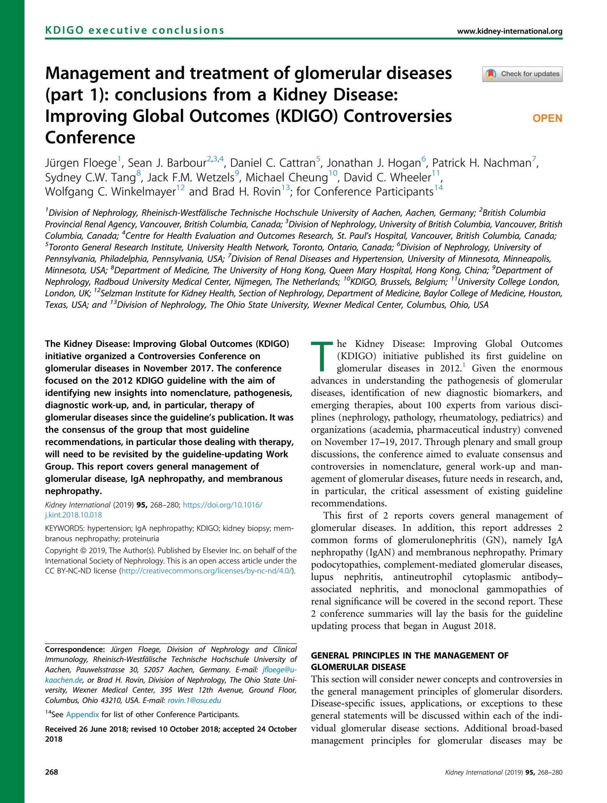
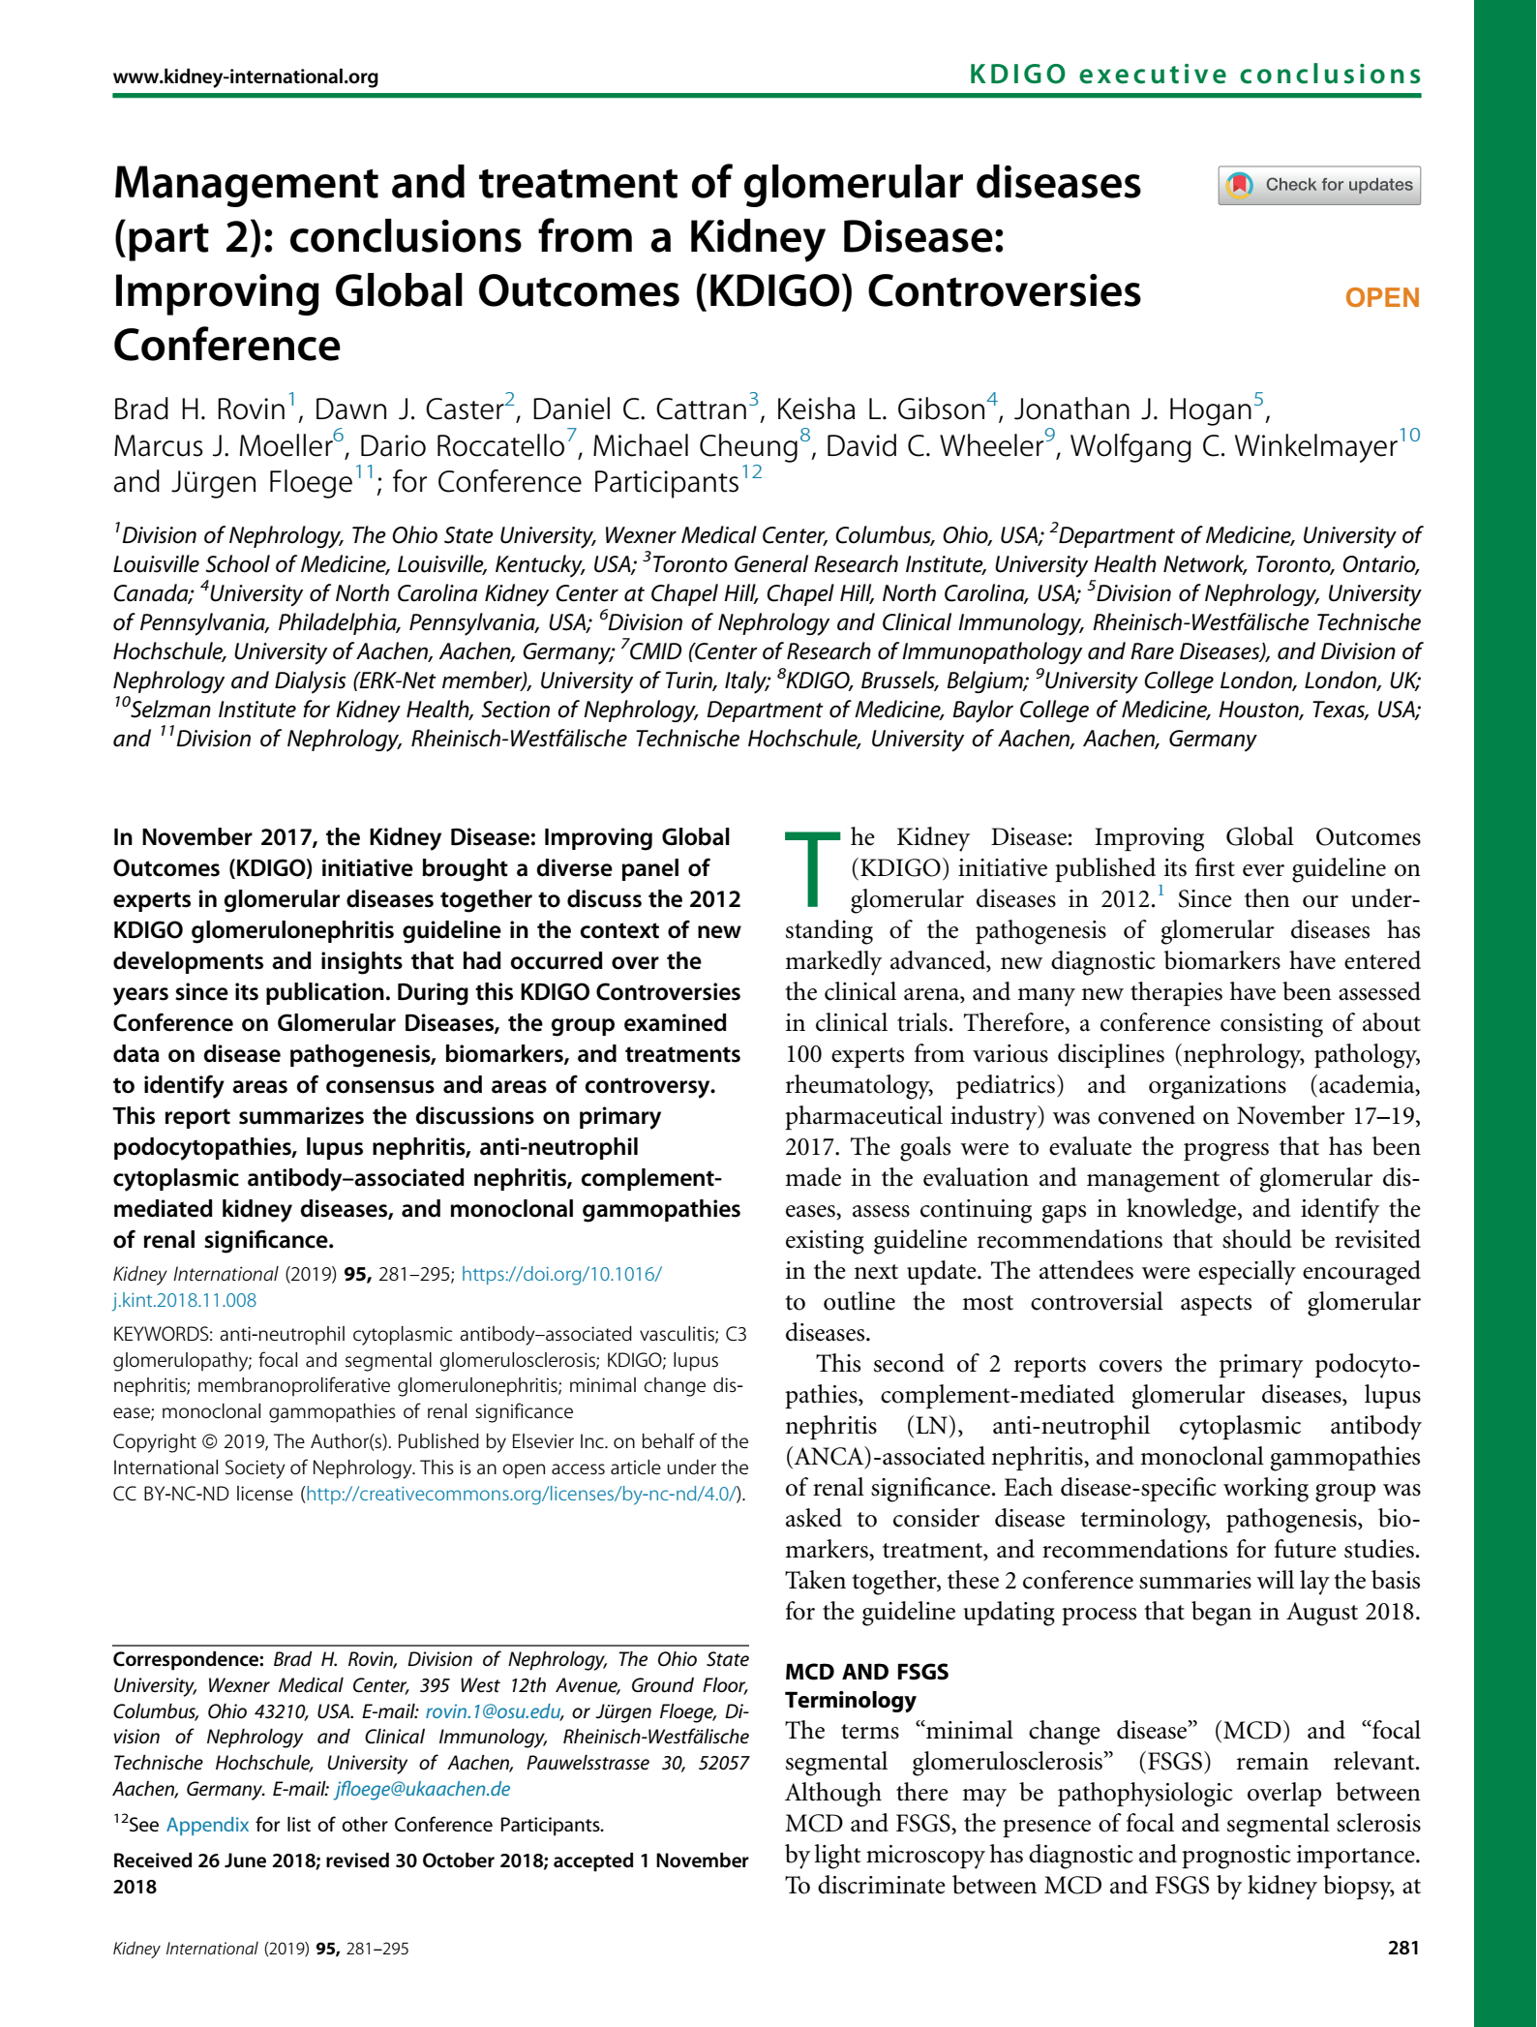
KDIGO Controversies Conference on Glomerular Diseases
November 2017 (Singapore)
Topics:
  General principles, Nephrotic syndrome, Membranoproliferative GN (MPGN), C3 glomerulonephritis (C3GN)
  IgA Nephropathy
  Membranous GN
  Minimal change disease (MCD) and Focal Segmental Glomerulosclerosis (FSGS)
  Lupus nephritis (LN) and ANCA vasculitis
Report published in Kidney International (2019)
Led to initiation of the update of the KDIGO guideline

Slide 7
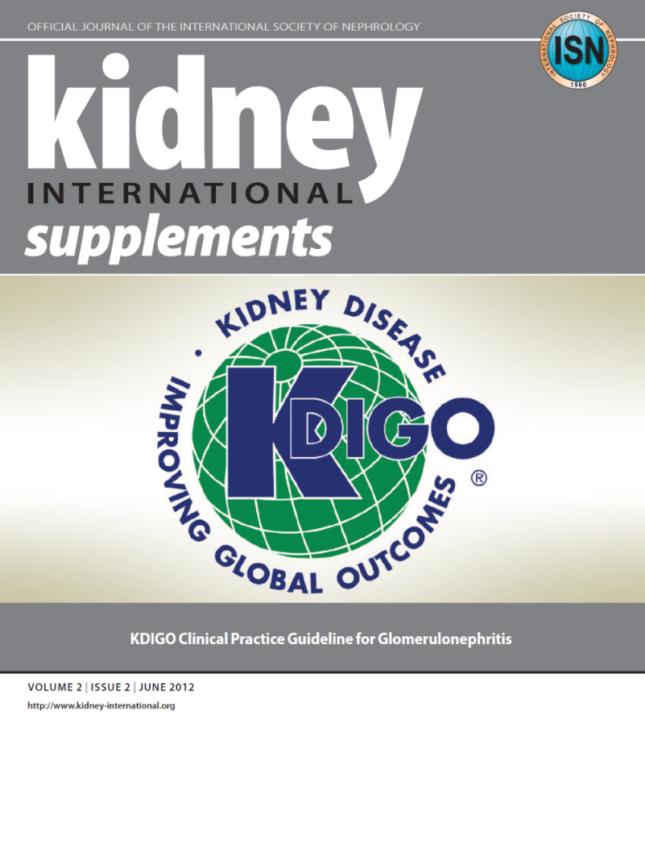
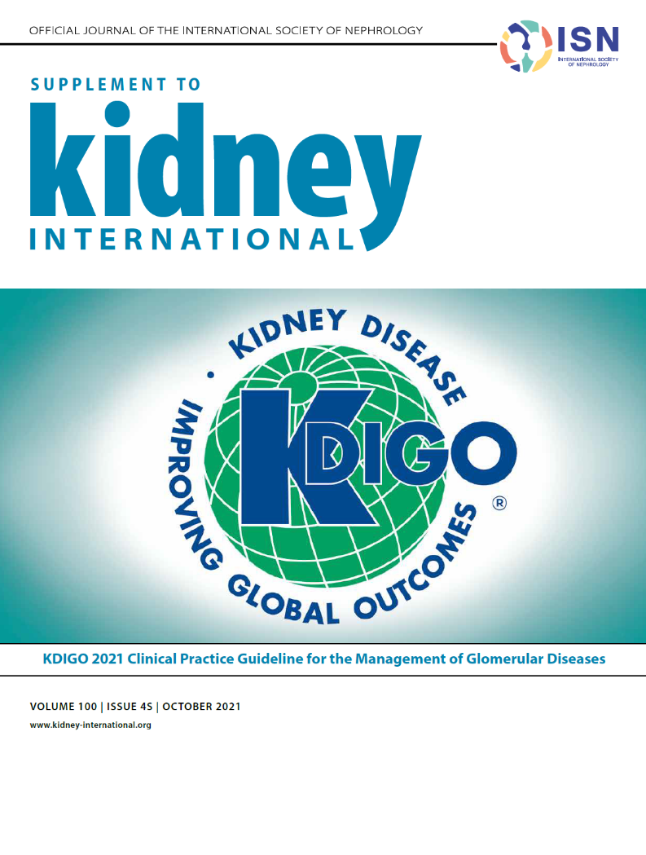

KDIGO 2012 Guideline: The Beginning
KDIGO 2021 Guideline: The Update
KDIGO 2024 Guideline: The LN Update

Slide 8
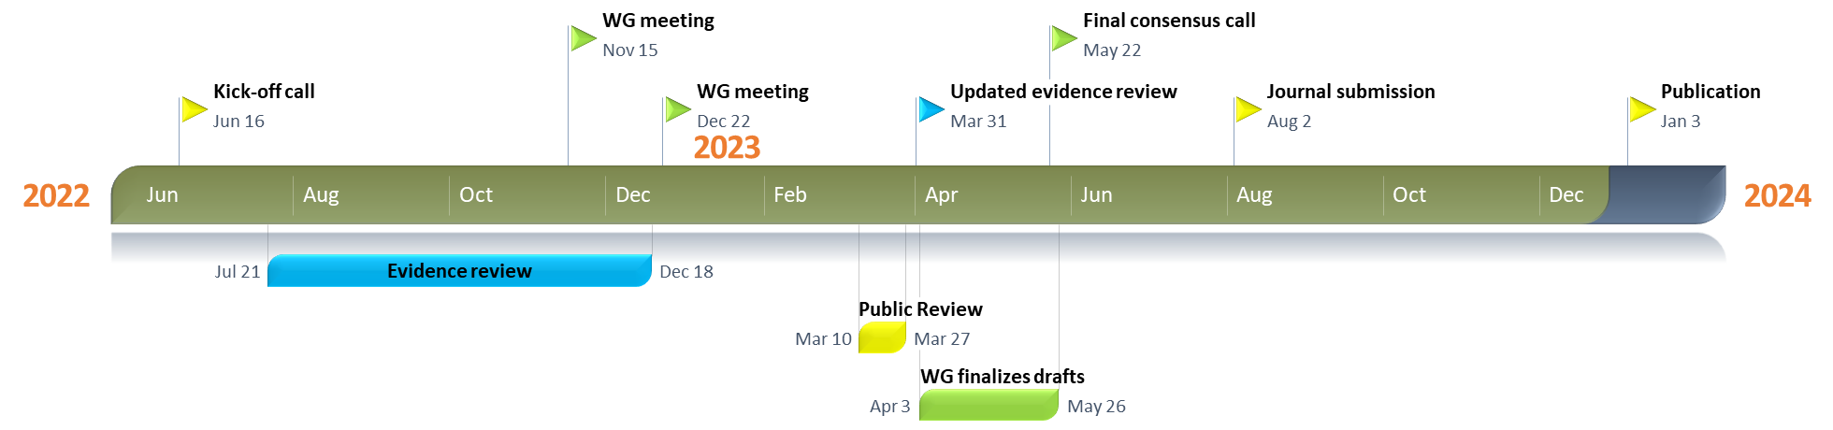
Timeline of Guideline for Management of LN

Slide 9
Guideline Goals
Generate a useful resource for clinicians and patients
  Address relevant questions with actionable recommendations
  Take on controversial topics when sufficient evidence
  Communicate clearly
Target audience: Primarily clinicians treating patients with lupus nephritis
Stay true to evidence, where available
Propose research questions
Be mindful of implications for policy and payment

Slide 10
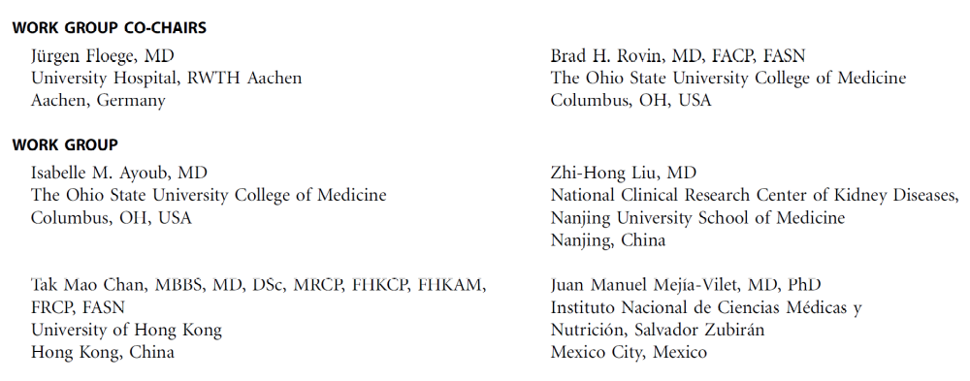






KDIGO Lupus Nephritis Guideline Work Group
Notes:
The KDIGO Guideline Work Group is:
Prior GL WG Members
Deep experience
Evidence Review Team

Slide 11
What Is New Since the 2021 KDIGO Guideline
Belimumab and voclosporin have been approved by the United States Food and Drug Administration (FDA) and the European Medicines Agency (EMA) as add-on immunosuppressives to standard-of-care (SOC) for the treatment of lupus nephritis (LN).
Identifying the profile of an LN patient who needs more than SOC, and whether belimumab or voclosporin would be best for that individual remains an issue.
These additions to the treatment of LN energized patients and providers in the lupus community with the promise of superior response rates compared to SOC alone; however, the availability of new therapies raised important questions of how best to apply them.

Slide 12
Guideline Development Process

Slide 13
Evidence Review
ERT – 2021 Guideline: Cochrane Kidney Transplant; 2024 Update: Brown University
  Existing Population, Intervention, Comparator, Outcome, Study design (PICOS) questions
  Clinical and important outcomes identified
    The critical and important outcomes were voted on by the Work Group using an adapted Delphi process (1–9 Likert scale). Critical outcomes were rated 7–9, and important outcomes were rated 4–6 on the 9-point scale.
Critical outcomes | Important outcomes
All-cause mortality Kidney failure ≥50% loss of GFR Infection Glucocorticoid-related adverse events Malignancy | Complete remission or relapse Annual GFR loss (minimum 3 years follow-up)
GFR, glomerular filtration rate

Slide 14
PICOS Questions
Key question | Population | Intervention | Comparator | Outcome | Study design
Lupus nephritis
In patients with biopsy-proven LN, compared to no treatment, placebo, or standard of care, does antimalarial therapy improve clinical efficacy outcomes and reduce adverse effects? | Patients with biopsy-proven LN | Antimalarial therapy | Placebo, no treatment, or standard of care | Critical and important outcomes | RCTs
In patients with nonproliferative LN, what immunosuppressive agents, compared to no treatment, placebo, or other immunosuppressive therapies, improve efficacy outcomes, and reduce adverse effects? | Patients with biopsy-proven nonproliferative (Class I, II, IV, or V) LN | Immunosuppressive therapy | No treatment, placebo, or other immunosuppressive therapies
In patients with biopsy-proven proliferative LN, what immunosuppressive agents, compared to no treatment, placebo, or other immunosuppressive therapies, improve clinical efficacy outcomes, and reduce adverse effects? | Patients with biopsy-proven proliferative (Class III, IV, III/V, or IV/V) LN

Slide 15
Literature Search
October 2018 Supplemented with additional studies until September 2019; Updated in June 2020, July 2022, and April 2023

Slide 16
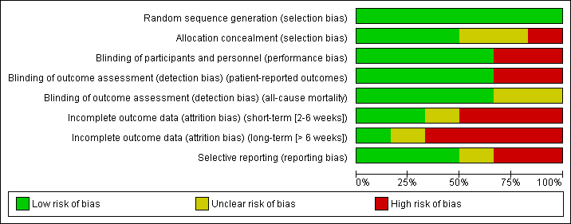
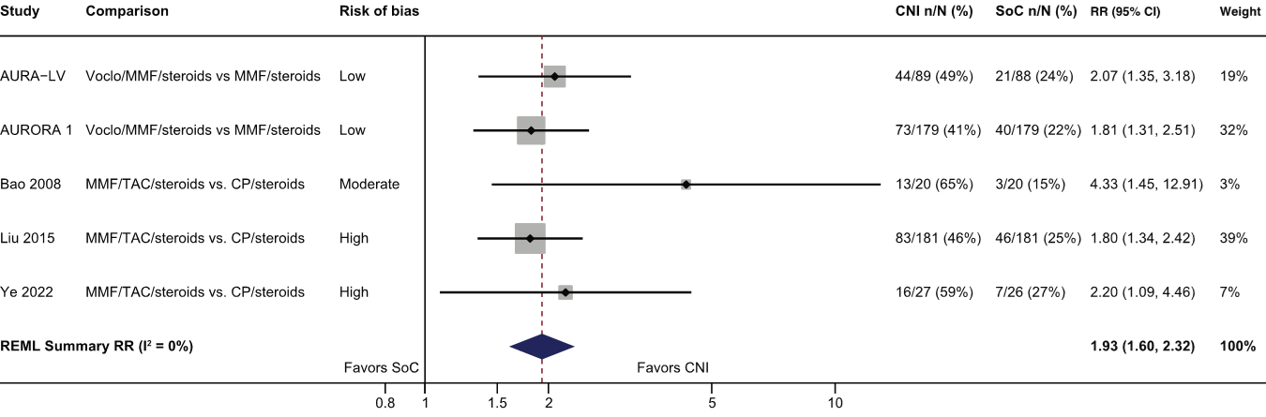
Evidence Synthesis
Risk of bias graph example
Standard Cochrane methods – Two independent reviewers
  Data abstraction
  Critical appraisal – using validated tools
Data-analysis
  Random effects meta-analysis and generic inverse variance
    Relative risk for dichotomous outcomes
    Mean difference for continuous outcomes
  Heterogeneity assessed using the I² statistic
Forest plot example

Slide 17

Grading Recommendations
  GRADE methodology
  The certainty of the evidence – Level A, B, C, D
    Study limitations
    Inconsistency
    Indirectness
    Imprecision
    Publication bias
  Strength of the recommendation – Level 1, “We recommend” or Level 2, “We suggest”
    Key Information
      Balance of benefits and harms
      Certainty of the evidence
      Patient values and preferences
      Resources and costs
      Considerations for implementation
    Rationale

Slide 18
Guideline Format
KDIGO guidelines continue to use the Grading of Recommendations Assessment, Development, Evaluation (GRADE) methodology, but we have strengthened the link between the recommendation statements and underlying evidence base.
Guidelines now include a mix of recommendations and “practice points” to help clinicians better evaluate and implement the guidance from the expert Work Group.
All graded recommendations follow a consistent and structured format and are similar in style to previous KDIGO recommendations.
Practice points may be formatted as text, a table, a figure, or an algorithm to make them easier to use in clinical practice.

Slide 19
Guideline Statements and Rationale

Slide 20
Lupus Nephritis - Diagnosis
Practice Point 10.1.1: Approach to the diagnosis of kidney involvement in systemic lupus erythematosus (SLE).
Notes:
Please read this slide and present the algorithm

Slide 21
Lupus Nephritis - Diagnosis
Notes:
Activity and chronicity items included in LN kidney biopsy report.
Clinicians should pay attention to the detailed description of both active and chronic histopathologic features affecting different elements of the kidney parenchyma, especially regarding potentially reversible active lesions versus chronic damage not reversible by immunosuppressive medications.
These histopathological features are not only important for diagnosis, but for treatment as well.

Slide 22
Lupus Nephritis – Treatment: General Management
Recommendation 10.2.1.1: We recommend that patients with SLE, including those with lupus nephritis (LN), be treated with hydroxychloroquine or an equivalent antimalarial unless contraindicated (1C).
Notes:
It is recommended that antimalarials be given to patients with systemic lupus erythematosus (SLE) if there are no contraindications.
This recommendation places a relatively higher value on the various benefits associated with hydroxychloroquine use reported in observational studies (including lower rates of disease flares, progressive kidney damage, and vascular complications) and on the generally favorable safety profile of hydroxychloroquine treatment. It places a relatively lower value on the lack of large scale prospective RCT data.

Slide 23
Lupus Nephritis – Treatment: General Management
Practice Point 10.2.1.1: Adjunctive therapies to manage LN and attenuate complications of the disease or its treatments should be considered for all patients, as outlined in the figure.
Notes:
Given the systemic nature of SLE and the potential adverse effects of therapies used to treat LN, the Work Group noted that a holistic approach to the management of LN be considered.
Several relevant suggestions to improve the health and well-being of LN patients are described in this slide.

Slide 24
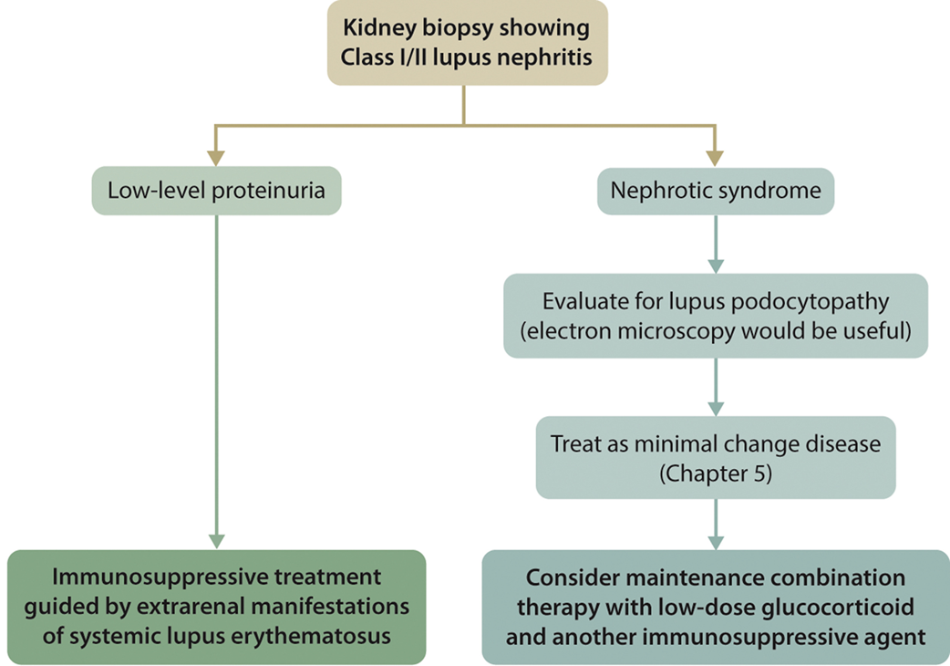
Lupus Nephritis – Treatment: Class I or Class II LN
Practice Point 10.2.2.1: Approach to immunosuppressive treatment for patients with Class I or Class II LN
Note: Chapter 5 refers to Chapter 5 of the KDIGO Guideline on Glomerular Diseases.
Notes:
Please read the slide and present the algorithm

Slide 25
Lupus Nephritis – Treatment: Class III or Class IV LN: Initial therapy
Recommendation 10.2.3.1.1: We recommend that patients with active Class III or IV LN, with or without a membranous component, be treated
initially with glucocorticoids plus any one of the following:
mycophenolic acid analogs (MPAAs) (1B); or
low-dose intravenous cyclophosphamide (1B); or
iii. belimumab and either MPAA or low-dose intravenous cyclophosphamide (1B); or
iv. MPAA and a calcineurin inhibitor (CNI) when kidney function is not severely impaired (i.e., estimated glomerular filtration rate [eGFR] ≤45 ml/min per 1.73 m²) (1B).
Notes:
This recommendation places a high value on results from clinical trials demonstrating clinical efficacy with combined immunosuppressive
regimens that include glucocorticoids and either lowdose intravenous cyclophosphamide or MPAA (dual immunosuppressive
therapy), as well as triple immunosuppressive regimens that include belimumab or voclosporin (or tacrolimus). added to the above dual immunosuppression. In the case of CNI, the improved clinical response was driven by greater reduction of proteinuria compared with placebo, and in the case of belimumab,
a reduced incidence rate of adverse kidney outcomes was also observed in post hoc analysis. A summary of options of initial therapy that can be recommended for active proliferative LN is shown in Figure 5. The Work Group acknowledges the considerable variation of characteristics among patients. Readers are advised to refer to the practice points for discussions on the preferred choice of therapy according to patient characteristics.
Also, regarding the choice of therapy and the dose of specific medications, the Work Group emphasizes the importance of
preventing potential adverse effects that could result from highdose glucocorticoid, high-dose cyclophosphamide, and CNI
nephrotoxicity. In this regard, patients with CKD G3b–G5 were often excluded from the respective clinical trials.

Slide 26
Lupus Nephritis – Treatment: Class III or Class IV LN: Initial therapy

Slide 27
Lupus Nephritis – Treatment: Class III or Class IV LN: Initial therapy
Practice Point 10.2.3.1.1: A regimen of reduced-dose glucocorticoids following a short course of methylprednisolone pulses may be considered during the initial treatment
of active LN when both the kidney and extrarenal disease manifestations show satisfactory improvement.
Notes:
Please read slide and present table

Slide 28
Lupus Nephritis – Treatment: Class III or Class IV LN: Initial therapy
Practice Point 10.2.3.1.2: Intravenous cyclophosphamide can be used as the initial therapy for active Class III and Class IV LN in patients who may have difficulty adhering to
an oral regimen.
Notes:
Please read slide and present table

Slide 29
Lupus Nephritis – Treatment: Class III or Class IV LN: Initial therapy
Practice Point 10.2.3.1.3: An MPAA-based regimen is the preferred initial therapy of proliferative LN for patients at high risk of infertility, such as patients who have a
moderate-to-high prior cyclophosphamide exposure.
Practice Point 10.2.3.1.4: Initial therapy with an immunosuppressive regimen that includes a CNI (voclosporin, tacrolimus, or cyclosporine) may be preferred in patients with relatively preserved kidney function and nephrotic-range proteinuria likely due to extensive podocyte injury, as well as patients who cannot tolerate standard-dose MPAA or are unfit for or will not use cyclophosphamide-based regimens.
Notes:
Please read slide

Slide 30
Lupus Nephritis – Treatment: Class III or Class IV LN: Initial therapy
Practice Point 10.2.3.1.5: triple immunosuppressive regimen of belimumab with glucocorticoids and either MPAA or reduced-dose cyclophosphamide may be preferred in patients with repeated kidney flares or at high-risk for progression to kidney failure due to severe chronic kidney disease.
Practice Point 10.2.3.1.6: Other therapies, such as azathioprine or leflunomide combined with glucocorticoids, may be considered in lieu of the recommended initial drugs for
proliferative LN in situations of patient intolerance, lack of availability, and/or excessive cost of standard drugs, but these alternatives may be associated with inferior efficacy,
including increased rate of disease flares and/or increased incidence of drug toxicities.
Practice Point 10.2.3.1.7: Newer biologic and non-biologic therapies are under development and may offer future options for the treatment of active LN. Rituximab may be considered for patients with persistent disease activity or inadequate response to initial standard-of-care therapy.
Notes:
Please read slide

Slide 31
Lupus Nephritis – Treatment: Class III or Class IV LN: Maintenance therapy
Recommendation 10.2.3.2.1: We recommend that after completion of initial therapy, patients should be placed on MPAA for maintenance (1B).
Notes:
This recommendation places a high value on the data demonstrating
that long-term, reduced-dose MPAA decrease the risk of
LN relapse compared to azathioprine or no treatment and that
MPAA have effectiveness comparable to that of cyclophosphamide
but with a lower risk of adverse events. The recommendation
places a lower value on the risk of adverse events
associated with long-term MPAA treatment as compared to no treatment

Slide 32
Lupus Nephritis – Treatment: Class III or Class IV LN: Maintenance therapy
Practice Point 10.2.3.2.1: Azathioprine is an alternative to MPAA after completion of initial therapy in patients who do not tolerate MPAA, who do not have access to MPAA, or
who are considering pregnancy.
Practice Point 10.2.3.2.2: Glucocorticoids should be tapered to the lowest possible dose during maintenance, except when glucocorticoids are required for extrarenal lupus
manifestations; discontinuation of glucocorticoids can be considered after patients have maintained a complete clinical renal response for ≥12 months.
Notes:
Please read slide

Slide 33
Lupus Nephritis – Treatment: Class III or Class IV LN: Maintenance therapy
Practice Point 10.2.3.2.3: The dose of mycophenolate mofetil (MMF) in the early maintenance phase is approximately 750–1000 mg twice daily, and for mycophenolic
acid (MPA), approximately 540–720 mg twice daily.
Practice Point 10.2.3.2.4: The total duration of initial immunosuppression plus combination maintenance immunosuppression for proliferative LN should be ≥36 months.

Slide 34
Lupus Nephritis – Treatment: Class III or Class IV LN: Maintenance therapy
Practice Point 10.2.3.2.5: Patients treated with triple immunosuppressive regimens that include belimumab or a CNI in addition to standard immunosuppressive therapy can continue with a triple immunosuppressive regimen as maintenance therapy.
Practice Point 10.2.3.2.6: If MPAA and azathioprine cannot be used for maintenance, CNIs or mizoribine or leflunomide can be considered.
Notes:
It is reasonable to consider a CNI for maintenance therapy in any patients who cannot take MPAA or azathioprine. Tacrolimus can also be used safely during pregnancy. Voclosporin is not recommended for pregnancy due to ethanol in the capsules and the need to give many pills.
The experience with mizoribine as maintenance therapy in LN is largely limited to Japanese patients, but the findings from the trial demonstrates that mizoribine was safe and effective.
Despite not knowing the optimal duration of maintenance immunosuppression for proliferative LN, most patients will require $≥$3 years of therapy. Clinical response findings do not correlate completely with ongoing kidney inflammation. A repeat kidney biopsy could be considered to inform the decision to continue or withdraw maintenance immunosuppression.

Slide 35
Lupus Nephritis – Treatment: Class V LN
Practice Point 10.2.4.1: A suggested approach to the management of patients with pure Class V LN is described in the figure.
Notes:
Of the histologic types of LN, the membranous form (Class V) has received the least attention in terms of specific clinical trials.
However, several of the newer trials evaluating novel treatments included patients with pure Class V LN.
Subgroup analyses will help in understanding if these new agents have a role in Class V management.
Until then, the suggested approach to pure Class V LN has not materially changed since the last glomerular disease guideline

Slide 36
Lupus Nephritis – Response and Relapse Considerations: Assessing Treatment Response
Practice Point 10.2.5.1.1: Definitions of response to therapy in LN used in clinical trials are provided in the figure.
Notes:
One of the issues facing the evaluation of novel LN therapies is defining a meaningful response to treatment.
These definitions are commonly used with “baseline” kidney function referring to the level before disease flare, which is not known in patients with no previous medical record.
Another caveat is the lack of consensus on the appropriate time when response should be assessed.
For logistic and economic reasons, large clinical trials often evaluate response at 6–12 months, but improvement of proteinuria and eGFR is continuous over time, and the rate of improvement varies considerably among patients. Also, there are marked differences in baseline kidney abnormalities at disease presentation.
Therefore, the time to reach prespecified proteinuria and eGFR cutoffs, either absolute or relative to baseline, varies considerably among patients.
Outside of a formal clinical trial setting, the Work Group suggests that if patients are improving, allowing 18–24 months to achieve a complete response is reasonable in patients who show continuous improvement.
A potential tool to predict kidney outcomes was derived from a post hoc analysis of the large ALMS trial.
This analysis suggested favorable kidney outcomes are predicted by normalization of complement levels and ≥25% reduction of proteinuria after 8 weeks of treatment.

Slide 37
Lupus Nephritis – Response and Relapse Considerations: Management of Unsatisfactory Response to Treatment
Practice Point 10.2.5.2.1: An algorithmic approach to patients whose response to therapy is deemed unsatisfactory is provided in the figure.
Notes:
LN may be considered refractory if a patient does not respond to either of the currently standard induction therapies (CYC or MMF) used sequentially.
A suggested algorithm for refractory disease is illustrated in this slide.
Medication adherence should always be evaluated.
Repeat kidney biopsy to distinguish active LN from scarring and/or identify new lesions could be considered.
For persistently active LN, if MMF was used for induction, consider switching to CYC or vice versa.
After this, other regimens could be tried.

Slide 38
Lupus Nephritis – Response and Relapse Considerations: Treatment of Relapse
Practice Point 10.2.5.3.1: After a complete or partial remission has been achieved, LN relapse should be treated with the same initial therapy used to achieve the original response, or an alternative recommended therapy.
Notes:
There are no data that focus on the treatment of LN flares alone. However, it is generally agreed that there is no major difference between management of an LN flare and that of de novo active LN, and initial therapies are the same as outlined above.
Although these considerations form the basis for Practice Point 10.2.5.3.1, there are several caveats in choosing an approach:
1. If patients had been treated with cyclophosphamide in the past, it is important to calculate lifetime exposure. Ovarian failure has been associated with age (and oocyte reserve) and cumulative dose, with sustained amenorrhea occurring in up to 50% of patients aged >32 years with a cumulative exposure of 8 g/m². The chance of future malignancy increases after a total exposure of 36 g, so if a patient is approaching this level, cyclophosphamide is better avoided.
2. If patients relapse during pregnancy, treatment choices are more limited. These are discussed in more detail in the guideline.
3. Patient preference and/or tolerance of the initial regimen should be considered. Also, patient adherence should be considered in the choice of treatment.
4. Disease activity should be verified, as proteinuria may be secondary to CKD. The last point is critical but complex.

Slide 39
Lupus Nephritis – Special Situations: LN and Thrombotic Microangiopathy
Practice Point 10.3.1.1: Patients with LN and thrombotic microangiopathy (TMA) should be managed according to the underlying etiology of TMA, as shown in the figure.
Notes:
The key to a good outcome for TMA in LN is rapid diagnosis and prompt treatment.
When appropriate expertise is available, it is preferable that patients with LN and TMA be comanaged with an experienced hematologist.
However, some of the serologic and genetic testing needed for a specific diagnosis, such as ADAMTS13 activity or the presence of anti-ADAMTS13 antibodies in the case of TTP, antiphospholipid antibodies, and complement studies may not be available, and even when they are available, they often take considerable time to complete.
If TTP is suspected, one may consider using the PLASMIC score, and if the score defines an intermediate-to-high risk of TTP, adults should be started on plasma exchange and glucocorticoids while waiting for the investigation results.
In children, TTP is less common, and plasma exchange has been associated with considerable morbidity, so it is acceptable to defer plasma exchange for 24–48 hours until the ADAMTS13 result is available to confirm that the procedure is indicated.

Slide 40
Lupus Nephritis – Special Situations: Pregnancy
Practice Point 10.3.2.1: Patients with active LN should be counseled to avoid pregnancy while the disease is active or when treatment with potentially teratogenic drugs is ongoing, and for ≥6 months after LN becomes inactive.
Practice Point 10.3.2.2: To reduce the risk of pregnancy complications, hydroxychloroquine should be continued during pregnancy, and low-dose aspirin should be started before 16 weeks of gestation.
Practice Point 10.3.2.3: Glucocorticoids, hydroxychloroquine, azathioprine, tacrolimus, and cyclosporine are considered safe immunosuppressive treatments during pregnancy.
Notes:
Please read slide

Slide 41
Lupus Nephritis – Special Situations: Treatment of LN in Children
Practice Point 10.3.3.1: Treat pediatric patients with LN using immunosuppression regimens similar to those used in adults, but consider issues relevant to this population,
such as dose adjustment, growth, fertility, and psychosocial factors, when devising the therapy plan.
Notes:
Approximately 20% of SLE is diagnosed before the age of 18 years, and genetic components are more common in childhood onset SLE.
There is suggestive evidence that disease is often more severe in the pediatric population.
In adolescent patients with SLE and isolated proteinuria, orthostatic or postural proteinuria should be excluded, as this phenomenon has been observed frequently in this population.

Slide 42
Lupus Nephritis – Special Situations: Management of LN in Kidney Failure
Practice Point 10.3.4.1: Patients with LN who develop kidney failure may be treated with hemodialysis, peritoneal dialysis, or kidney transplantation; and kidney transplantation
is preferred to long-term dialysis.
Notes:
There are no data to favor one form of dialysis over another in kidney failure due to LN.
Patients with lupus receiving hemodialysis display similar 3-year survival rates and mortality due to CV or infectious complications to those of patients receiving peritoneal dialysis.
Therefore, kidney replacement therapy should be individualized, taking into account patient characteristics and preferences.
Although lupus activity tends to decrease after kidney failure develops, patients can still flare, so periodic monitoring is required. LN can recur in kidney allografts, but the risk is low, and flares do not generally result in allograft loss.

Slide 43
Research Recommendations
Identify and validate biomarkers of kidney histology that can be used to follow the tissue response to treatment in real-time to help in managing immunosuppression.
Identify and validate biomarkers of impending LN flare that can be used to decide if preemptive immunosuppressive therapy is indicated.
Classify LN on the basis of molecular pathogenesis and histology as opposed to histology alone. This classification ideally could be used in conjunction with novel, targeted therapies for LN to select the most appropriate treatment, including biologic medications targeting specific pathogenic pathways.
Establish renal response criteria that reflect resolution of disease activity at the tissue level and are also predictive of long-term kidney survival and patient survival without need of kidney replacement therapy.
Establish criteria for duration of maintenance immunosuppression and the safe withdrawal of therapy.

Slide 44
Research Recommendations
RCTs are needed to test the following questions:
What is the optimal therapy for patients with severe Class III/IV LN (i.e., patients presenting with severe acute kidney disease and/or markedly abnormal SCr level or eGFR) who have been excluded from the majority of clinical trials to date?
What is the optimal therapy for pure Class V LN?
Do antimalarials improve the responsiveness of LN to treatment and/or help maintain disease quiescence and prevent flares?
Is there a role for complement inhibition in the management of LN?
What are the optimal or prioritized therapies for childhood LN?
What are the efficacy and safety profiles of CNIs, including the optimal drug exposure when used as initial or maintenance treatment of LN? What are the long-term implications of such treatment?
What are the optimal glucocorticoid-reduction protocols for LN management?
What is the effect on the incidence of disease relapses from B-cell–directed therapies initiated during the maintenance phase?

Slide 45
Acknowledgments

Slide 46
Acknowledgments
KDIGO gratefully acknowledges our Knowledge Translation Lead, Edgar V. Lerma, MD, FACP, FASN, FAHA, FASH, FNLA, FNKF, FASDIN, FCRS, FPSN (Hon) for his time and expertise in creating the speaker's notes in this Speaker's Guide.
KDIGO also gratefully acknowledges Guideline Co-Chairs, Brad Rovin, MD (United States), and Jürgen Floege, MD (Germany), and the Guideline Work Group for their dedication, time, and insights in authoring the Glomerular Diseases Guideline.

Slide 47
Notes
Use the subsequent slides to tailor individual presentations
Notes:
Sample slide

Slide 48
Questions?
Notes:
Optional slide to close with questions

Slide 49
Sample Header
Bullet 1
Bullet 2
  Sub-bullet

Slide 50
Notes:
Sample slide

